Slide 1


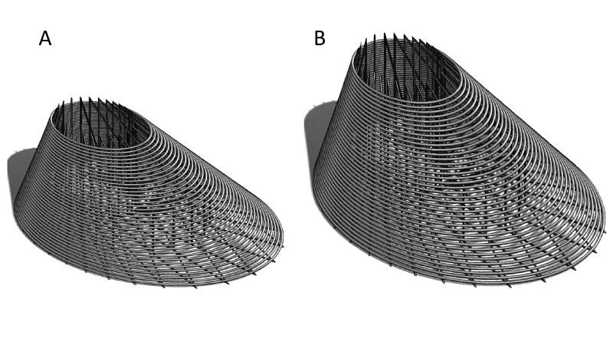
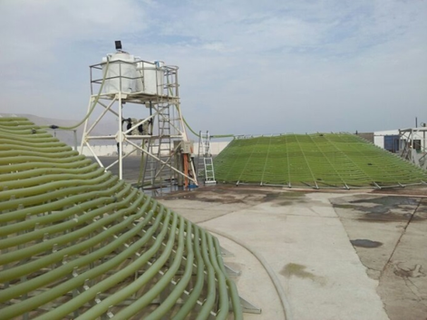
New design of a photobioreactor for the massive production of microalgae, named Fibonacci-type.
Juan Pablo Díaz ^{1,2}, Cristian Inostroza², F. Gabriel Acién²
¹ Universidad Arturo Prat, Avda. Arturo Prat 21-20, Iquique, Chile
² Chemical Engineering Department, University of Almeria, Ctra. Sacramento, s/n, E04120 Almería (Spain); jpdiaz@unap.cl
Introduction
Materials and Methods
The design of a device is shown called Fibonacci-type tubular photobioreactor for the super-intensive production of microalgae biomass, preferably Spirulina, Dunaliella and Chlorella, which can be used for other types of non-colony forming microalgae. The challenge of photobioreactors is to make efficient use of light and in this case the new design is based on forms of marine organisms. These geometric shapes of design, served as a basis for developing the spiral photobioreactor generating a large photoactive panel, corresponding to one of the most relevant aspects of the design, where at all times the suspension of microalgae captures and uses the energy of sunlight for its photosynthetic processes, improving the production of algal biomass in quality and productive efficiency.
Results
Small and medium scale Fibonacci-type photobioreactor. A) 330 L reactor, b) 1.250 L
Pilot-scale photobioreactors (2500 l)
Conclusions
This Fibonacci type photobioreactor can capture up to 1.6 times more solar radiation than the horizontal surface¹, achieve higher specific growth rates of the microalgae and reach higher concentrations of biomass, according to the availability of light, while providing optimal conditions, without the need for cooling, also allows maximum efficiency in the use of CO₂ and in avoiding excessive accumulation of dissolved oxygen ².
Data from batch culture of Spirulina platensis performed in the Fibonacci’s type photobioreactor.
Modelling of growth rate and photosynthetic performance of Spirulina platensis cultures performed in the Fibonacci’s type photobioreactor.
References
¹ J.P. Díaz, C. Inostroza, y F. G. Acién Fernández, “Fibonacci-type tubular photobioreactor for the production of microalgae”, Process Biochemistry, vol. 86, pp. 1–8, nov. 2019.
² J.P. Díaz, C. Inostroza, y F. G. Acién Fernández, “Fibonacci-type tubular photobioreactor for the production of microalgae”, Process Biochemistry, vol. 86, pp. 1–8, nov. 2019.
Acknowledgements. We wish to thank the members of the FONDEF project, D04I1258 of Chile and funding Information This research was supported by EU H2020 SABANA project from the European Union’s Horizon 2020 Research and Innovation program under the Grant Agreement No. 727874.

