Slide 1

LCSD: An interactive tool for the analysis and design of linear systems
15 years of experience in the development of interactive tools for control education
Sebastián Dormido, José Manuel Díaz
Dpto. Informática y Automática, UNED.
{sdormido, josema}@dia.uned.es

Slide 2
Contenido
Introduction
Some of our interactive tools
The “loop-shaping” concept
The interactive tool LSAD (ACE 2003)
From LSAD to LCSD: A new family of interactive tools
Examples with LCSD
Conclusions
Notes:
The outline of the presentation is as follows:
First, the introduction will illustrate the motivation and the objectives of this thesis
Secondly, the proposed anticipative control design in internet-like networks is presented
Distributed event-based control for interconnected linear systems and several extensions is explored afterwards
Then, the simulation tools and application examples of the distributed event-based control is given
And finally, the presentation ends with the conclusions and future works, as well as the set of publications related to this thesis
2

Slide 3
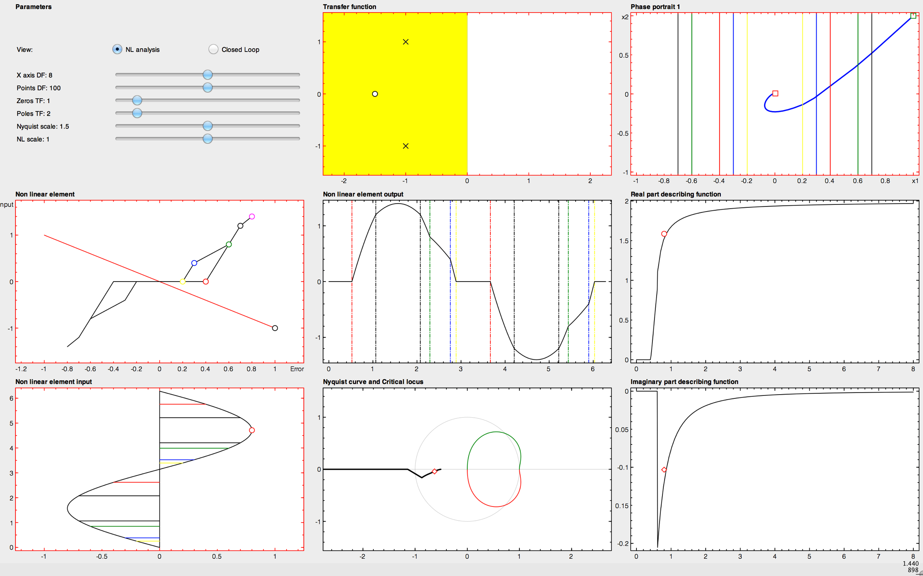
1. Introduction
Dormido, S.; Gordillo, F.; Dormido Canto, S.; Aracil, J. “An interactive tool for introductory nonlinear control systems education”, IFAC World Congress b’02, Barcelona, 2002

Slide 4
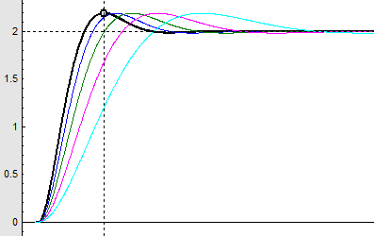
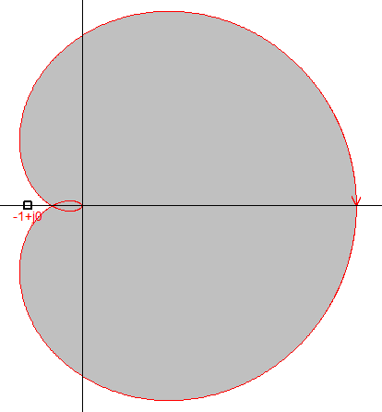
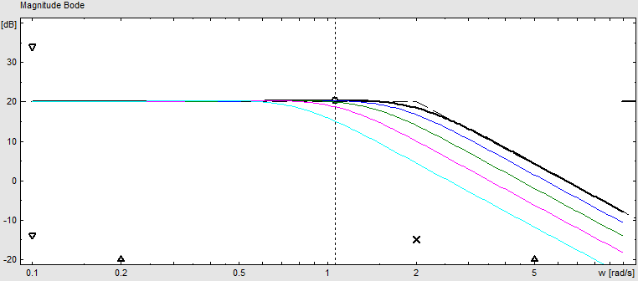
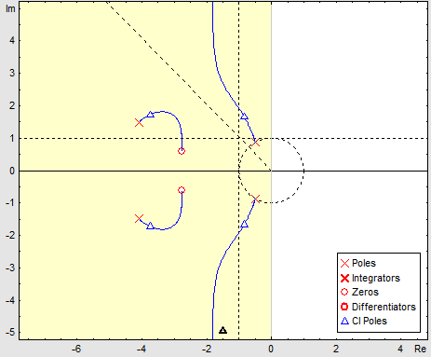
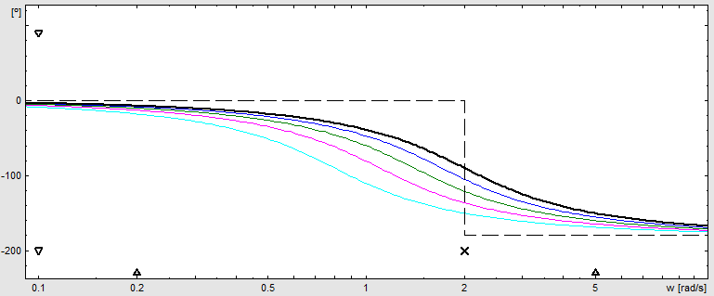
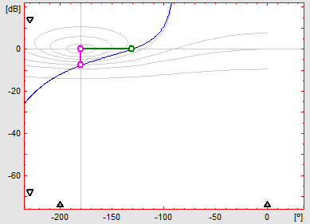
1. Introduction
Visualization and interactivity play an important role in automatic control education .
The ideas, concepts and methods in control engineering have a great richness of visual content.
S. Dormido. “Control learning: Present and future”, Annual Reviews in Control, vol. 28, pp. 115-136, 2004
Notes:
4

Slide 5
3. Interactity in control education
1. Introduction: Characteristic of the interactive approach
The modification of the parameters produces immediately an update of the graphical scopes.
The design process is completely dynamic.
Students notice the level of the change of the performance in relation with the elements that they are handling.
This interactivity allows to identify more easily the trade off that it is possible to reach.

Slide 6

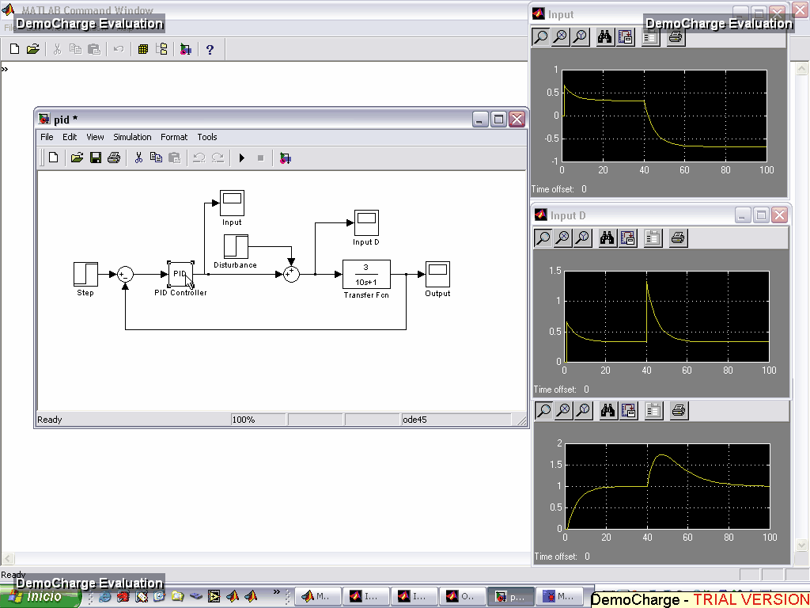
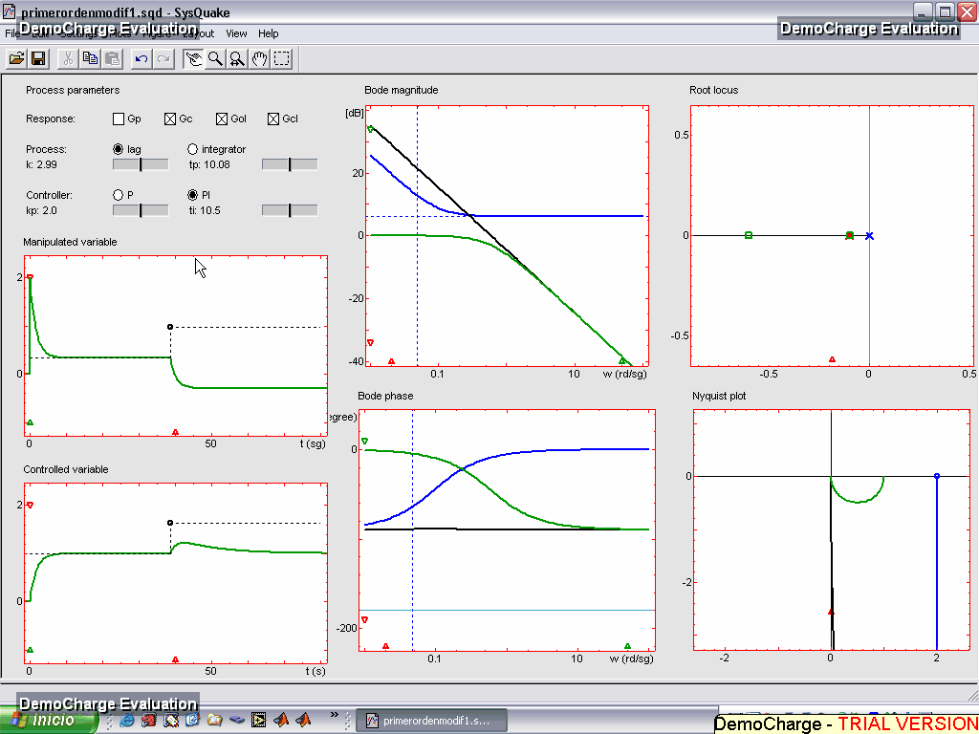
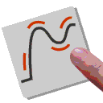
3. Interactivity in control education
1. Introduction: Characteristic of the interactive approach
http://www.um.es/fem/Ejs/
Easy Java Simulations
Non-Interactive paradigm
Interactive paradigm
Sysquake
http://www.calerga.com
S. Dormido. “Control learning: Present and future”, Annual Reviews in Control, vol. 28, pp. 115-136, 2004
Notes:
Information handling: remote access, bigger availability, and above all, Interactivity

Slide 7
3. Interactive Learning Modules Project
2. Some of our interactive tools
The Interactive Learning Modules project is a set of interactive tools developed as support to the well-know book Advanced PID Control of Profs Åström and Hagglünd. The objective of the set of interactive modules that comprise the ILM Project is to support the teaching and learning of basic automatic control concepts.
Modelling
PID Basics
PID Windup
PID Loopshaping
PID Design
Dead-time compensators
Interaction
Feedforward design
Notes:
Information handling: remote access, bigger availability, and above all, Interactivity

Slide 8
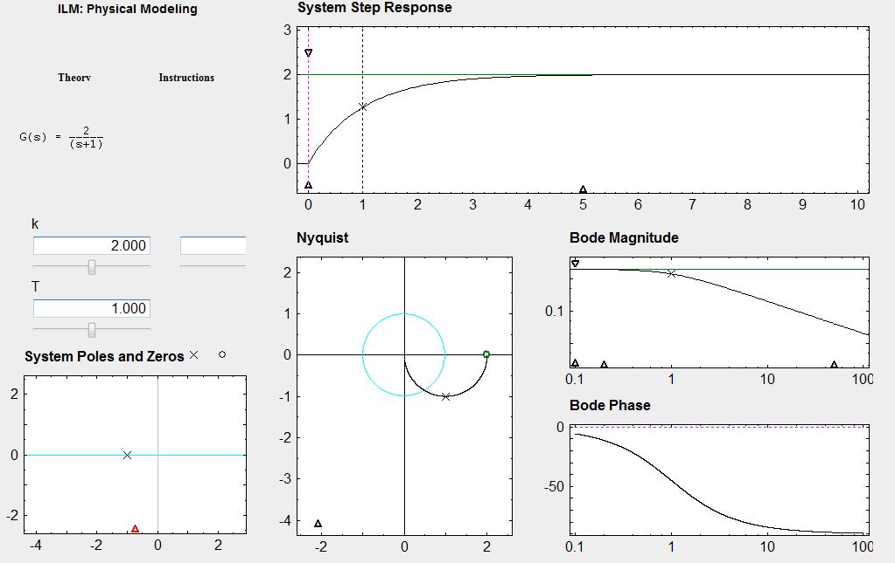
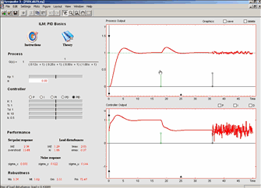
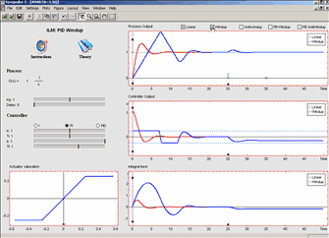
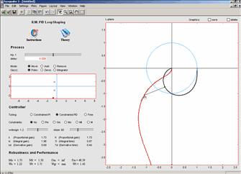
3. Interactive Learning Modules Project
2. The Interactive Learning Modules
Modelling
PID Basics
PID Windup
PID Loopshaping
Notes:
Information handling: remote access, bigger availability, and above all, Interactivity

Slide 9
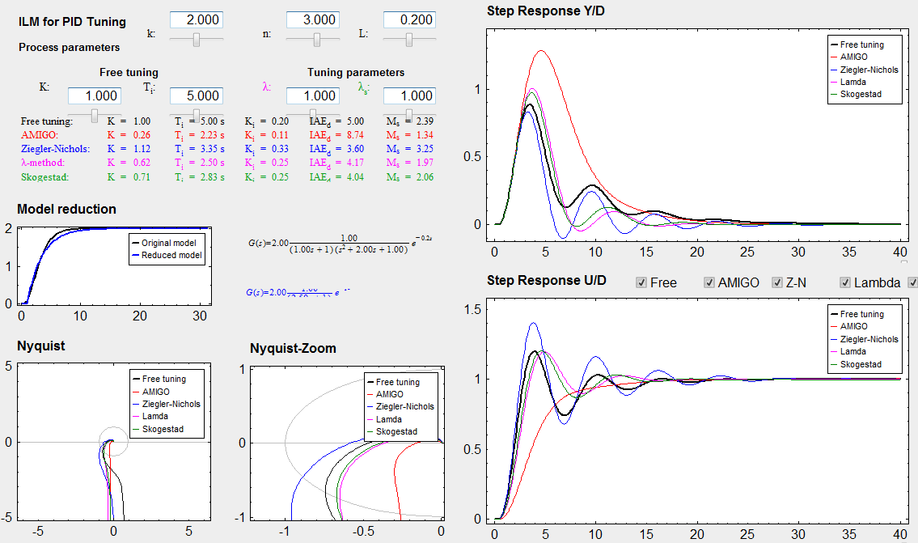
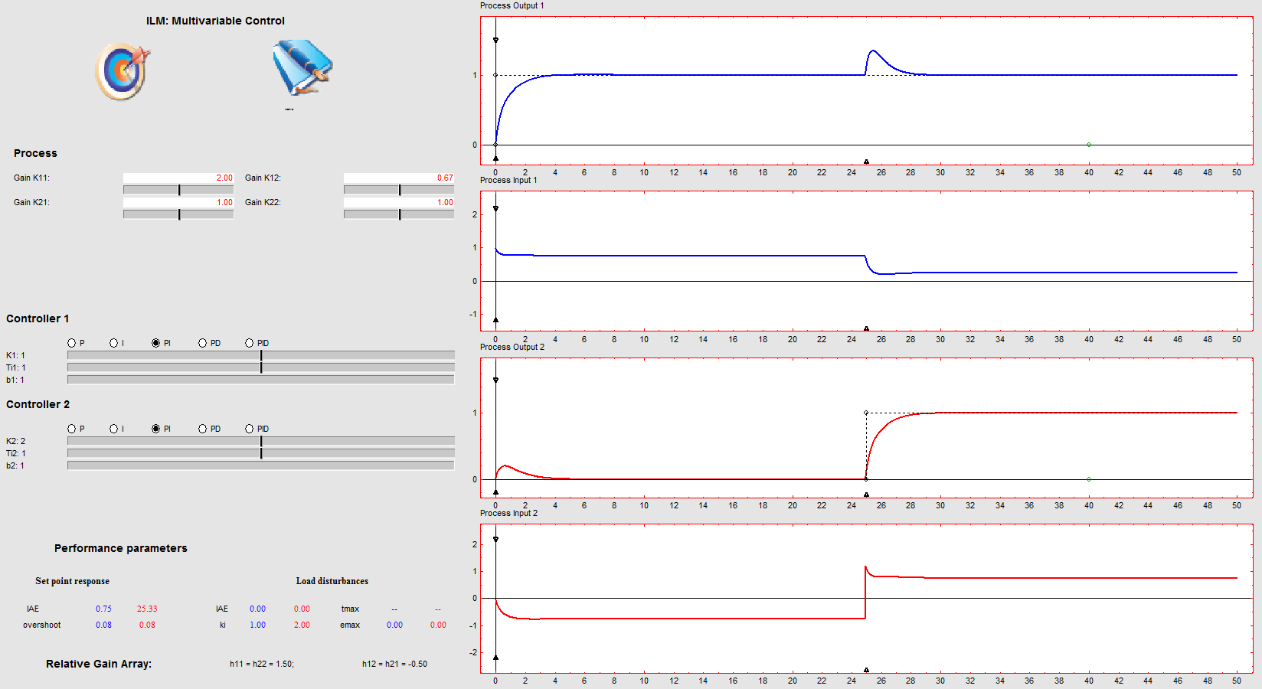
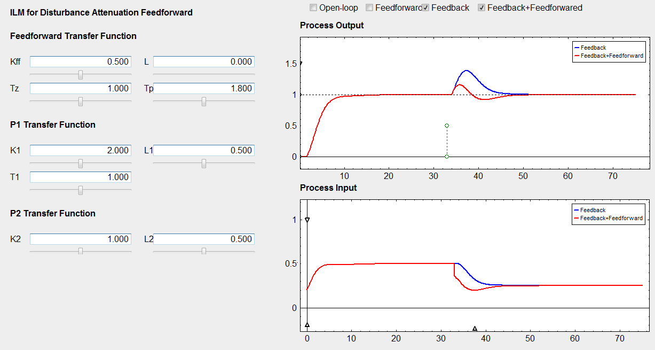
3. Interactive Learning Modules Project
2. The Interactive Learning Modules
PID Design
Dead-time compensators
Interaction
Feedforward design
Notes:
Information handling: remote access, bigger availability, and above all, Interactivity

Slide 10
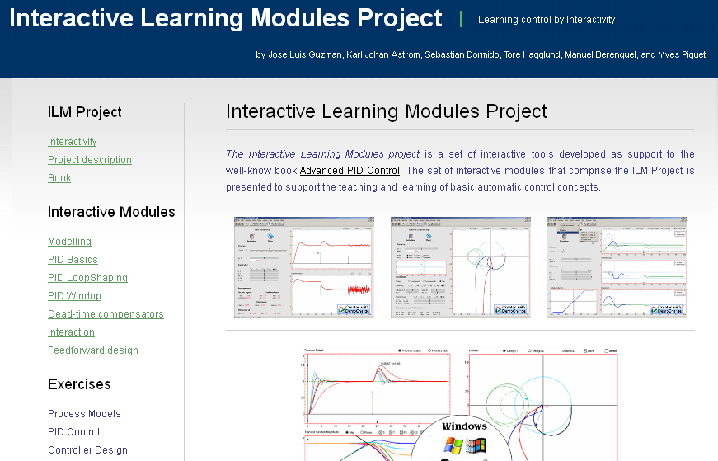
3. Interactive Learning Modules Project
2. The Interactive Learning Modules
http://aer.ual.es/ilm/
J. L. Guzmán; K. J. Åström, S. Dormido, T. Hägglund; M. Berenguel; Y. Piguet. “Interactive Learning Modules for PID Control: Using interactive graphics to learn PID control and develop intuition”, IEEE Control Systems Magazine, 28, 5, 118-134, 2008

Slide 11
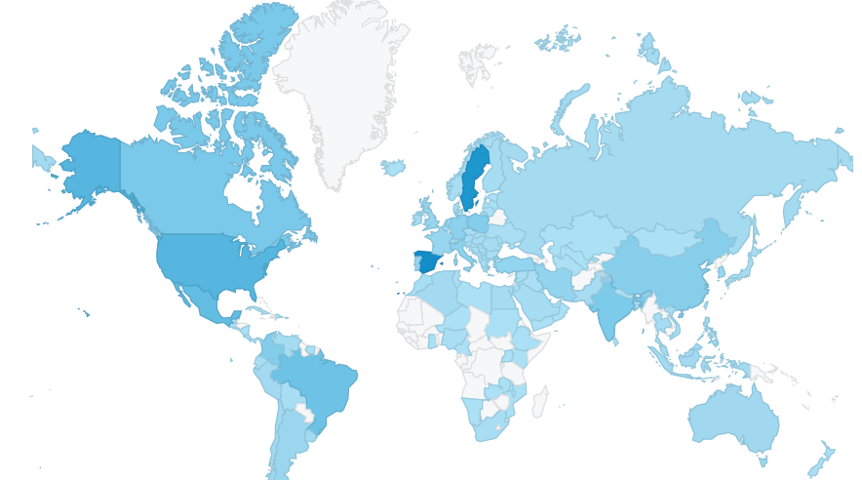
3. Interactive Learning Modules Project
2. The Interactive Learning Modules
> 150.000 downloads from 01/01/2009 till now

Slide 12
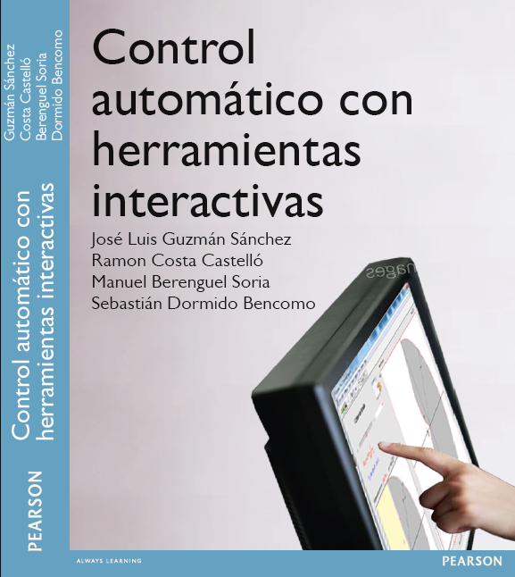
2. Some of our interactive tools
The
“interactive cards” project
J. L. Guzmán, R. Costa, S. Dormido, M. Berenguel. " An interactivity-based methodology as support to control education" IEEE Control Systems, 35, 111-25, 2016, doi: 10.1109/MCS.2015. 2495092
Notes:
12
12
12

Slide 13
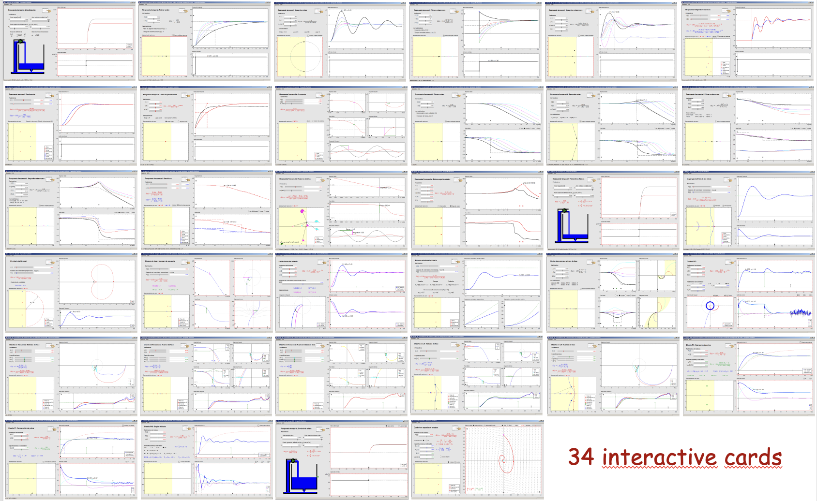
2. Some of our interactive tools
https://www2.ual.es/icontrol/

Slide 14
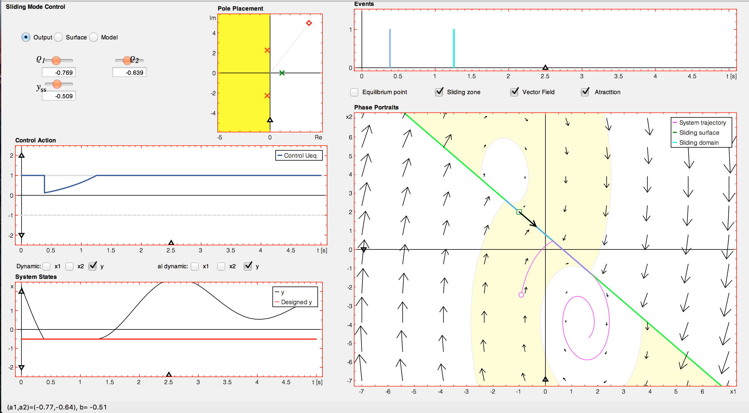
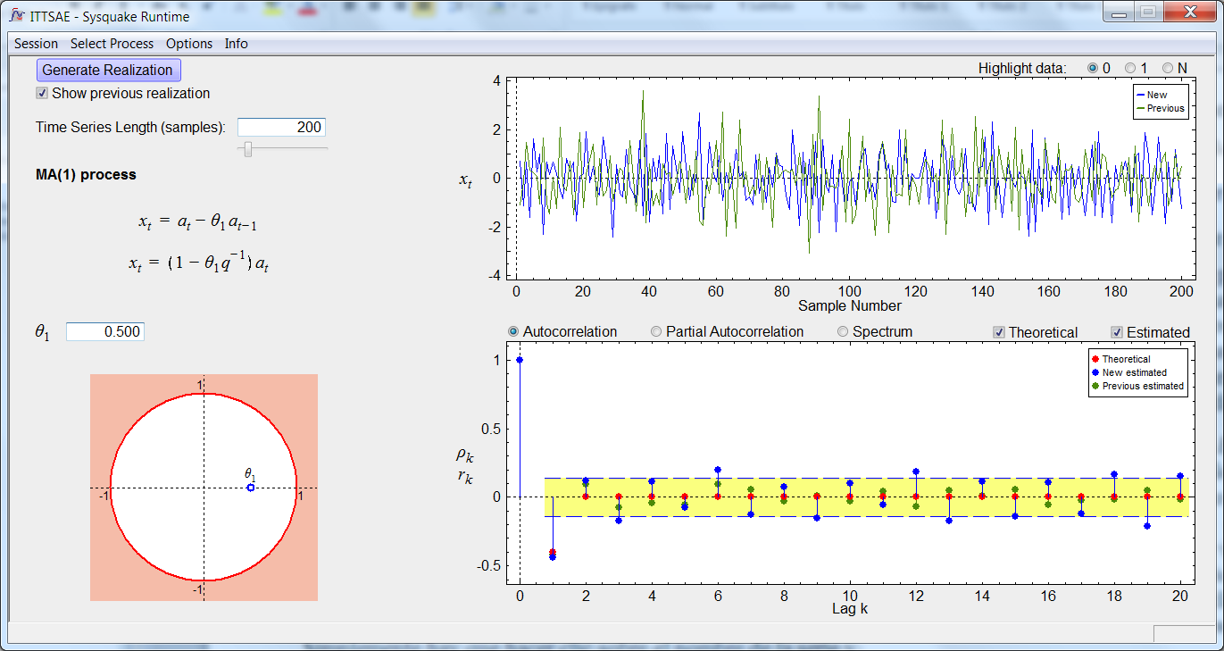
2. Some of our interactive tools
Sliding mode control
https://ramon-costa.staff.upc.edu/SMCITOOL/SMCITOOL.html
N. Carrero, R. Costa, S. Dormido, E. Fossas, “Using interactive tools to teach/learn Sliding Mode Control”, Conference Decision and Control, Atlanta, december 2010

Slide 15
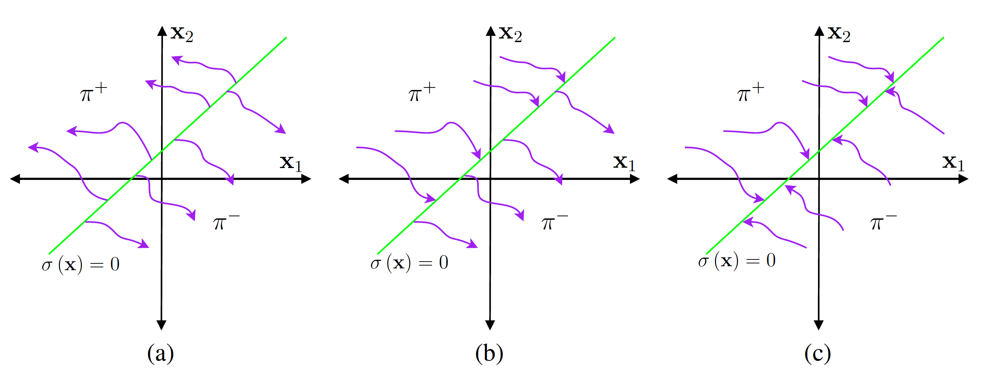
2. Some of our interactive tools
Different possible phase trajectories close to the switching surface: a) σ(x) = 0 acts as a repeller, b) paths cross σ(x) = 0 and c) σ(x) = 0 acts as an attractor
Sliding mode control

Slide 16
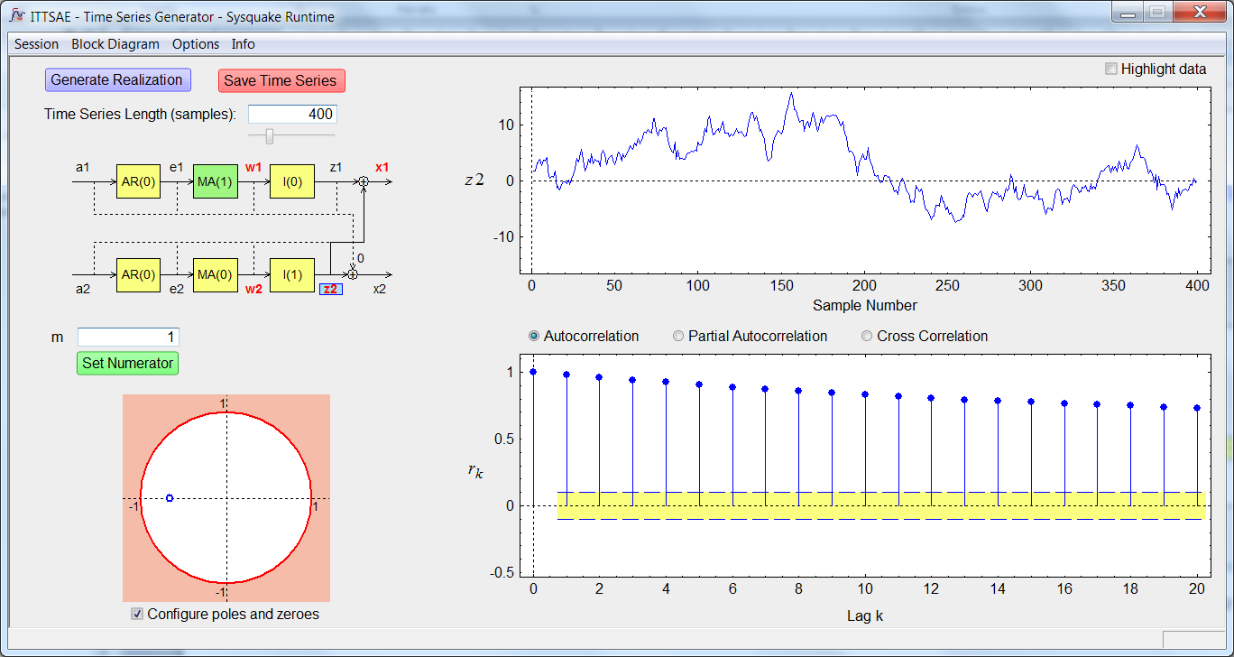
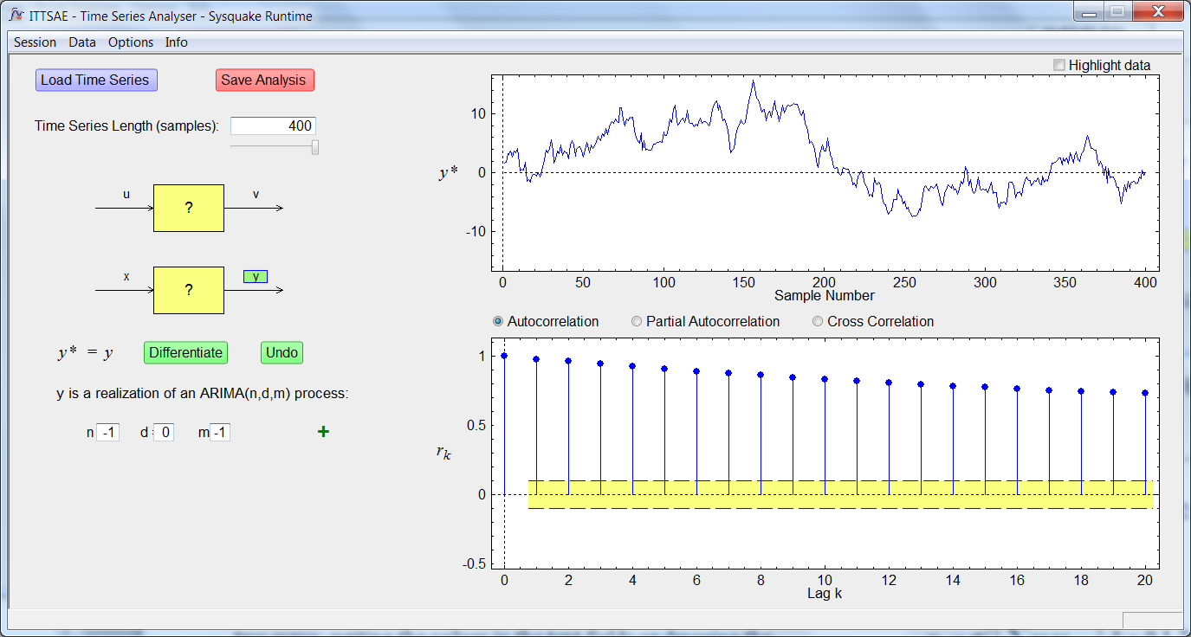
2. Some of our interactive tools
ITTSAE illustrates the basic concepts of time series analysis in the time domain and the properties of the ARIMA(n,d,m) processes.
http://www2.uned.es/itfe/ITTSAE/ITTSAE.html
ITTSAE-TSG helps the instructor in the task of generating time series to propose exercises.
http://www2.uned.es/itfe/ITTSAE/ITTSAE_TSG.html
ITTSAE-TSA provides to the students with everything they need to do the time series analysis exercises proposed by the instructor.
http://www2.uned.es/itfe/ITTSAE/ITTSAE_TSA.html
J. M. Díaz, S. Dormido, D. E. Rivera. "ITTSAE: A set of interactive software tools for time series analysis education" IEEE Control Systems, 36, 3, 2016, 112-120

Slide 17
4. ITTSAE tool suite
2. Some of our interactive tools
Concepts that can be illustrated with ITTSAE
A time series is simply one of the infinite realizations of a stochastic process.
The possible values of a point of a time series can be modeled as a random variable and its associated probability distribution.
The behavior of a time series at any moment of time can be described by a set of random variables and their associated probability distribution.
The shape of the autocorrelation function depends on the value of the poles and zeros of a stochastic process.
The characterization of the non-stationary behavior of a stochastic process.
The estimated autocorrelation function of a time series depends on the realization considered since it is calculated based on it. On the contrary, the theoretical autocorrelation function is independent of the realization since it is calculated based on the stochastic process model.
Notes:
17

Slide 18
4. ITTSAE tool suite
2. Some of our interactive tools
Concepts that can be illustrated with ITTSAE
The error of the estimated autocorrelation function depends on the length N of the time series. The greater the number of available observations, the lower the error of the estimates and will be closer to the theoretical values.
From the study of the autocorrelation function and the partial autocorrelation associated with a given time series, it is possible to infer the type of stochastic process that this time series can generate.
Notes:
18

Slide 19
3. The “loopshaping” concept
Loopshaping is a technique to design controllers in the frequency domain.
Loopshaping is a classic method for the synthesis of controllers that shapes the open loop transfer function to fulfill a set of specifications.
In most cases it is a graphical method that works well with minimum phase systems.
Loopshaping is inherently a two-step process.
4a. The open loop transfer function L(s) = P(s)C(s), is shaped to fulfill a set of specifications.
4b. Once this is done, the compensator C(s) is determined, from the knowledge of L(s) = P(s)C(s) and the nominal plant P(s).

Slide 20
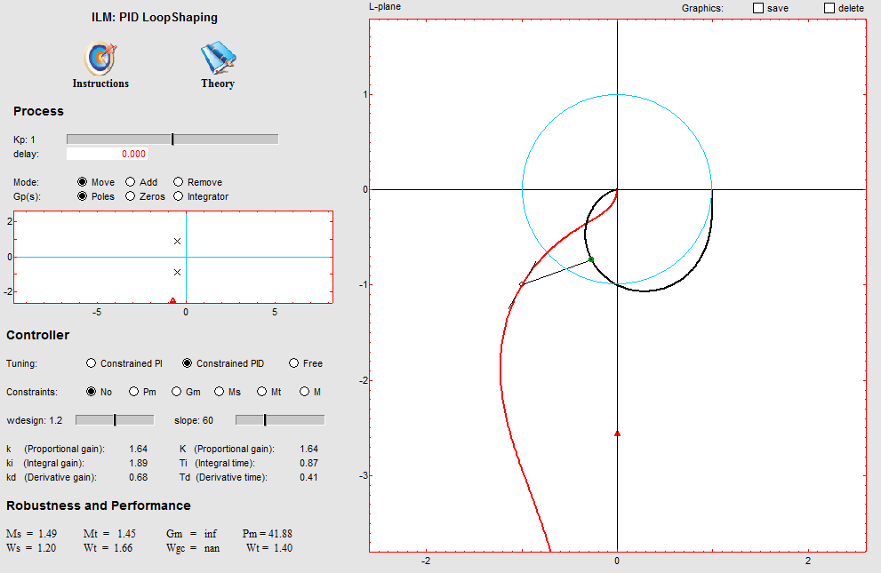
3. The concept of "loopshaping": A simple example
J. L. Guzmán; K. J. Åström, S. Dormido, T. Hägglund; M. Berenguel; Y. Piguet. “Interactive Learning Modules for PID Control: Using interactive graphics to learn PID control and develop intuition”, IEEE Control Systems Magazine, vol. 28, nº 5, pp. 118-134, 2008

Slide 21
3. The concept of "loopshaping"
Classic control system with one degree of freedom
d
n
e
u
r
C(s)
G(s)
y
-
The closed loop relation between the inputs r, d y n and the output y is:
where:
is the sensitivity function
is the complementary sensitivity function

Slide 22
3. The concept of "loopshaping"
Specifications on L(s) in a Bode diagram
∣L∣
ω
ω_{B}
ω_{C}
Crossover Band
Control Band
Cut-off Band

Slide 23
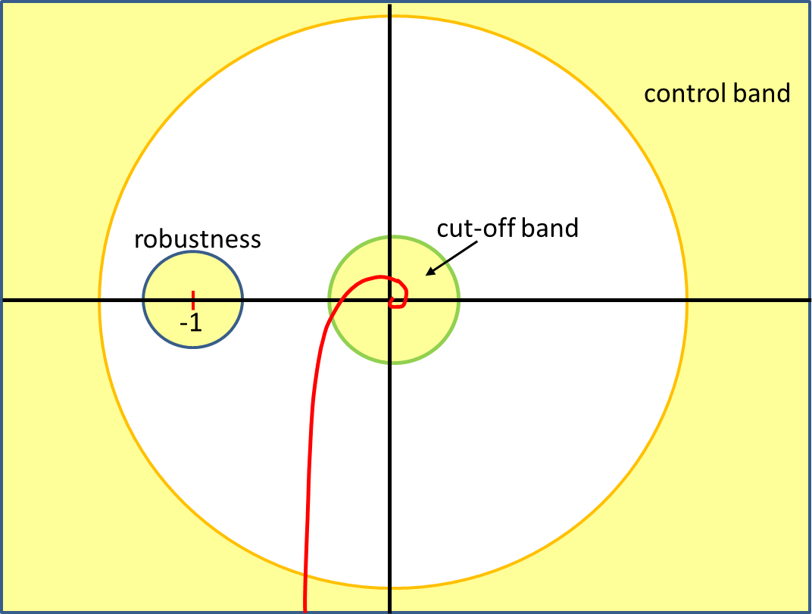
3. The concept of "loopshaping"
Specifications on L(s) in a Nyquist diagram

Slide 24
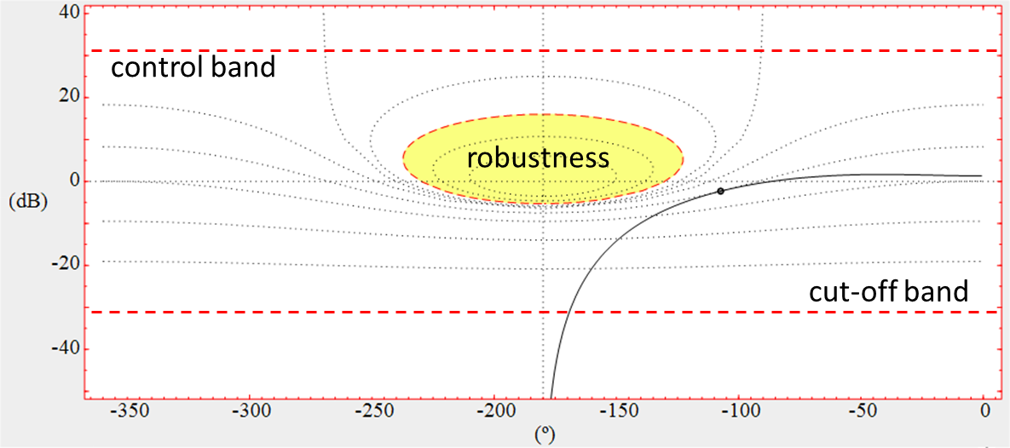
3. The concept of "loopshaping"
Specifications on L(s) in a Nichols diagram

Slide 25
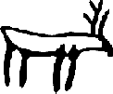

4. The interactive tool LSAD (ACE 2003)
IFAC ACE 2003
The role of interactivity in control learning
Sebastián Dormido
Dpt. Informática y Automática
Facultad de Ciencias
UNED, Madrid
sdormido@dia.uned.es
Oulu 16thjune 2003

Slide 26
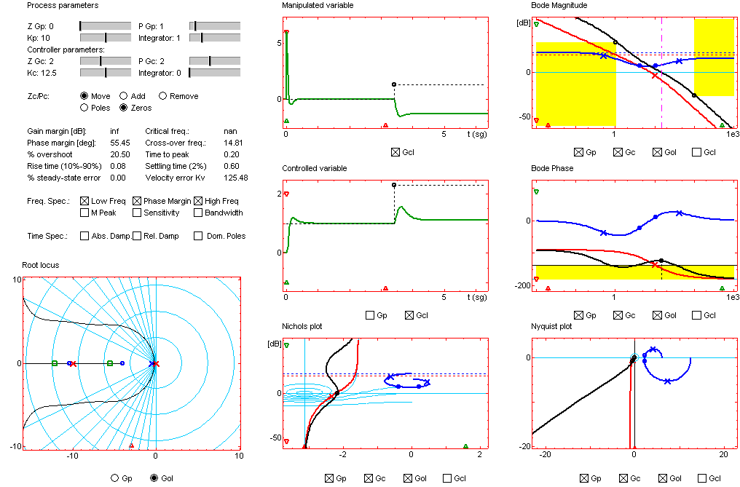
4. The interactive tool LSAD (ACE 2003)
S. Dormido. “The role of interactivity in control learning (Plenary Lecture)”, IFAC Symposium on Advances Control Education ACE’03, Oulu (Finland), 2003

Slide 27
4. The interactive tool LSAD (ACE 2003)
A critical vision of LSAD
Teaching aspects
Implementation aspects
Information overload
Designed for the teacher
Difficult learning
Difficult to put exercises
Does not consider the evaluation
Not scalable
Poor interactivity
Difficult to maintain
Very limited handling of delays
It does not allow to save and recover session

Slide 28
5. From LSAD to LCSD
LCSD design requirements
Teaching aspects
Implementation aspects
Scalable
Interactivity through the GUI
Easy to maintain
Delay management
Allows save and recover session
Allows generate reports
Simple and self-contained
Designed for the teacher
But also for the student
Easy to understand and use
Easy to put exercises
Consider the evaluation
J. M. Díaz, R. Costa, R. Muñoz, S. Dormido. "An Interactive and Comprehensive Software Tool to Promote Active Learning in the Loop Shaping Control System Design" IEEE Access, 5, 2017, 10533-10546

Slide 29
5. From LSAD to LCSD
Ways of using LCSD
Explain and explore control concepts
Give the statement of a problem in textual form for the student to define it using the interface of the tool
Formulate the problem statement with the tool
Send the solution of the problem to the teacher using the tool
Generate a report with the solution of the problem
Send the rigth solution to the student

Slide 30
5. From LSAD to LCSD
F
x
C
x
P
x
L
T
Interactive block diagram
Graphic representation
Bode
Nyquist
Nichols
Root locus
Symbolic representation TFs and signals
Specifications
Frequency Time
Temporal response
Interactive
Poles-Zeros Map

Slide 31
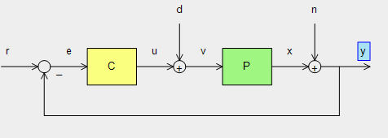
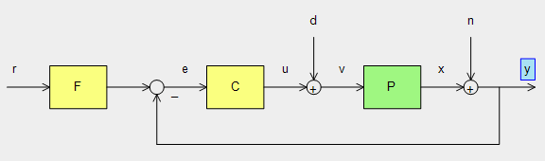
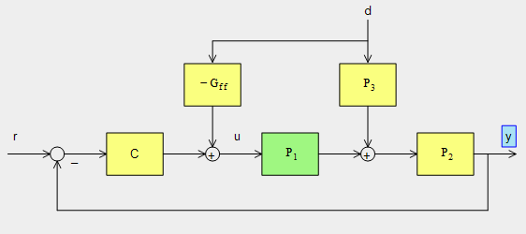
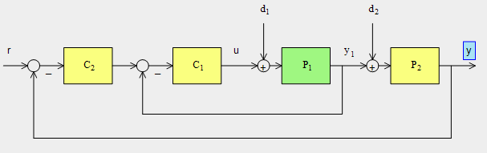
5. From LSAD to LCSD
Interactive block diagram
One degree of freedom control structure
Two degree of freedom control structure
Cascade control structure
Feedforward control structure

Slide 32
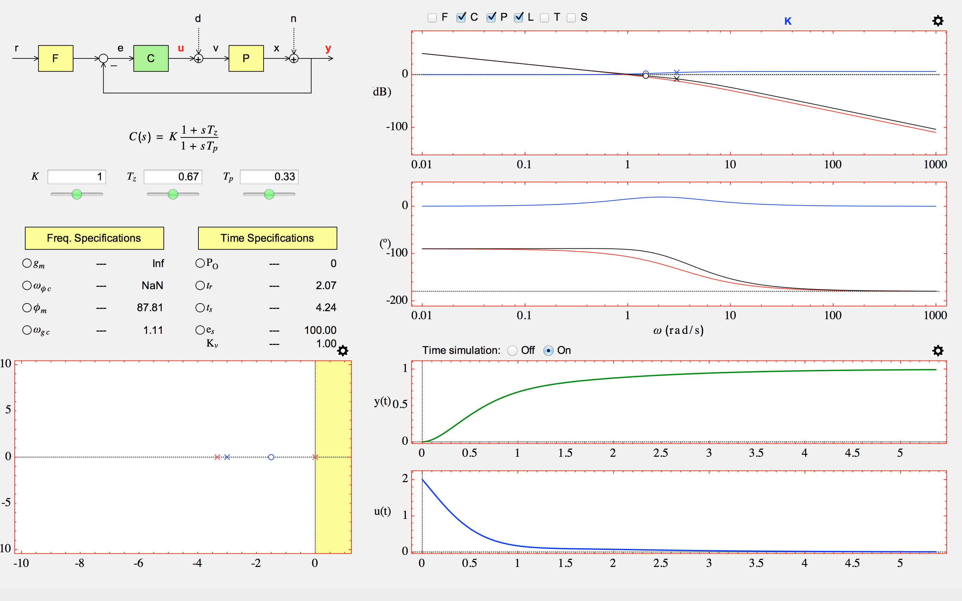
5. From LSAD to LCSD
Interactive block diagram
TFs and signals
Graphical representation
Poles-Zeros Map
Specifications
Temporal response

Slide 33
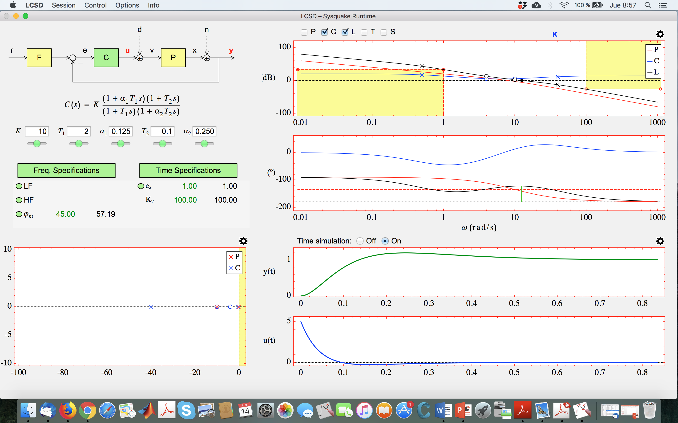
5. From LSAD to LCSD
https://www.dia.uned.es/itfe/LCSD/LCSD.html

Slide 34
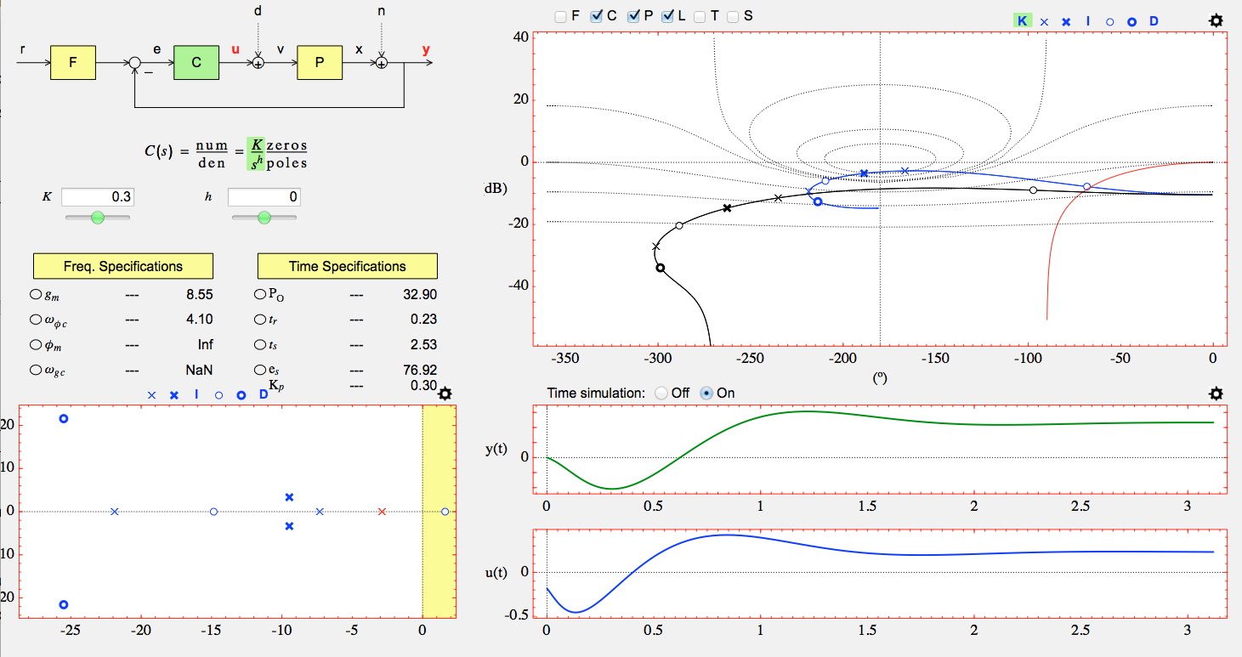
5. From LSAD to LCSD
Interactive block diagram
Symbolic TFs and signals
Graphical representation
Pole-Zero map
Performance/Specification
Temporal response

Slide 35
6. Example 1 using LCSD: Bode diagram
Introducción | Concepto | Orígenes | Homeostasis | Dos historias | Propiedades | Interdisciplinariedad | Conclusiones
Introducción | Concepto | Orígenes | Homeostasis | Dos historias | Propiedades | Interdisciplinariedad | Conclusiones
r(t)
y(t)
-
Specifications: The open loop transfer function L(s) = G(s)C(s) must fulfill:
1) Velocity error constant: K_{v} = 100 s⁻¹
2) Phase margin: Φ_{M} ≥ 45º
3) Sinusoidal inputs up to 1 rad/s must be reproduced with an error ≤ 2%
4) Sinusoidal inputs ≥ 100 rad/s must be atenuated to the output to 5% of the input

Slide 36
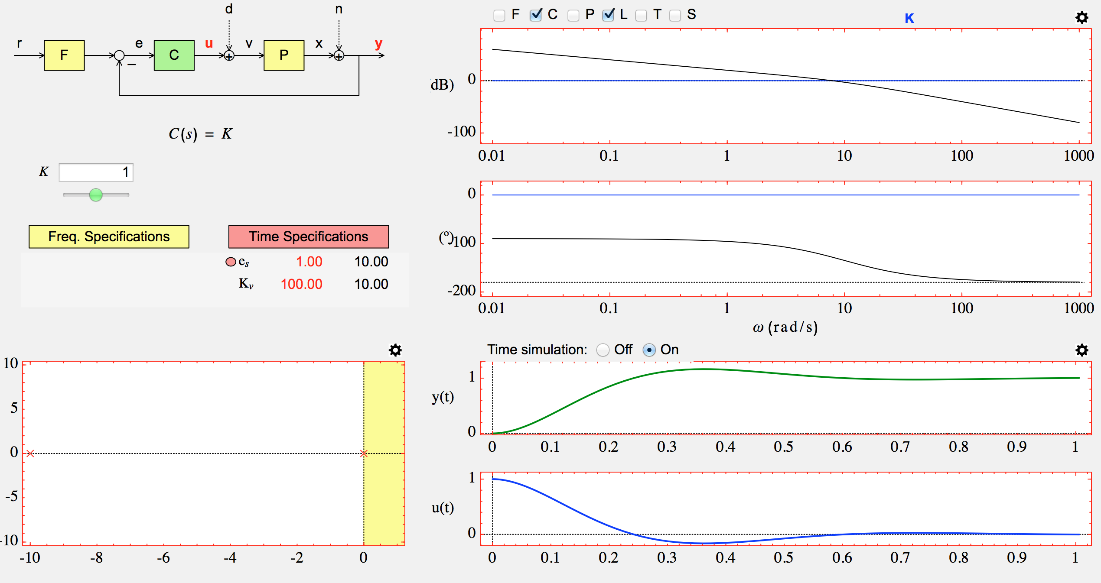
6. Example 1 using LCSD: Bode diagram
Formulation of example 1 with specification 1

Slide 37
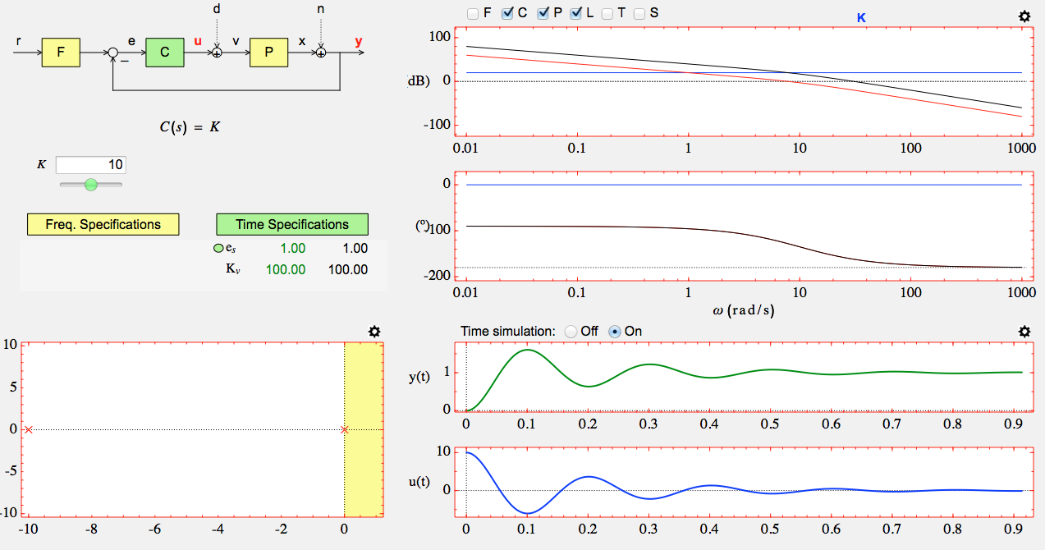
6. Example 1 using LCSD: Bode diagram
Solution of example 1 with specification 1

Slide 38
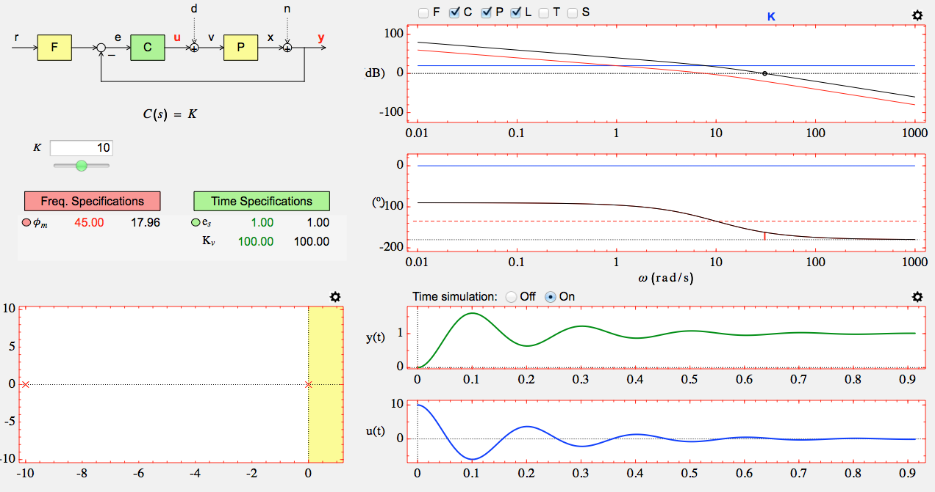
6. Example 1 using LCSD: Bode diagram
Formulation of example 1 with specifications 1 and 2

Slide 39
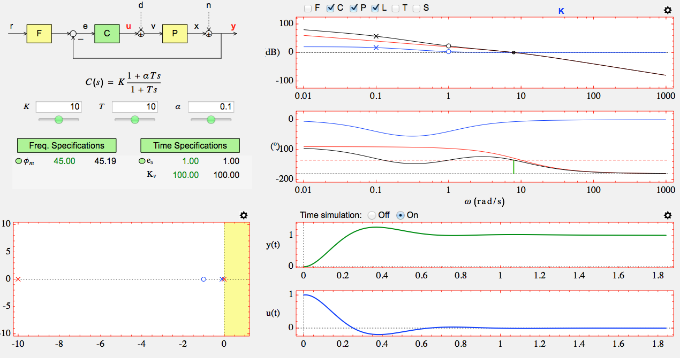
6. Example 1 using LCSD: Bode diagram
Solution of example 1 with specifications 1 and 2

Slide 40
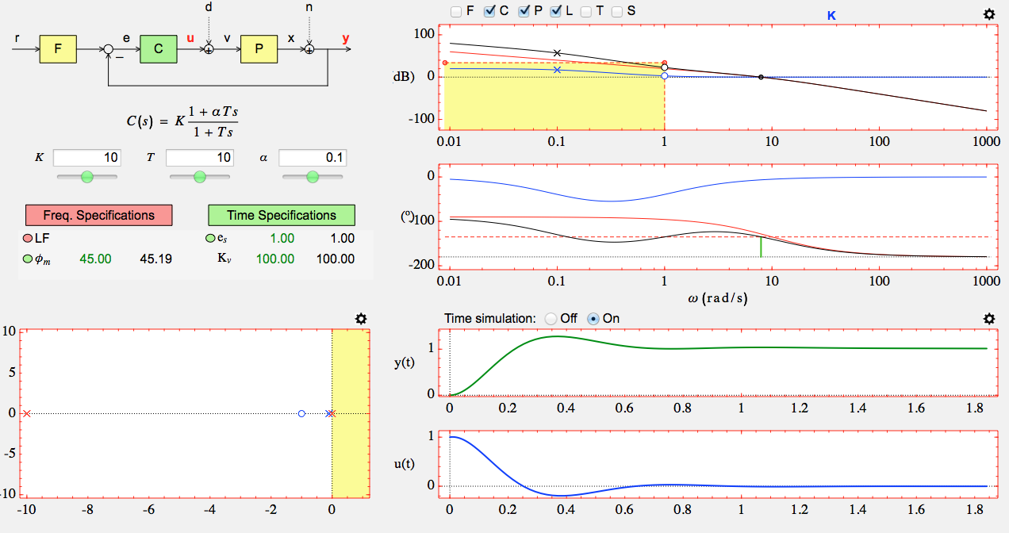
6. Example 1 using LCSD: Bode diagram
Formulation of example 1 with specifications 1, 2 and 3

Slide 41
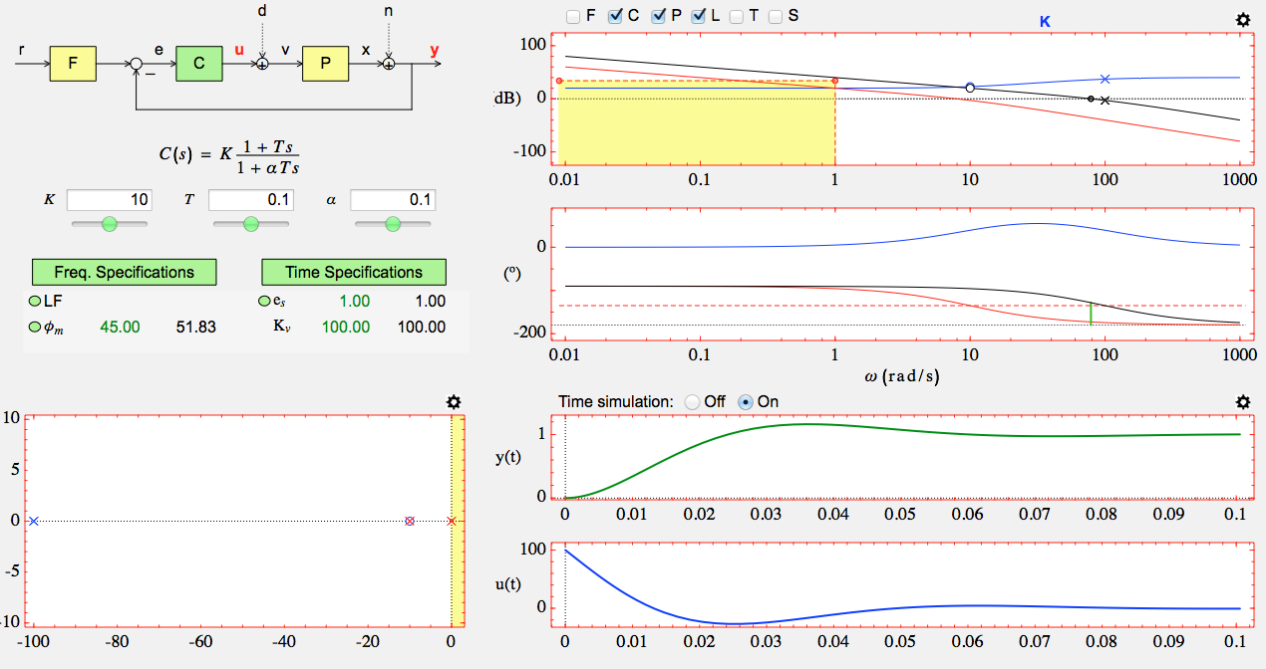
6. Example 1 using LCSD: Bode diagram
Solution of example 1 with specifications 1, 2 and 3

Slide 42
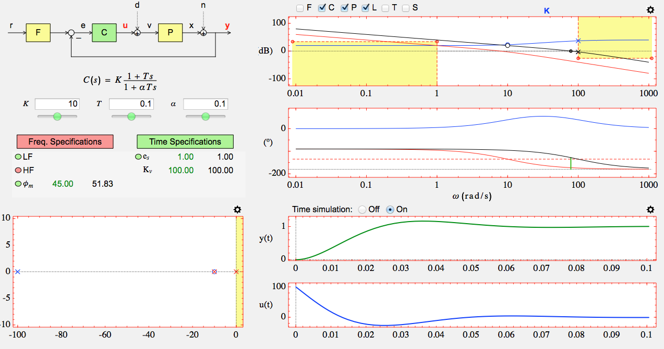
6. Example 1 using LCSD: Bode diagram
Formulation of example 1 with specifications 1, 2, 3 and 4

Slide 43
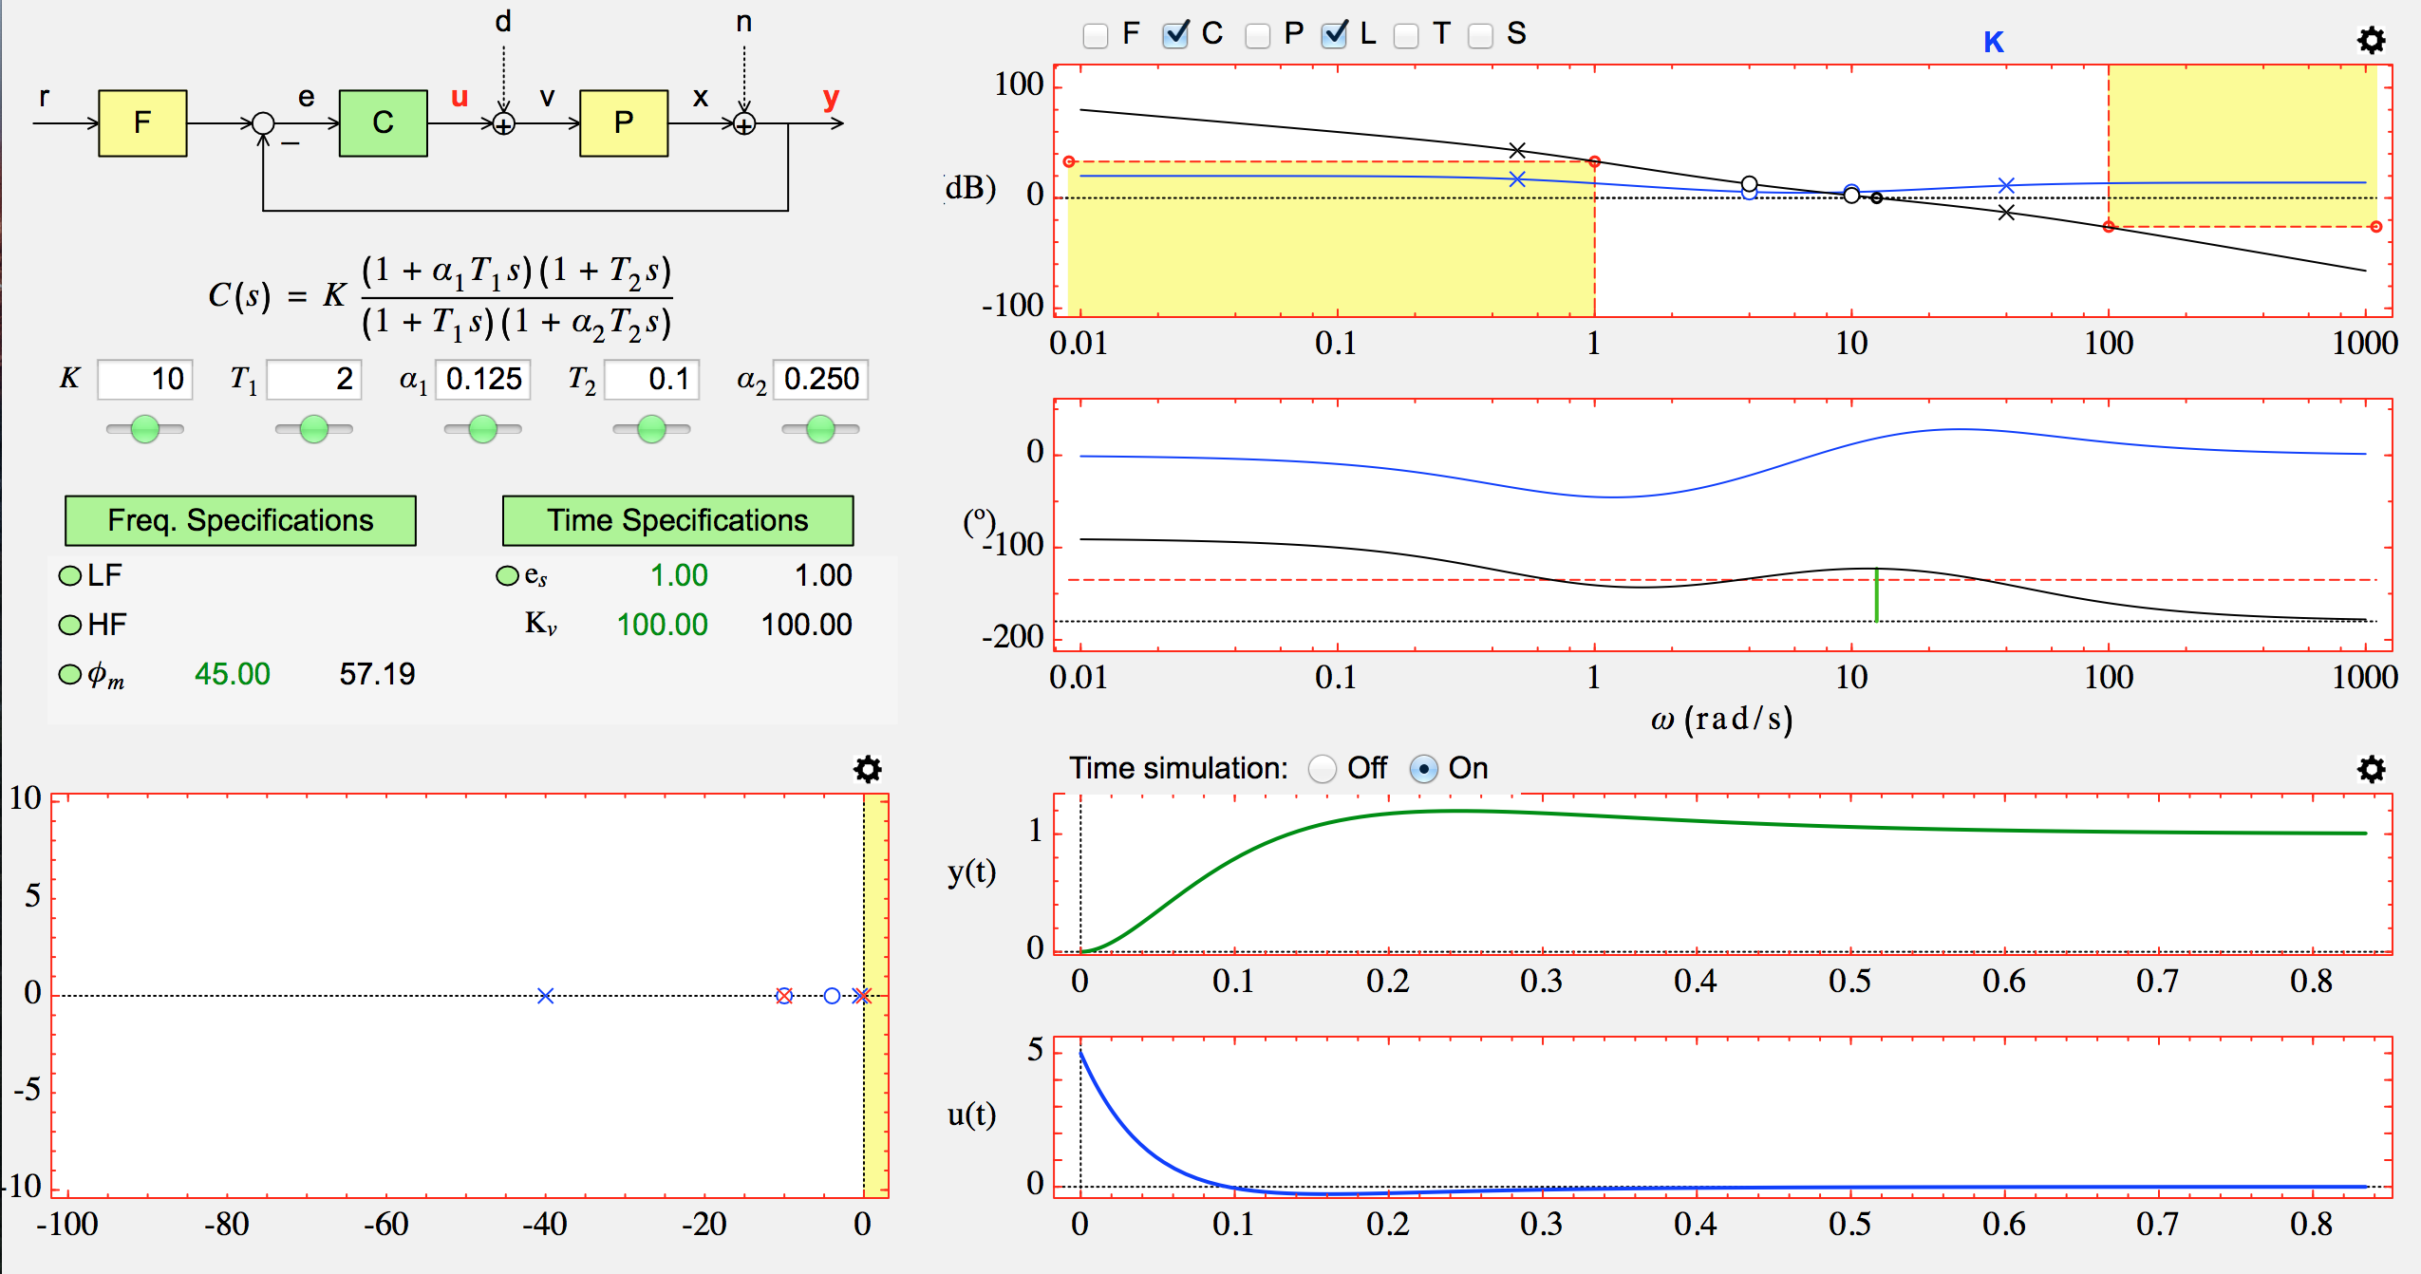
6. Example 1 using LCSD: Bode diagram
Solution of example 1 with specifications 1, 2, 3 and 4

Slide 44
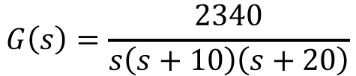
6. Example 2 using LCSD: Nichols diagram
Introducción | Concepto | Orígenes | Homeostasis | Dos historias | Propiedades | Interdisciplinariedad | Conclusiones
Introducción | Concepto | Orígenes | Homeostasis | Dos historias | Propiedades | Interdisciplinariedad | Conclusiones
$$G\left(s\right)=\frac{2340}{s\left(s+10\right)\left(s+20\right)}$$
Specifications: The open loop transfer function L(s) = G(s)C(s) must fulfill:
1) The maximum magnitude of the complementary sensitivity function must be < 1.4
2) Velocity error constant : K_{v} > 11,5 s⁻¹
3) Settling time t_{s} < 0,5s
4) Overshoot PO < 10%

Slide 45
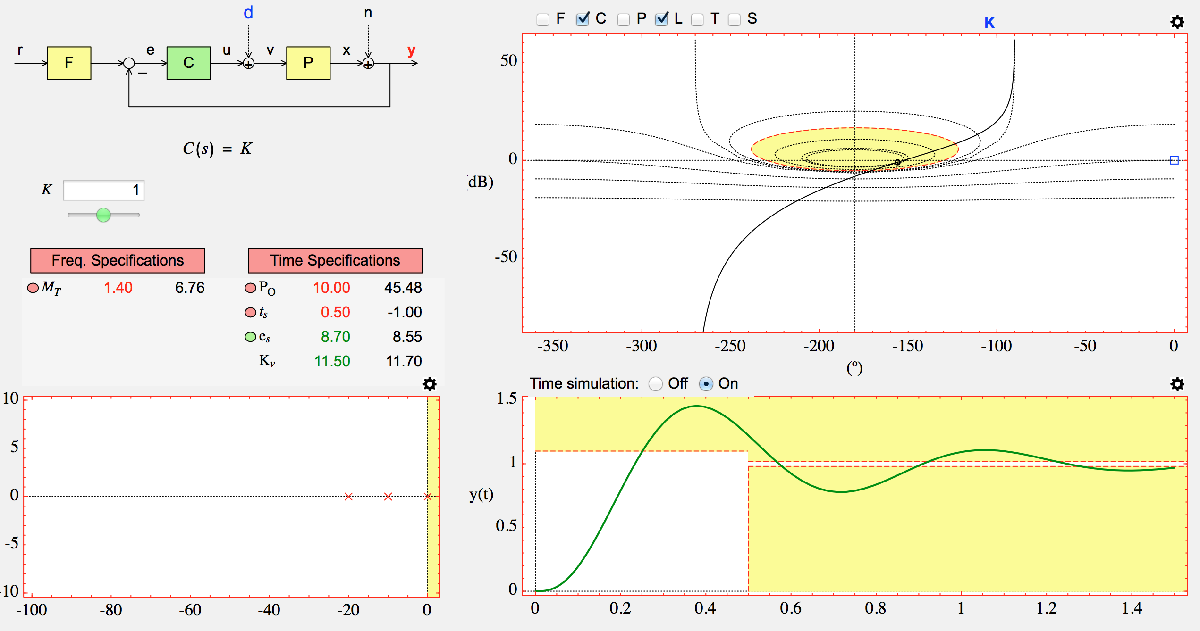
6. Example 2 using LCSD: Nichols diagram
Formulation of example 2

Slide 46
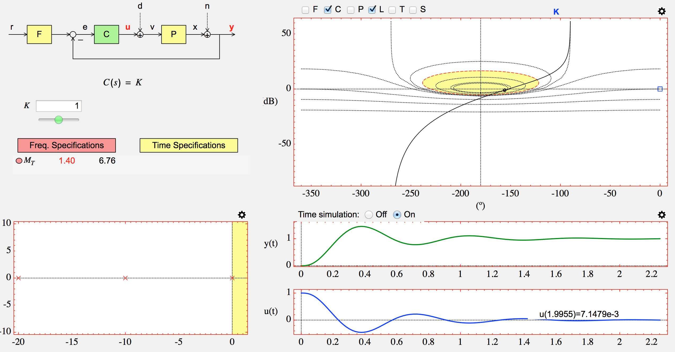
6. Example 2 using LCSD: Nichols diagram
Formulation of example 2 with specification 1

Slide 47
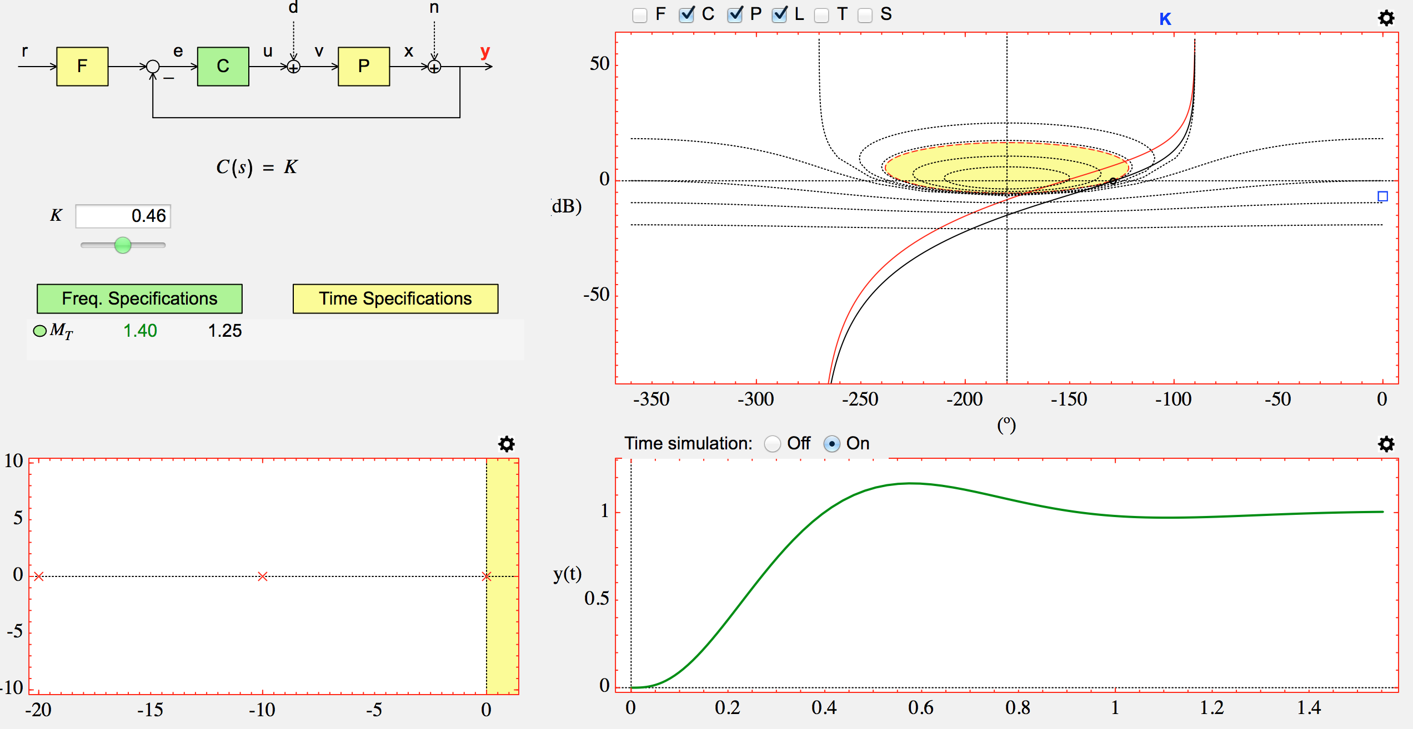
6. Example 2 using LCSD: Nichols diagram
Solution of example 2 with specification 1

Slide 48

6. Example 2 using LCSD: Nichols diagram
Formulation of example 2 with specifications 1 and 2

Slide 49

6. Example 2 using LCSD: Nichols diagram
Solution of example 2 with specifications 1 and 2

Slide 50

6. Example 2 using LCSD: Nichols diagram
Formulation of example 2 with specifications 1, 2 and 3

Slide 51

6. Example 2 using LCSD: Nichols diagram
Solution of example 2 with specifications 1, 2 and 3

Slide 52

6. Example 2 using LCSD: Nichols diagram
Formulation of example 2 with specifications 1, 2, 3 and 4

Slide 53

6. Example 2 using LCSD: Nichols diagram
Solution of example 2 with specifications 1, 2, 3 and 4

Slide 54

6. Example 3 using LCSD: Nyquist diagram
Introducción | Concepto | Orígenes | Homeostasis | Dos historias | Propiedades | Interdisciplinariedad | Conclusiones
Introducción | Concepto | Orígenes | Homeostasis | Dos historias | Propiedades | Interdisciplinariedad | Conclusiones
$$G\left(s\right)=\frac{1}{{\left(1+s\right)}^{4}}$$
Specifications: The open loop transfer function L(s) = G(s)C(s) must fulfill:
1) The maximum magnitude of the sensitivity function M_{s} must be ≤ 1.4

Slide 55

6. Example 3 using LCSD: Nyquist diagram
Formulation of example 3

Slide 56

6. Example 3 using LCSD: Nyquist diagram
Solution of example 3 with “derivative cliff”

Slide 57

6. Example 3 using LCSD: Nyquist diagram
Solution of example 3 without “derivative cliff”

Slide 58

6. Example 3 using LCSD: Nyquist diagram
Joint solution of example 3

Slide 59

6. Example 4 using LCSD: Root-locus
r(t)
y(t)
-
Specifications: The open loop transfer function L(s) = G(s)C(s) must fulfill:
1) Settling time: T_{s} ≤ 4 s
2) Damping factor: δ ≥ 0,36
3) Overshoot PO to a step input ≤ 35%
⇒ ζ ≥ 0.32
⇒ ζω_{n} = 1
4) Location of dominant roots:

Slide 60

6. Example 4 using LCSD: Root-locus
Formulation of example 4

Slide 61

6. Ejemplo 4 con LCSD: lugar de las raíces
Introducción | Concepto | Orígenes | Homeostasis | Dos historias | Propiedades | Interdisciplinariedad | Conclusiones
Introducción | Concepto | Orígenes | Homeostasis | Dos historias | Propiedades | Interdisciplinariedad | Conclusiones
Solution of example 4

Slide 62
7. Conclusions
Introducción | Concepto | Orígenes | Homeostasis | Dos historias | Propiedades | Interdisciplinariedad | Conclusiones
Introducción | Concepto | Orígenes | Homeostasis | Dos historias | Propiedades | Interdisciplinariedad | Conclusiones
The underlying philosophy of interactive software is to minimize the programming effort so that the student focuses on learning control concepts.
Interactive tools promote the essential aspects of dynamic systems and their control.
The teaching of control concepts has never been more motivating and exciting than today with the use of interactive software as a "teaching assistant".
The interactive tools reinforce the essential aspects of the basic concepts in control: dynamic systems, stability, feedback and compensation.

Slide 63








Acknowledgments
Karl J. Åström
Lund Univ.
Tore Hagglünd
Lund Univ.
Yves Piguet
Calerga
José Manuel Diaz
UNED
Manuel Berenguel
UAL
José Luis Guzmán
UAL
Ramón Costa
UPC
Daniel E. Rivera
ASU Univ.

Slide 64

Workshop on “Interactivity in Control Education: New advances” (Madrid, septiembre 2014)

