Slide 1
Interactive tools and methods for teaching an automatic control fundamentals course
Sebastián Dormido
Dpto. Informática y Automática
ETS Ing. Informática, UNED
sdormido@dia.uned.es
Manuel Berenguel
Dpto. Informática
ETS Ingeniería, Univ. Almería
beren@ual.es
José Luis Guzmán
Dpto. Informática
ETS Ingeniería, Univ. Almería
joguzman@ual.es
Ramon Costa
Dpto. Ing. Sistemas y Automática
ETS Ing. Industrial, UPC
ramon.costa@upc.edu
La Laguna 26 de octubre de 2023

Slide 2
Contents
Contents
Education (teaching vs learning)
Engineering education
Control education
Interactivity and visualization in control education
Automatic Control with Interactive Tools
Conclusions

Slide 3
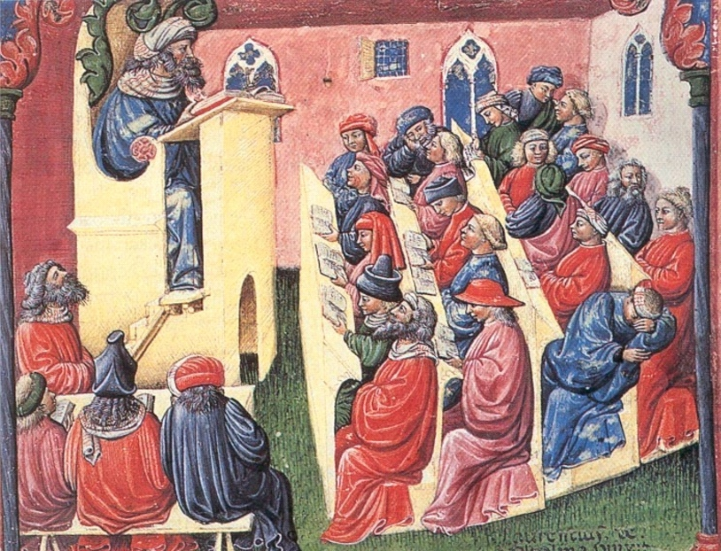
1. Education (teaching vs learning)
1. Introduction
The class environment many years ago
social
interaction
reading
disengaged
quality
assurance
listening
University of Bologna, Laurentius de Voltolina 14th century lecture
Notes:
ATN Assessment Conference 2009
3
3

Slide 4

1. Education (teaching vs learning)
1. Introduction
Teaching and learning are two different things It is possible teaching without learning It is possible learning without teaching And even more it is possible learning despite teaching

Slide 5
1. Education (teaching vs learning)
1. Introduction
Seven Principles for Good Practice in Education
1
Student-
Faculty
Contact
Education: Instruction by means of the teacher action.
7
Diverse
ways of
Learning
2
Cooperation
Among
Students
Teach: (Del lat. vulg. Insigna- re) Show or expose something, to be seen and appreciated.
6
High
Expectations
3
Active
Learning
Learn: (Del lat. Apprehendĕre). Acquire knowledge of something by means of the study or experience.
5
Emphasize
Time on
Task
4
Prompt
Feedback
A. W. Chickering and Z. F. Gamson, 1987

Slide 6
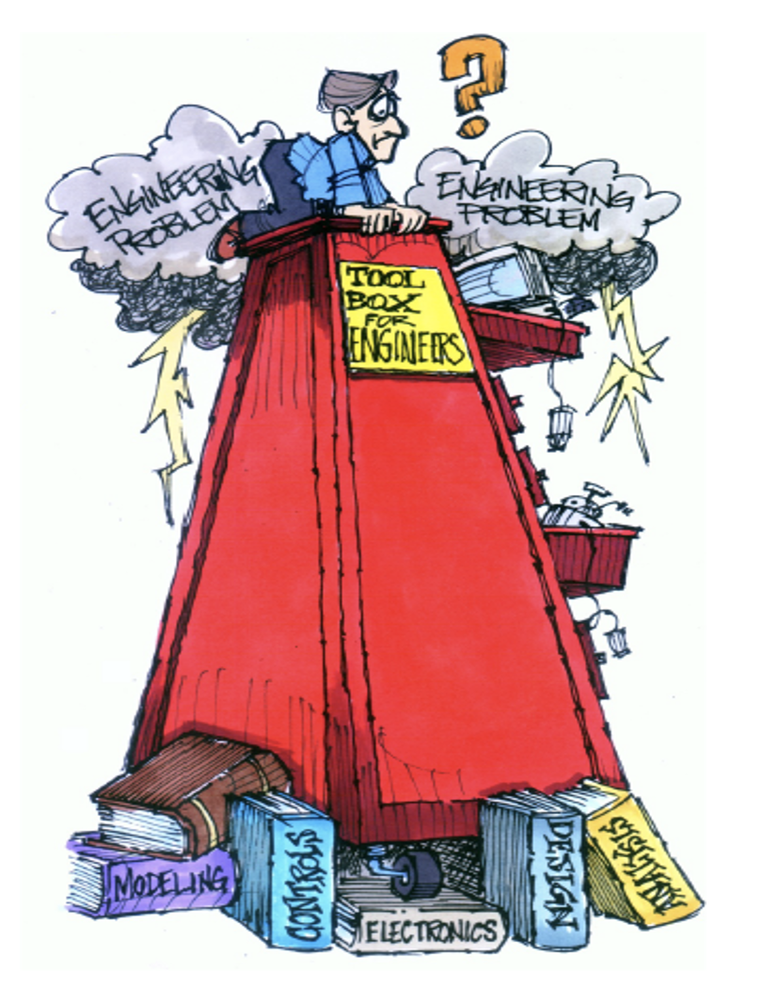
2. Engineering education
Teaching and learning in science and engineering
The training of a good scientist and/or engineer is not an easy task.
The “toolbox” that students need for their work seems to grow more and more
It is demanding to combine a solid theory background with the necessary “know how” for professional activities
It is necessary to maintain an equilibrium between theory and practice

Slide 7
2. Engineering education
A shift from hands-on and practical emphasis to engineering science and analytical emphasis.
A shift to outcomes-based education and accreditation.
A shift to emphasizing engineering design.
A shift to applying education, learning, and social behavioral sciences research
A shift to integrating information, computational, and communications technology in education
Froyd, J. E., Wankat, P. C., Smith, K. A., 2012. Five major shifts in 100 years of engineering education. Proceedings of the IEEE, 1344–1360

Slide 8
3. Control education
Mechanical Engineering
Nuclear Engineering
Electrical Engineering
Control
Engineering is
Interdisciplinary
Bioengineering
Chemical Engineering
Aeronautical
Engineering
Civil Engineering
Naval
Engineering
J. A. Rossiter, C. Cassandras, J. Hespanha, S. Dormido, L. de la Torre, G. Ranade, A. Visioli, J. Hedengren, R. M. Murray, P. Antsaklis, F. Lamnabhi-Lagarrigue, T. Parisini. “Control education for societal-scale challenges: a community roadmap”, Annual Reviews in Control, 2023, doi:10.1016/j.arcontrol.2023.03.007

Slide 9
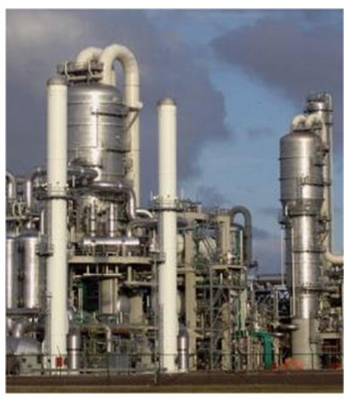

3. Control education
2. Control education
dynamic system
feedback
stability
dynamic compensation
fundamentals
L
experimentation
simulation
D, y
F, z
reality
(system)
model
B, x
modeling
D, Muñoz de la Peña, M. Domínguez, F. Gómez-Estern, O. Reinoso, F. Torres, S. Dormido. “Estado del arte de la educación en automática”, Revista Iberoamericana de Automática e Informática Industrial, 19, 2022, 117-131; doi: 10.4995/riai.2022.16989

Slide 10
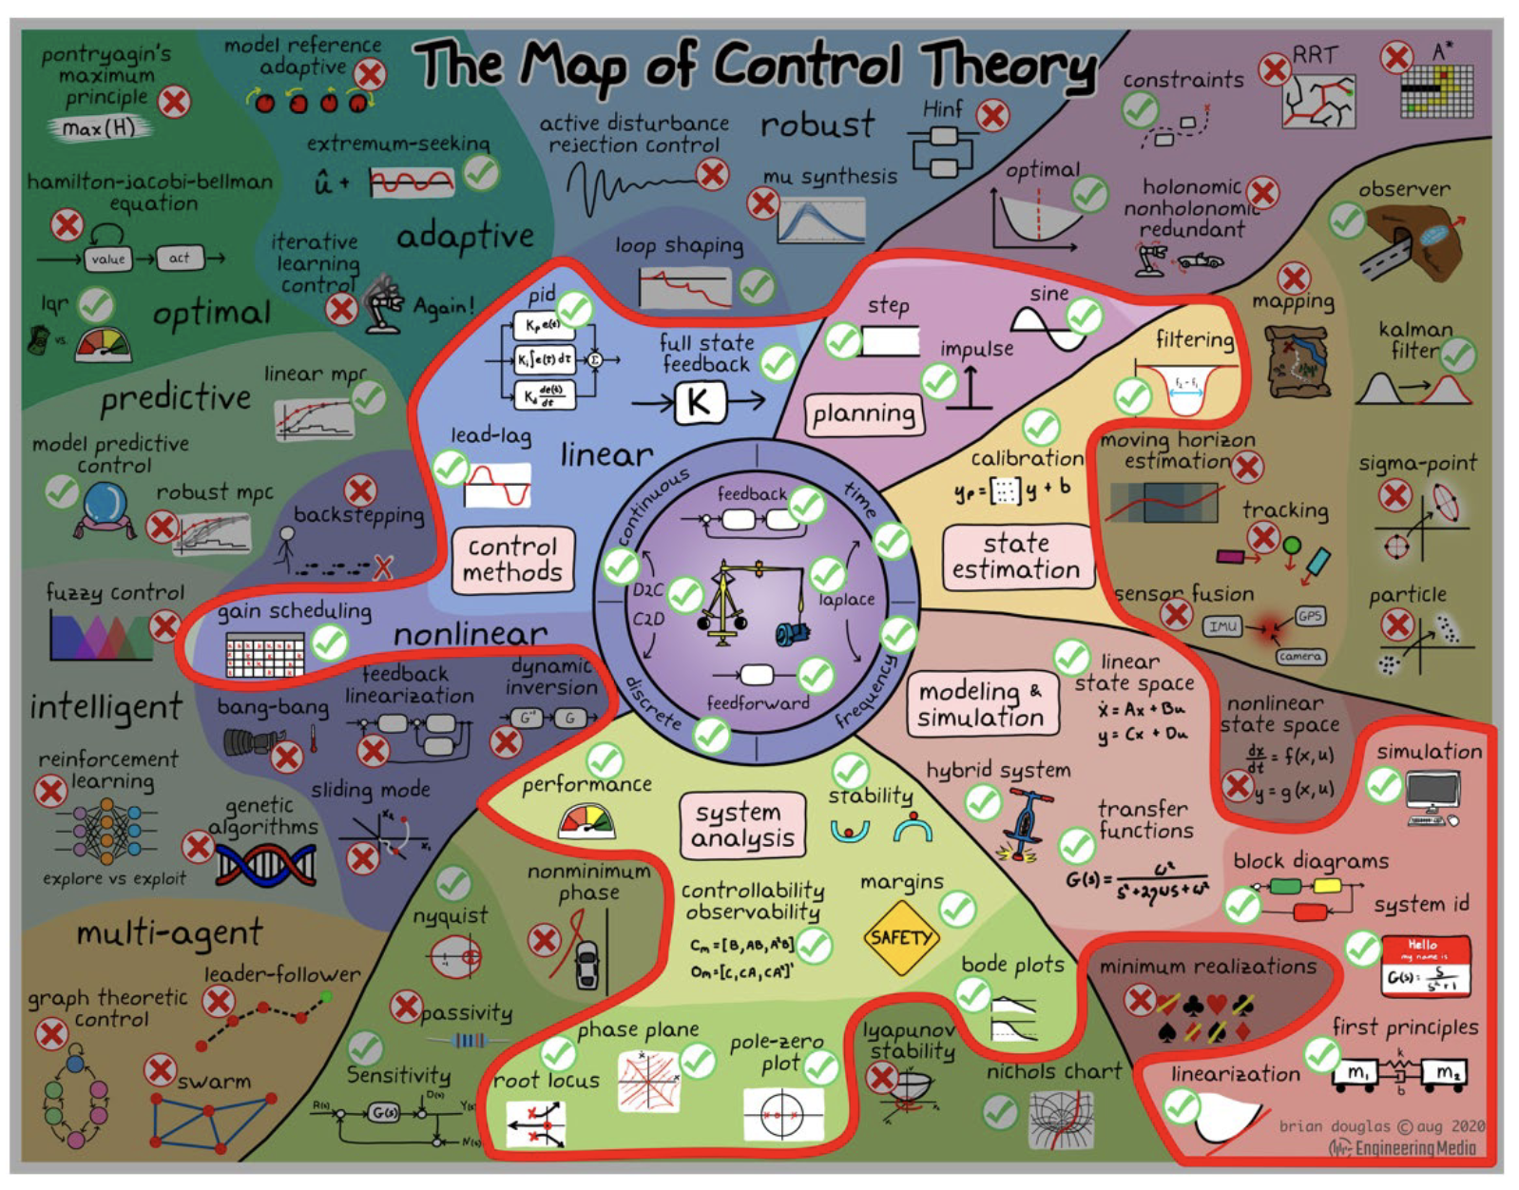
3. Control education (pictorial map of control theory topics)
5. The interactive card project

Slide 11
4. Interactivity and visualization in control education
3. Interactivity in control education
A simple example of visualization: Pythagoras’ theorem
a
c
b
b² + c²
=
a²

Slide 12
4. Interactivity and visualization in control education
3. Interactivity in control education
A simple example of visualization: Pythagoras’ theorem
c
b
b
c
T
T
T
c
c²
c
c
b
a
a
T
a
a²
T
a
b²
a
b
b
b
a
c
T
T
T
c
b
c
b
b² + c² + 4T
=
a² + 4T
b² + c²
=
a²
M. de Guzmán, 1980

Slide 13
4. Interactivity and visualization in control education
3. Interactivity in control education
Characteristic of the interactive approach
The modification of the parameters produces immediately an update of the graphical scopes.
The design process is completely dynamic.
Students notice the level of the change of the performance in relation with the elements that they are handling.
This interactivity allows to identify more easily the trade off that it is possible to reach.
A. Rossiter, B. Pasik-Duncan, S. Dormido, B. Jones, L. Vlacic, R. Murray. “Survey of Good Practice in Control Education”, European Journal of Engineering Education, 43, 6, 801-823, 2018, doi: 10.1080/03043797.2018.1428530

Slide 14
4. Interactivity and visualization in control education
1982-2023: A long way developing interactive resources
1982 Sebastián Dormido moves to the UNED.
1997 Ph.D. Thesis Yves Piguet, Multimodel synthesis of a robust polynomial controller, EPFL.
2002 IFAC b02 Barcelona: Control Learning: Present and Future
2003 ACE03 Oulu: The role of interactivity in control learning
2004 IBCE04 Grenoble: Interactive learning of control concepts using EJS
2006 Ph.D. Thesis José Luis Guzmán: Interactive Control System Design
2009 The suite of Interactive Learning Modules (joint project with Lund University)
2012 Pearson: “Control automático con herramientas interactivas”
2014 ECC14 Tools and methods for control education
2023 Springer: “Automatic control with interactive tools”

Slide 15
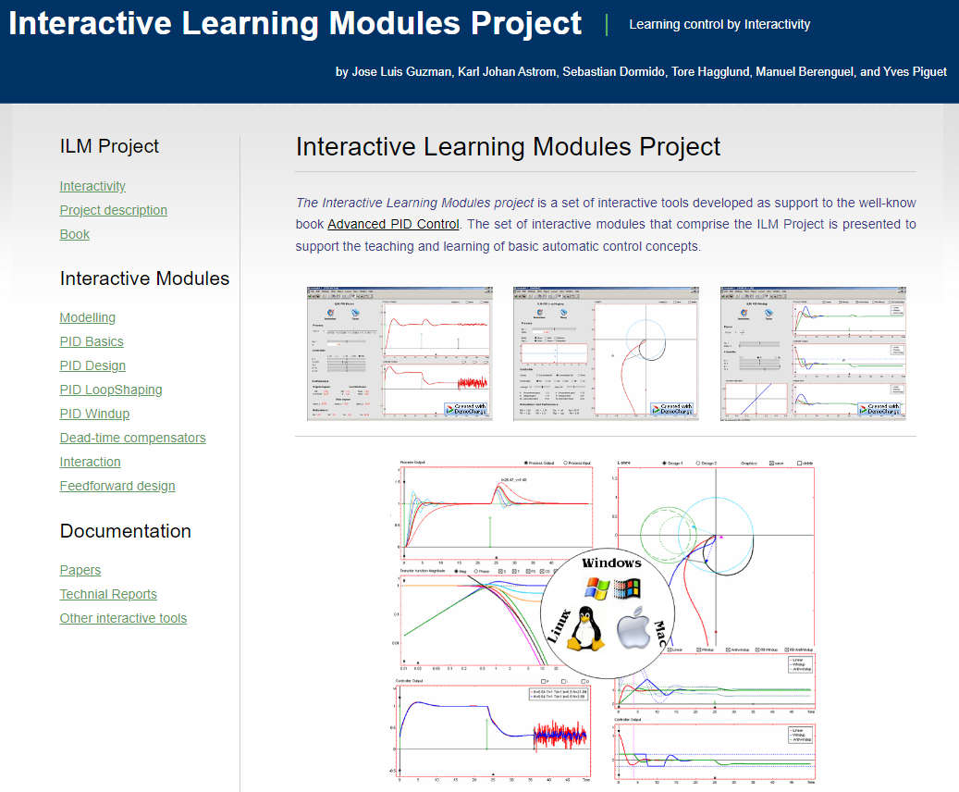
4. Interactivity and visualization in control education
Interactive Learning Modules (ILM project)
https://arm.ual.es/ilm/

Slide 16
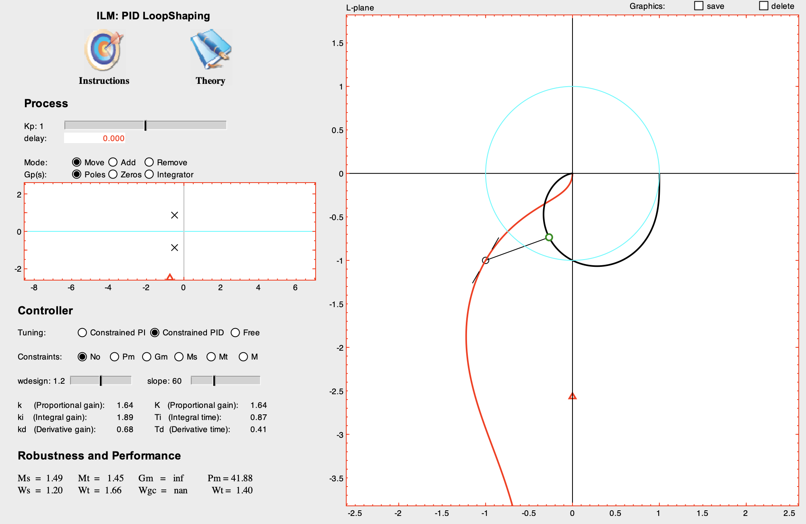
4. Interactivity and visualization in control education
Interactive Learning Modules: The concept of loop-shaping

Slide 17
4. Interactivity and visualization in control education
SISO-GPCIT: Interactive tool for the study of Generalized Predictive Control in single-input single-output systems (J. L. Guzmán, M. Berenguel, F. Rodríguez, S. Dormido). https://arm.ual.es/siso-gpcit/.
MIMO-GPCIT: Interactive tool for the study of Generalized Predictive Control in multiple-input multiple-output systems (J. L. Guzmán, M. Berenguel, S. Dormido). https://arm.ual.es/mimo-gpcit/.
MRIT: Interactive tool to explain fundamentals of mobile robotics (J. L. Guzmán, O. López, M. Berenguel, F. Rodríguez, S. Dormido). https://arm.ual.es/mrit/.
Filtered Smith Predictor interactive tool: A Unified approach for dead-time process control (J. E. Normey-Rico, J. L. Guzmán, S. Dormido, M. Berenguel, E. F. Camacho). https://arm.ual.es/interactiveFSP/.
ITCRI: Interactive tool for control relevant identification (J. D. Álvarez, J. L. Guzmán, D. E. Rivera, M. Berenguel, S. Dormido). https://arm.ual.es/ITCRI/.
ITSIE: Interactive tool for system identification education (J. L. Guzmán, D. E. Rivera, S. Dormido, M. Berenguel). https://arm.ual.es/ITSIE/.
ITCLI: Interactive Tool for closed-loop identification (J. L. Guzmán, D. E. Rivera, M. Berenguel, S. Dormido). https://arm.ual.es/ITCLI/.
SISO-QFTIT: Interactive tool for the study of Quantitative Feedback Theory (QFT) in single-input single-output systems (J. M. Díaz, S. Dormido, J. Aranda). https://www2.uned.es/itfe/QFTIT/.
i-pIDtune: Interactive tool for integrated system identification and PID control (J. L. Guzmán, D. E. Rivera, M. Berenguel, S. Dormido). https://arm.ual.es/i-pidtune/.
ITTSAE: Interactive tool for time series analysis education (J. M. Díaz, S. Dormido, D. E. Rivera). https://www2.uned.es/itfe/ITTSAE/ITTSAE.html.
ITTSAE-TSG: Interactive tool for time series analysis education - Time series generator (J. M. Díaz, R. Costa-Castelló, S. Dormido). https://www2.uned.es/itfe/ITTSAE/ITTSAE_TSG.html.
ITTSAE-TSA: Interactive tool for time series analysis education - Time series analyser (J. M. Díaz, R. Costa-Castelló, S. Dormido). https://www2.uned.es/itfe/ITTSAE/ITTSAE_TSA.html.
LCSD: Interactive tool for linear control system design (J. M. Díaz, R. Costa- Castelló, S. Dormido). https://www2.uned.es/itfe/LCSD/LCSD.html.
ITCLSD: Interactive tool for closed loop shaping linear control design (J. M. Díaz, R. Costa-Castelló, S. Dormido). https://www2.uned.es/itfe/ITCLSD/ITCLSD.html.
RCLSD: Interactive tool for robust closed-loop shaping linear control systems design (J. M. Díaz, R. Costa-Castelló, S. Dormido). https://www2.uned.es/itfe/RCLSD/RCLSD.html.
SMCITOOL: Interactive tool for teaching, analyzing, designing and interactively simulating sliding mode control (R. Costa-Castelló, N. Carrero, S. Dormido, E. Fossas). https://sites.google.com/site/ramoncostacastello/smcitool.

Slide 18
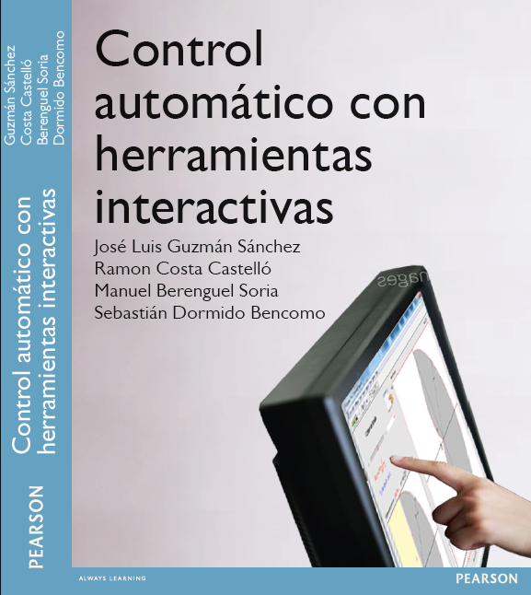
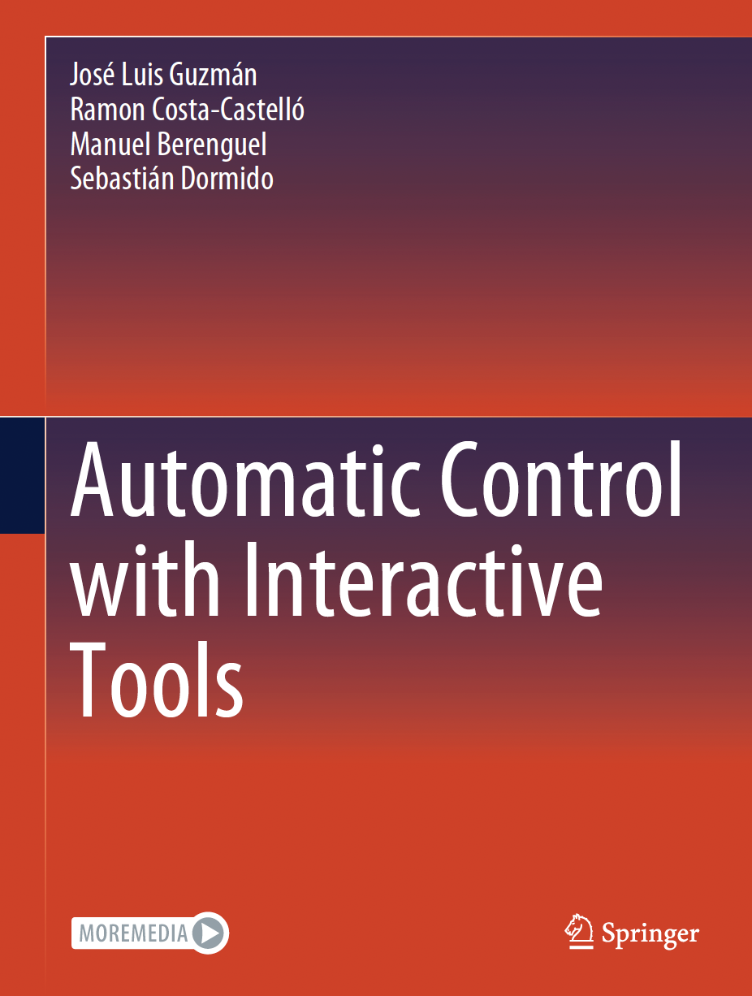
5. Automatic Control with Interactive Tools
5. The interactive card project

Slide 19
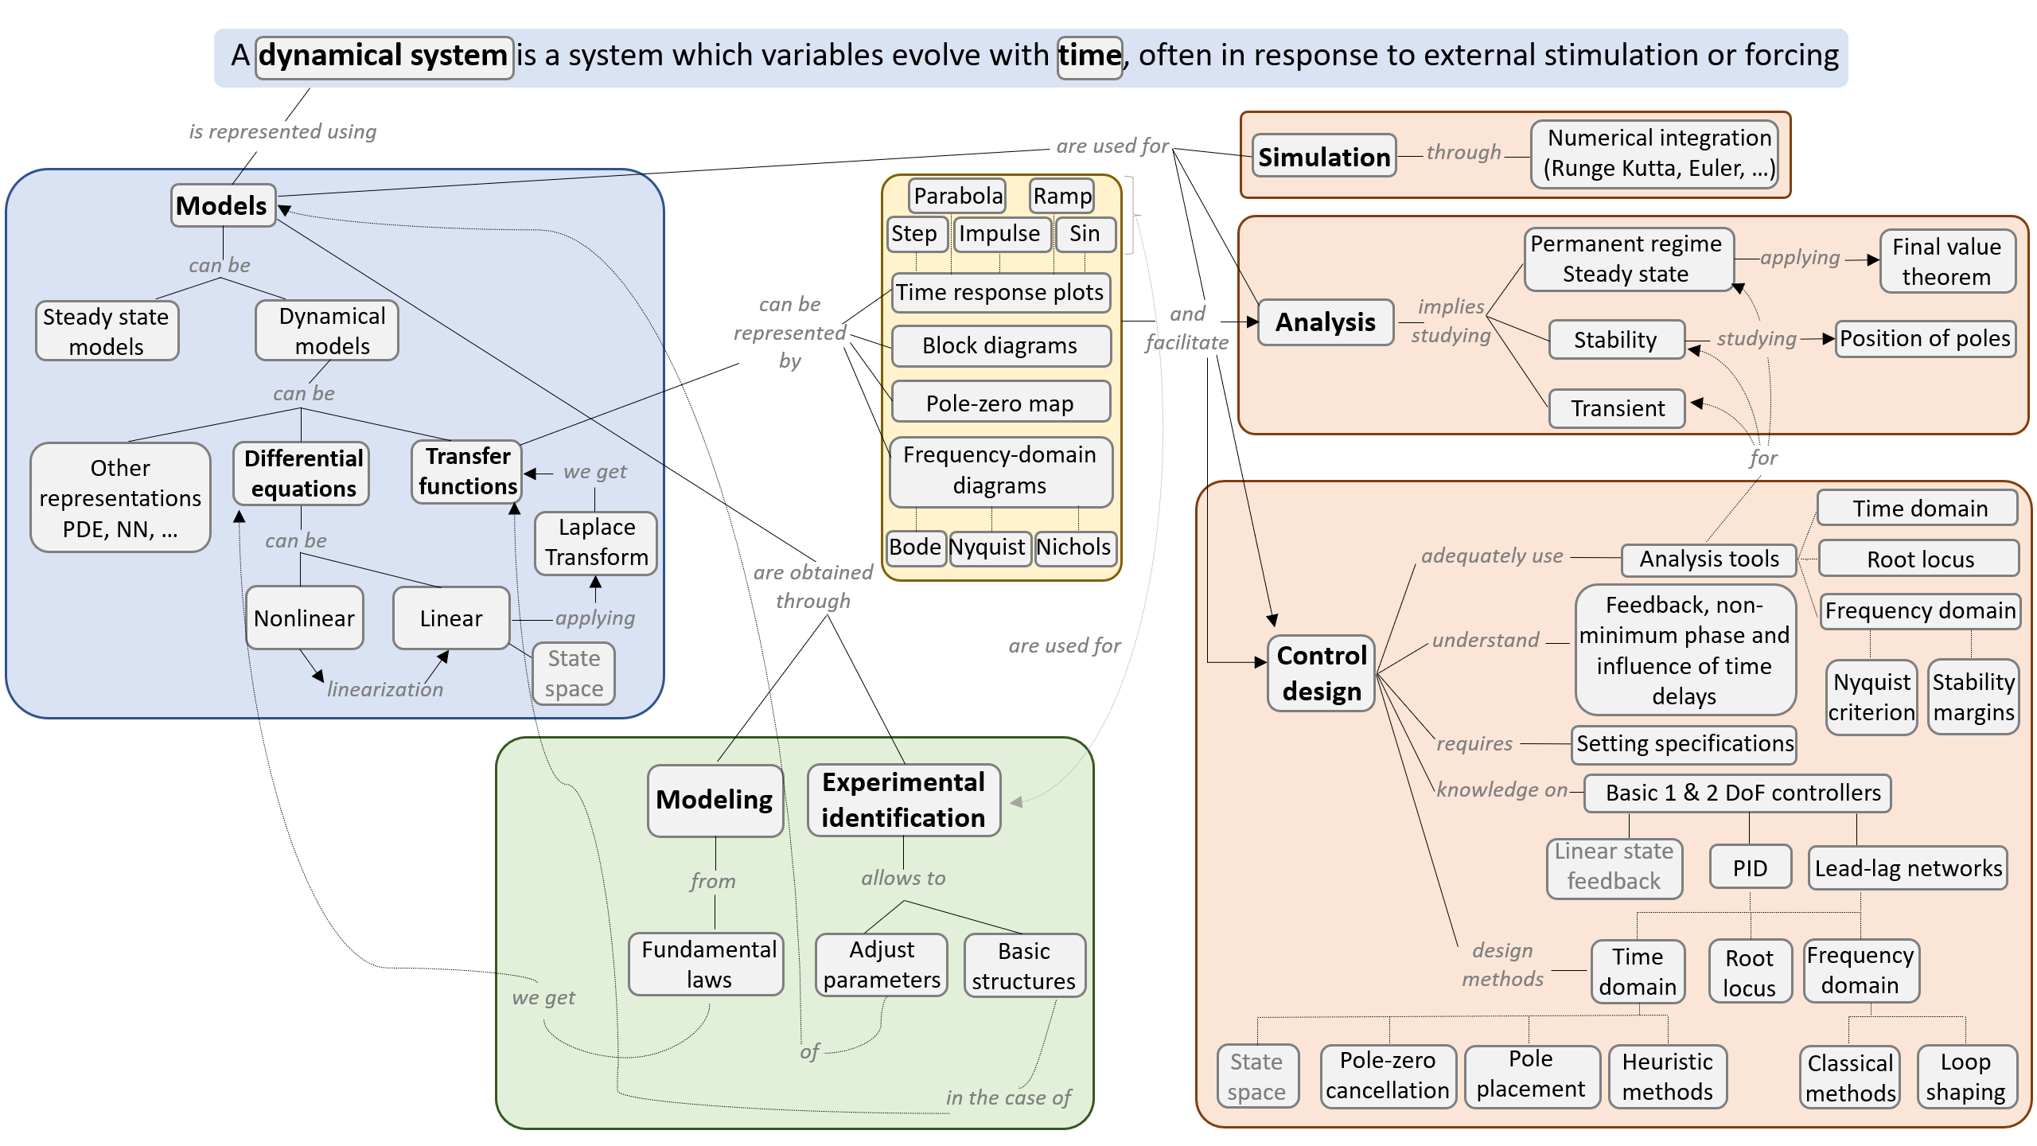
5. Automatic Control with Interactive Tools (Conceptual map)

Slide 20
5. Automatic Control with Interactive Tools
Part I About interactivity and main objectives of the book
Part II Open-loop analysis
Introduction
From nonlinear physical models to linear models
Time response
Frequency response
Relationship between model parameters with physical models
Problems on open-loop analysis
Part III Closed-loop analysis and design
Closed-loop systems and stability
Control systems design
Control of physical systems
Problems on closed-loop analysis and design
References

Slide 21
5. Automatic Control with Interactive Tools
Objectives of the book
The objective we set ourselves was that it could be used as a vehicle through which to explain basic concepts of an introductory course in automatic control and facilitate learning for the newcomer. This generic objective was specified in a series of premises that we considered essential from the outset:
Simplicity. The tools should be simple and focus on the specific concept to be transmitted, without overloading their content. The virtue of simplicity is therefore a priority objective.
Uniformity. The tools must share a structure in their visual aspect that identifies them as belonging to the same family.
Self-contained. Each card can be accessed as an independent study unit that provides all that is necessary for its learning.

Slide 22
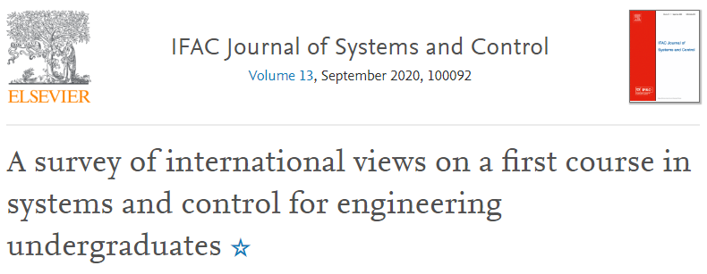
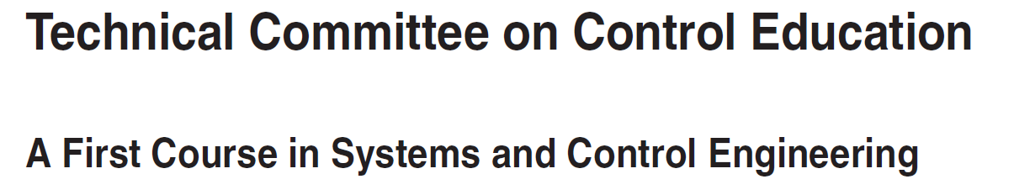

5. Automatic Control with Interactive Tools
Focus of the book
The focus of the book are aligned with the recent study led by the IEEE and IFAC Technical Committees on Control Education, where some important reflections are made based on a survey made along the world both for academia and industry with 500 participants.

Slide 23
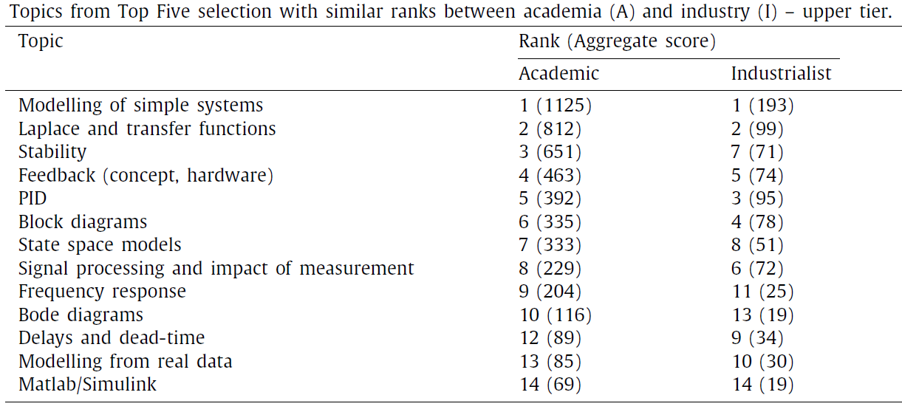
5. Automatic Control with Interactive Tools
Treated in the book
Focus of the book
*
* State space for 2nd order in supplementary material

Slide 24
5. Automatic Control with Interactive Tools
Treated in the book
3.3.1. Signal processing
Delays and deadtime
Low Pass Filters
3.3.2. Identification and modeling
Modelling of simple, 1st and 2nd order systems
Block diagrams
Laplace and transfer functions
Models with integrating response
State space models
3.3.3. System analysis
Stability
Frequency response
Bode diagrams
Bode diagrams, gain/phase margins
Nyquist diagrams
Nyquist stability criteria
3.3.4. Control design
Feedback loop concepts, definitions, and hardware components
PID
Control loop requirements
Control performance
Disturbances
Design with frequency response
Several topics received significantly higher scores by industry than by academia. These topics are:
Feedforward
Lead and lag
Measurement noise
Wind-up and anti-windup
On–off control.
*
*State space for 2nd order in supplementary material
Tools for other approaches

Slide 25
5. Automatic Control with Interactive Tools
Interactive tools developed in the book
Controlling Physical Systems
Time Response
Closed-loop Systems: Stability
The tank system.
The circular tank system
The ball and beam system
The DC motor
The inverted pendulum
First order system without zeros
Second order system without zeros
First order system with zeros
Second order system with zeros
Time response in generic systems
Time response dominance
Fitting models from experimental data
Root locus
Nyquist criteria
Concept of stability margins
Delay limitations
Control System Design
From Nonlinear to Linear Models
Steady state
Concept of PID controller
Concept of lead-lag controller
Lag controller
Lead controller
Lead/Lag controller
PI design: lambda method
PI design: pole placement
PID design: Ziegler-Nichols
PI loop-shaping
The tank system.
The circular tank system
Frequency Response
Concept of frequency response
First order system without zeros
Second order system without zeros
First order system with zeros
Second order system with zeros
Frequency response in generic systems
Concept of non minimum phase system
Fitting models from experimental data
Relationship between model pa-rameters with physical models
The tank level system transfer function.
Variable section tank level system transfer function
.
Linear Control System Design (LCSD)
Notes:
25
Information handling: remote access, bigger availability, and above all, Interactivity

Slide 26
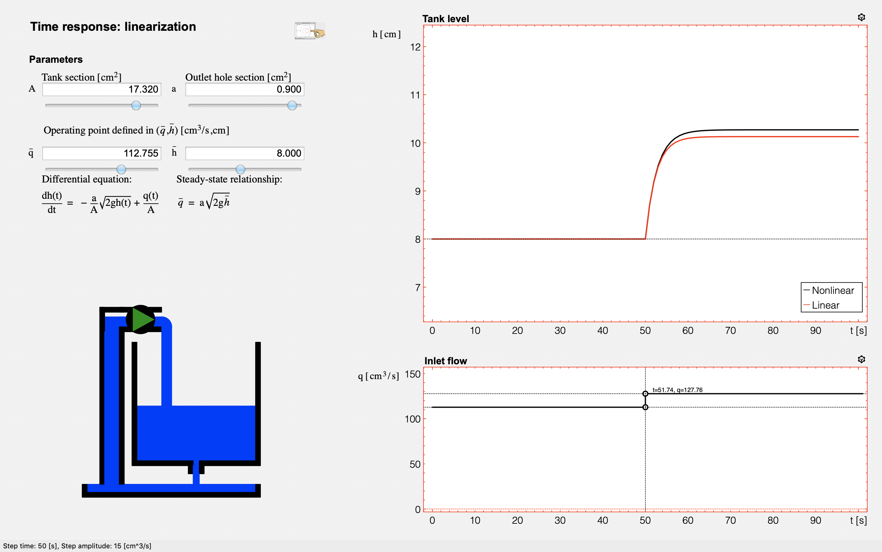
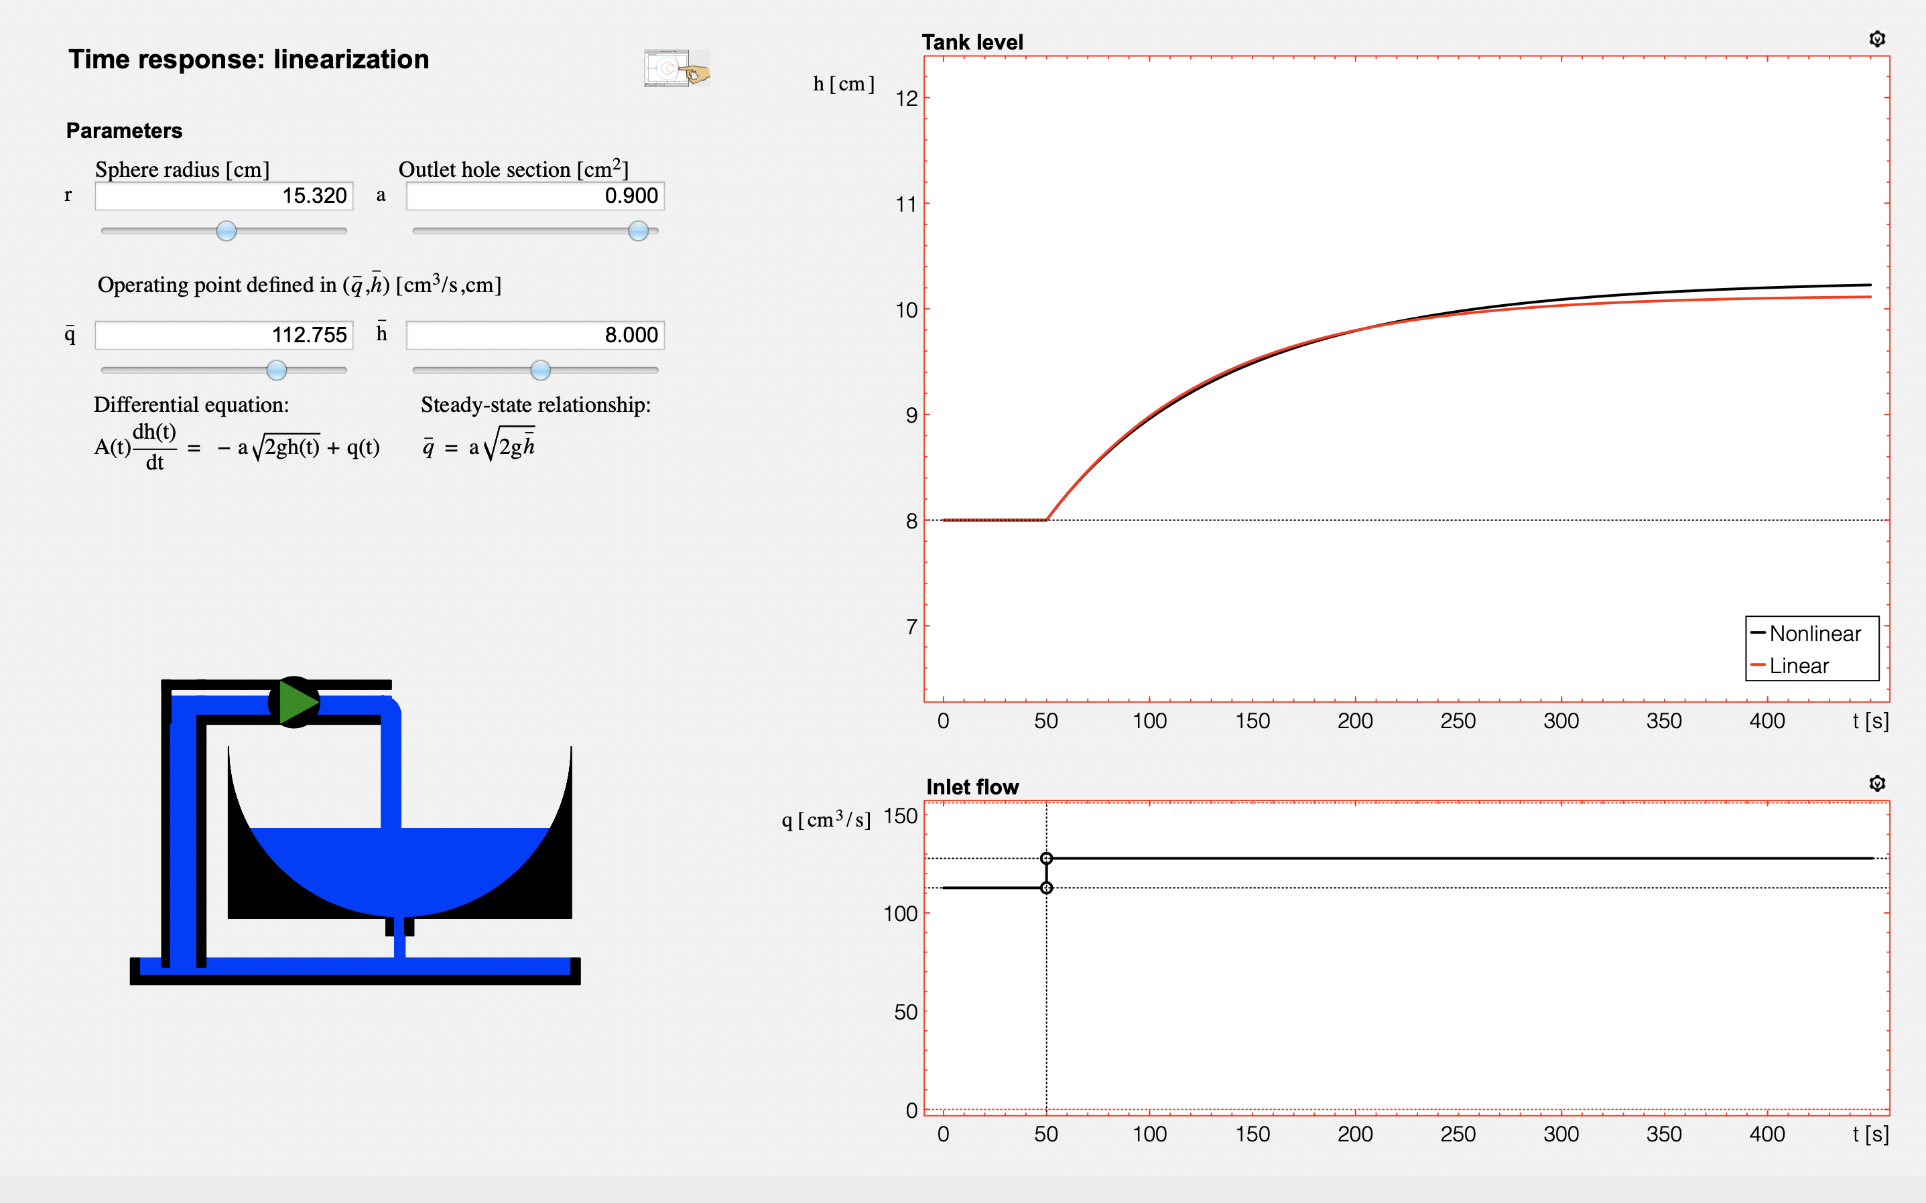
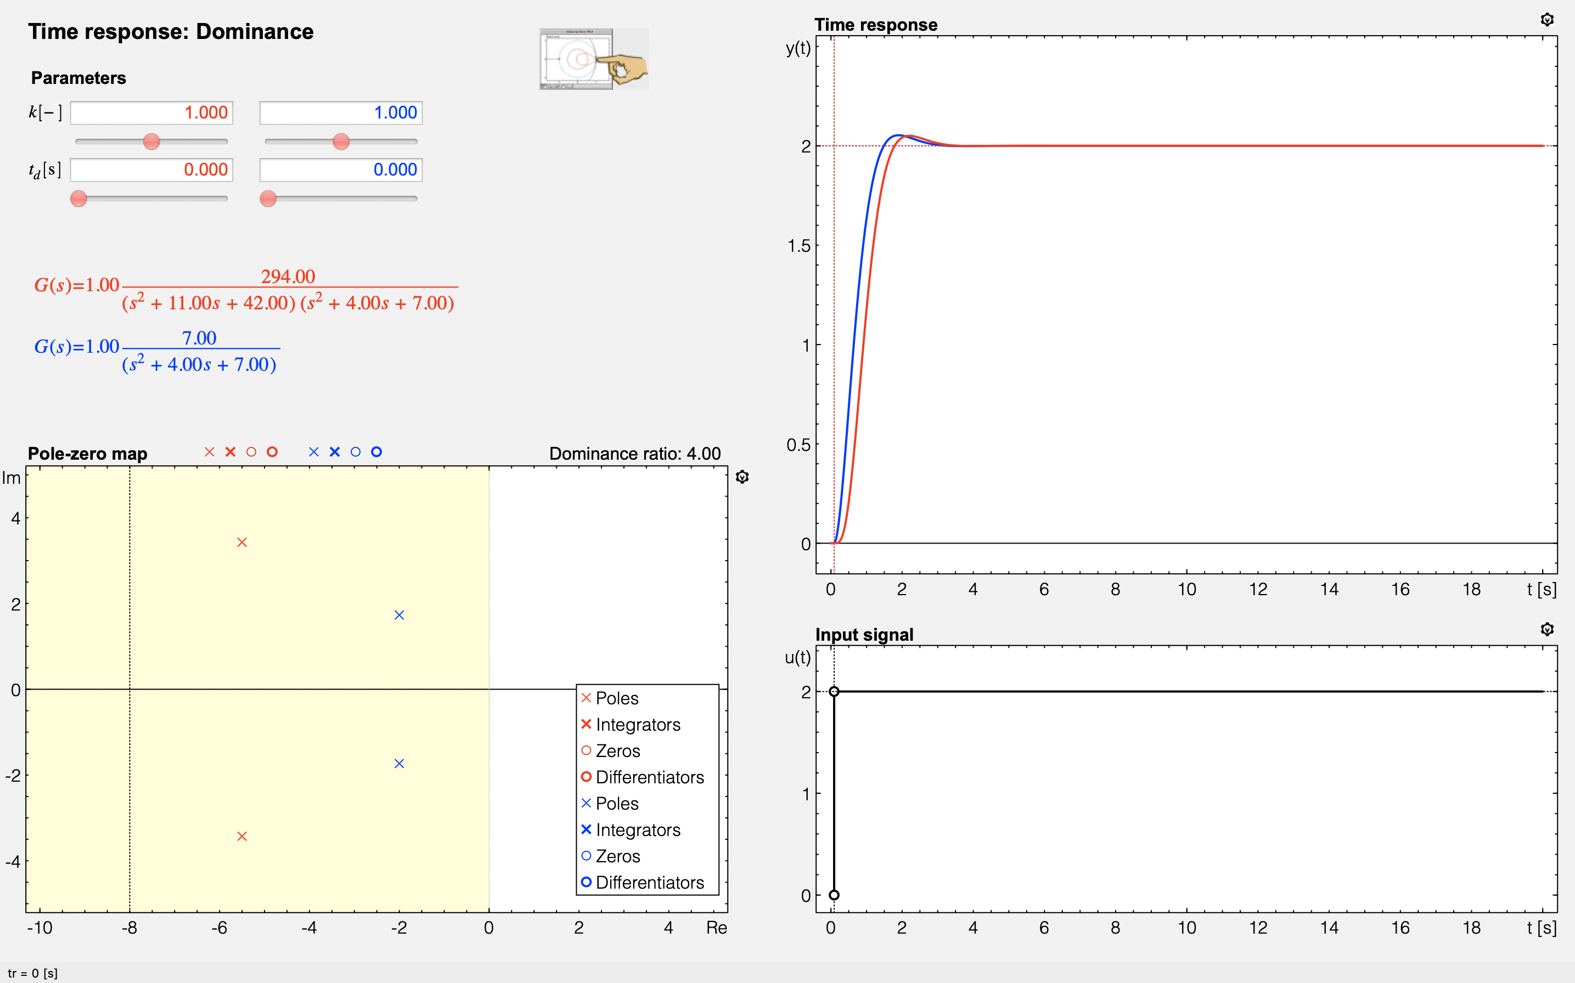
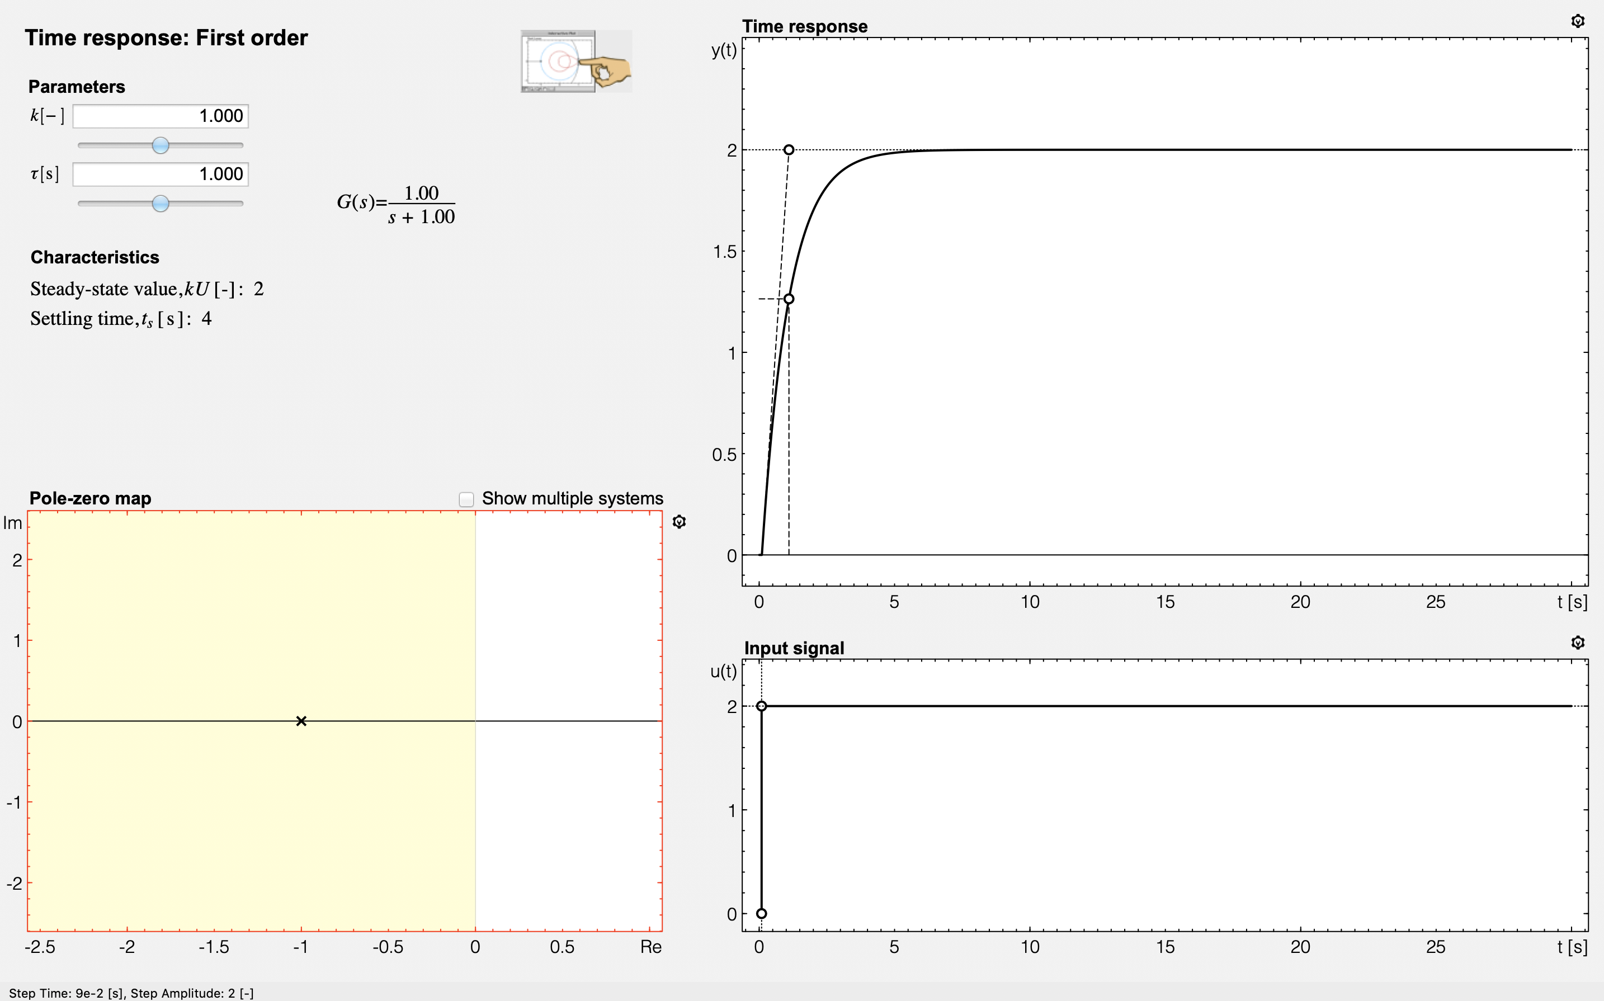
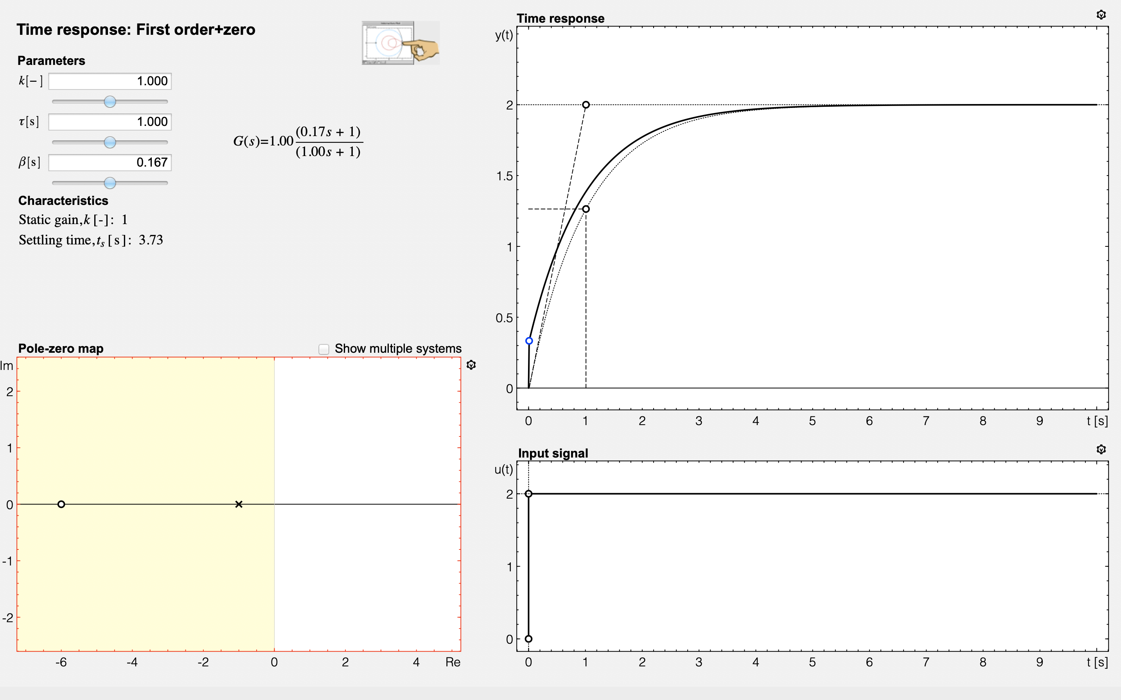
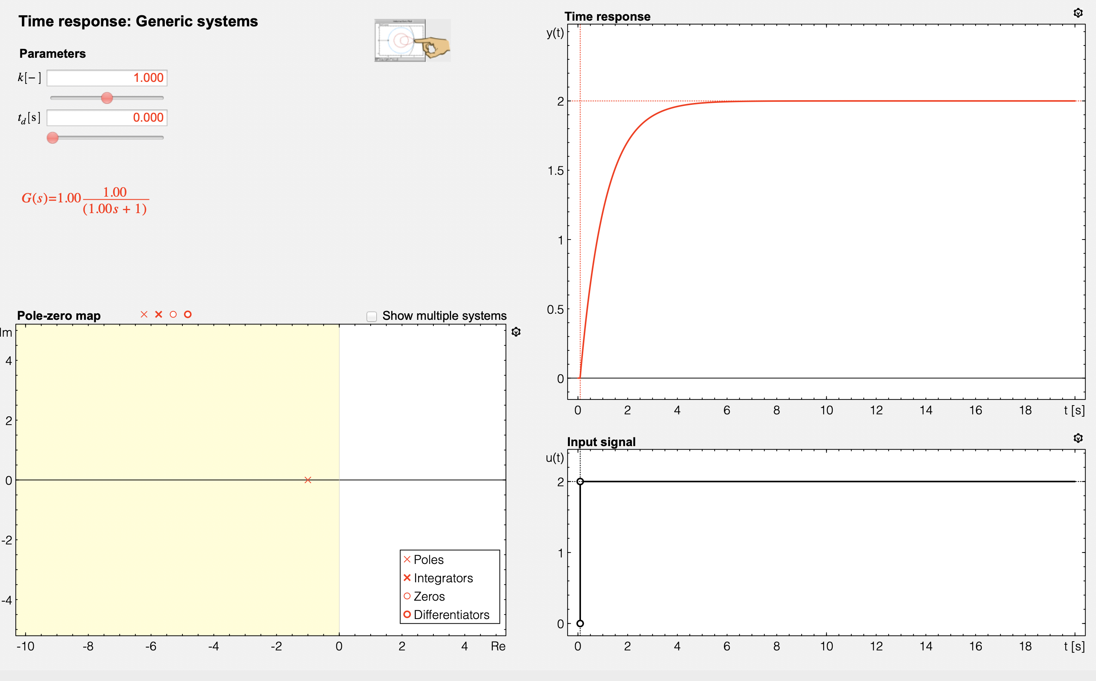
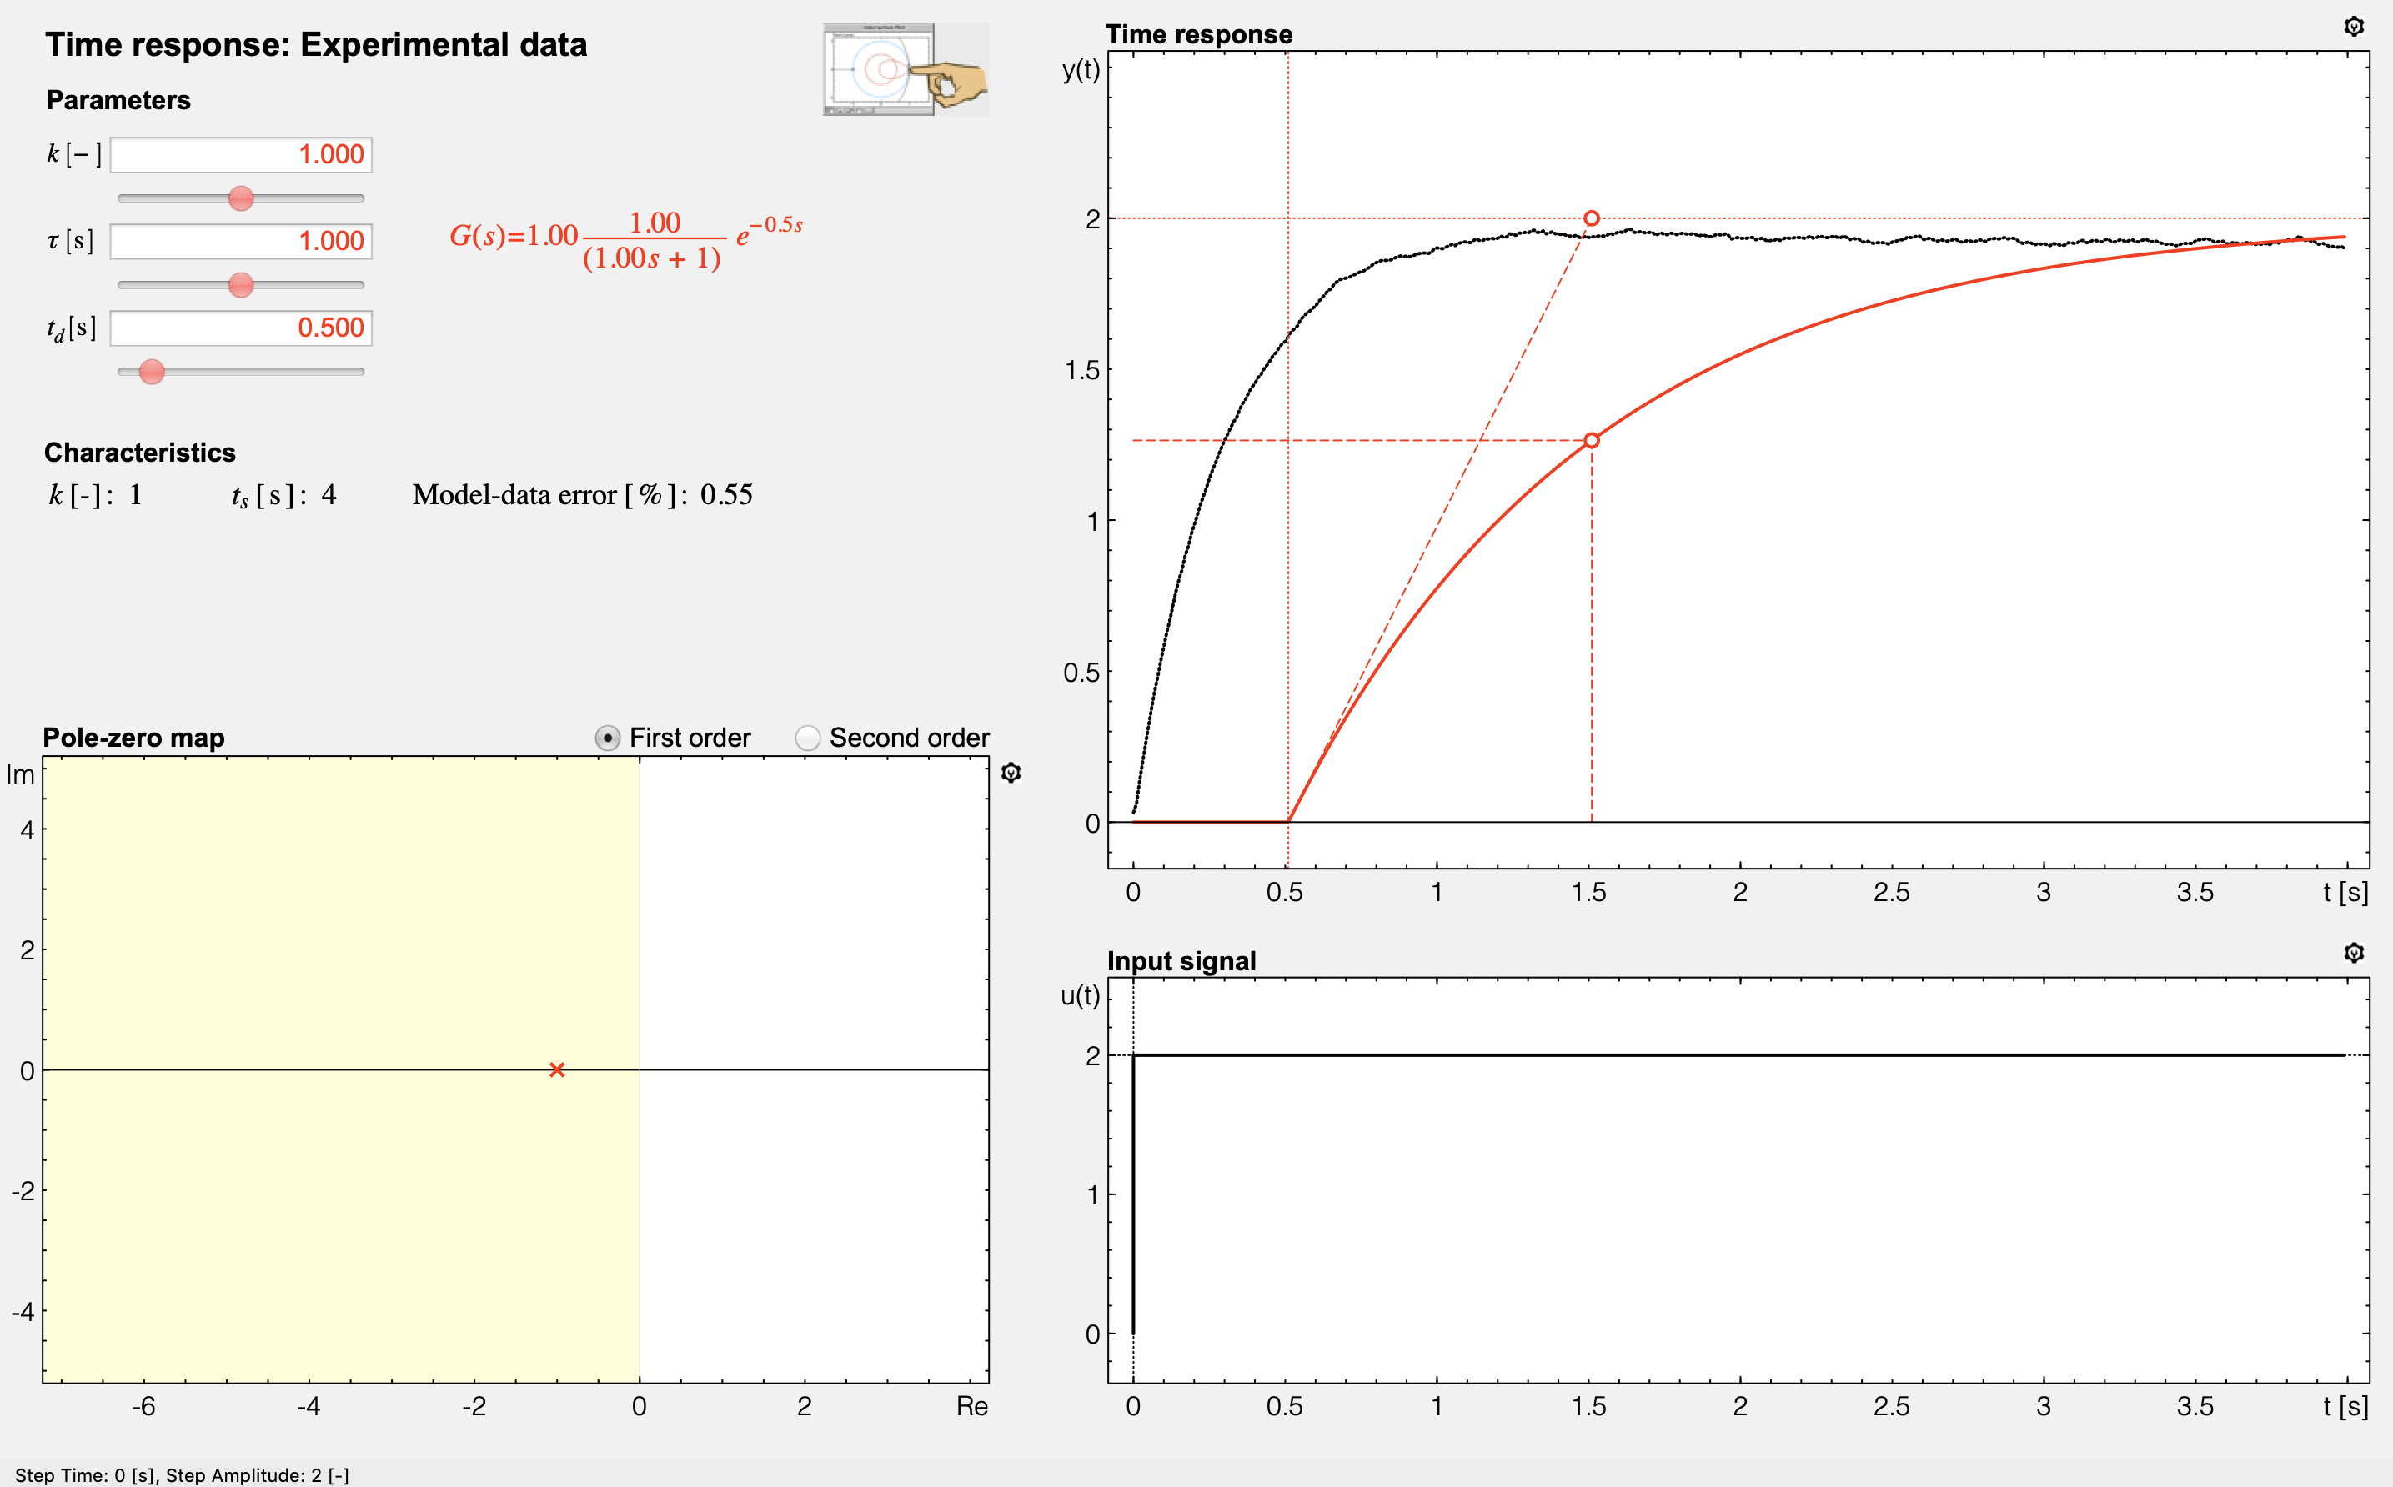
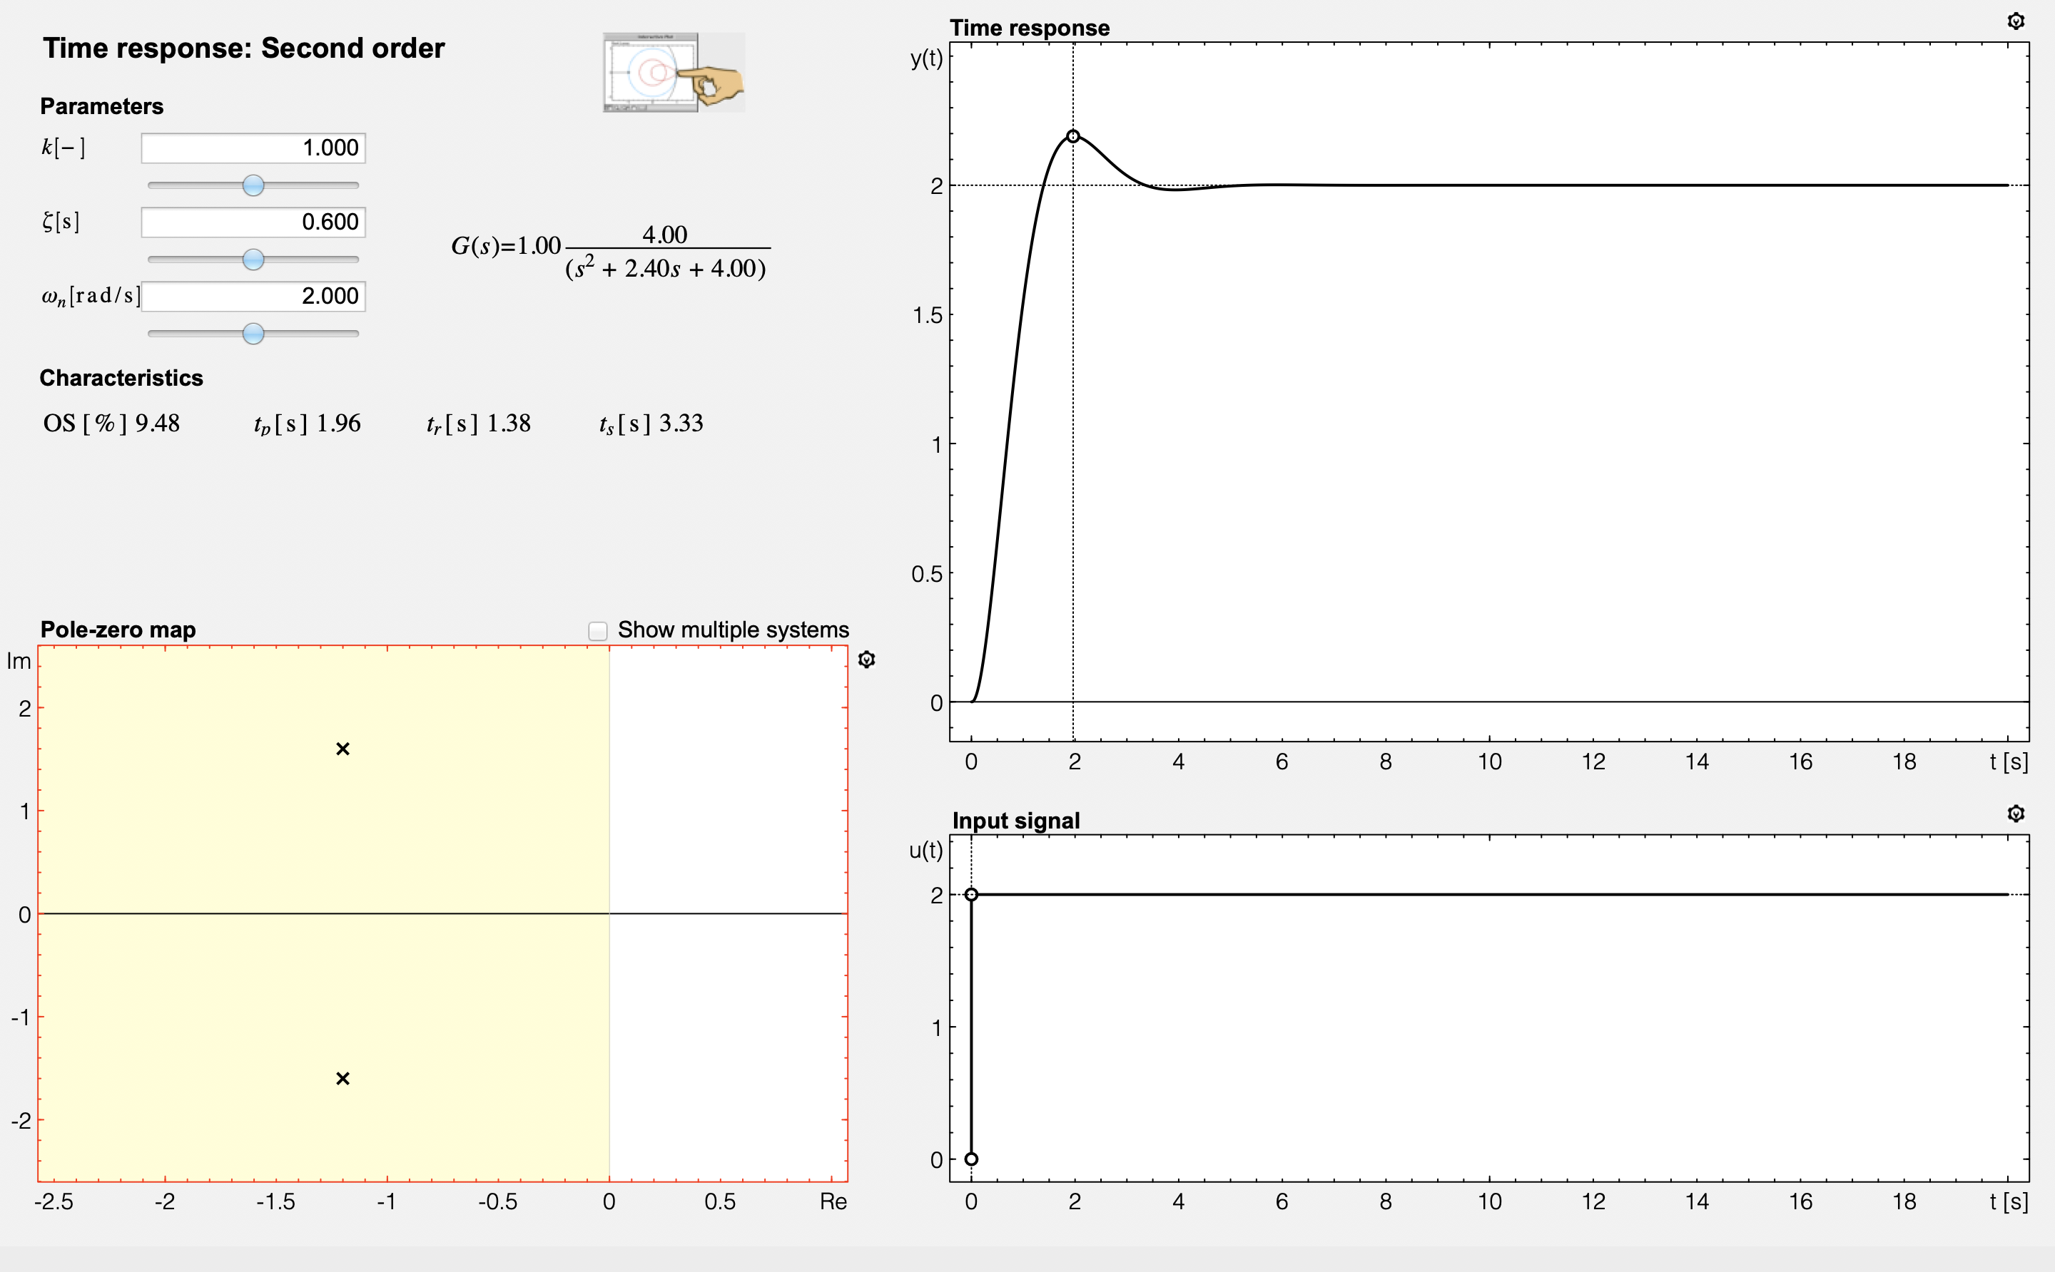
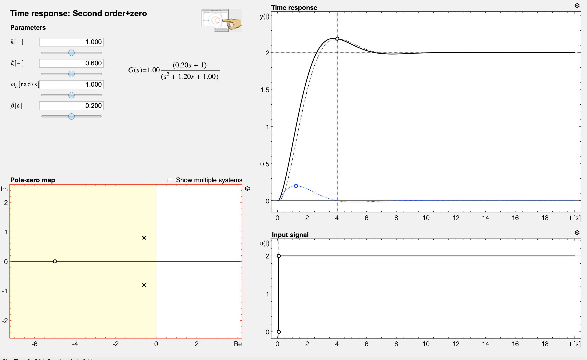
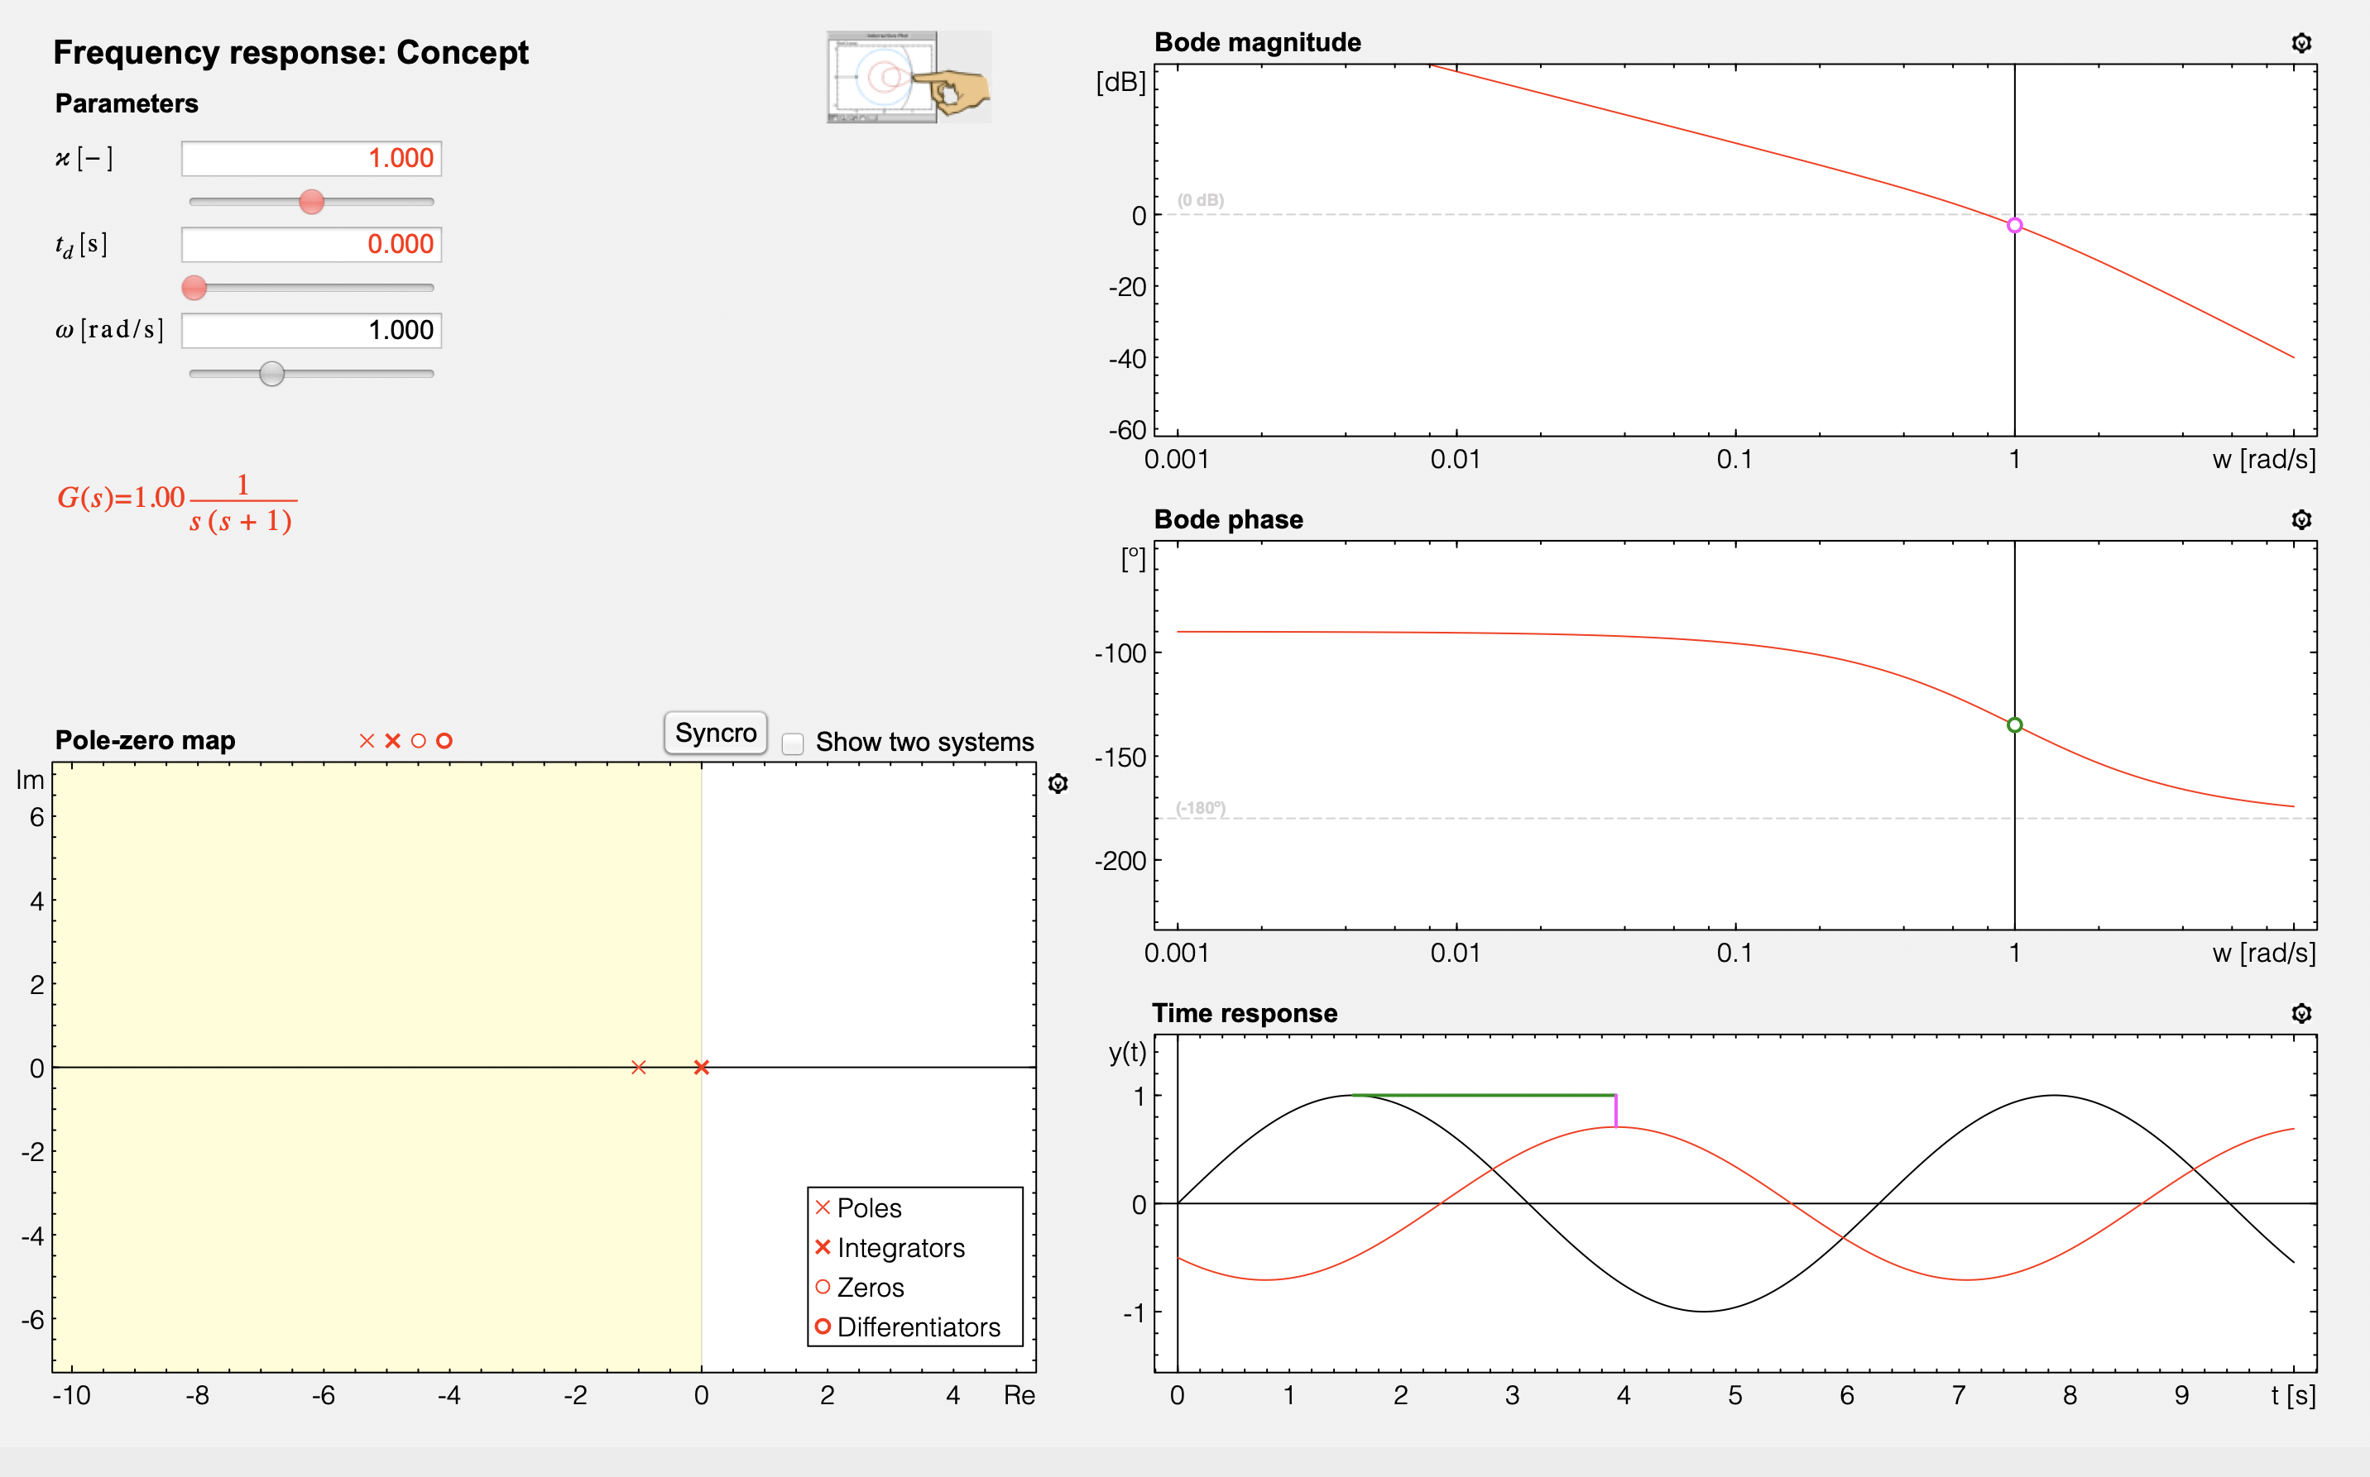
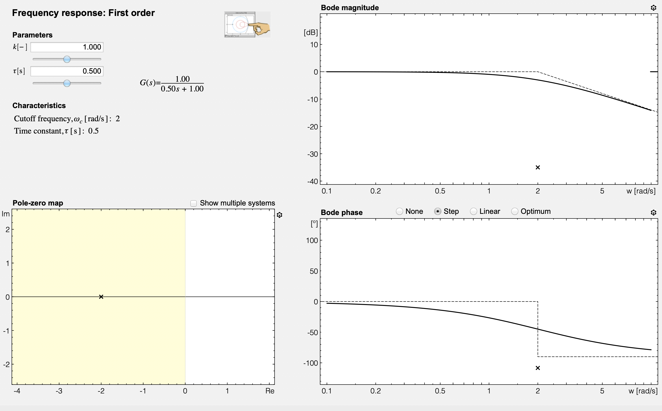
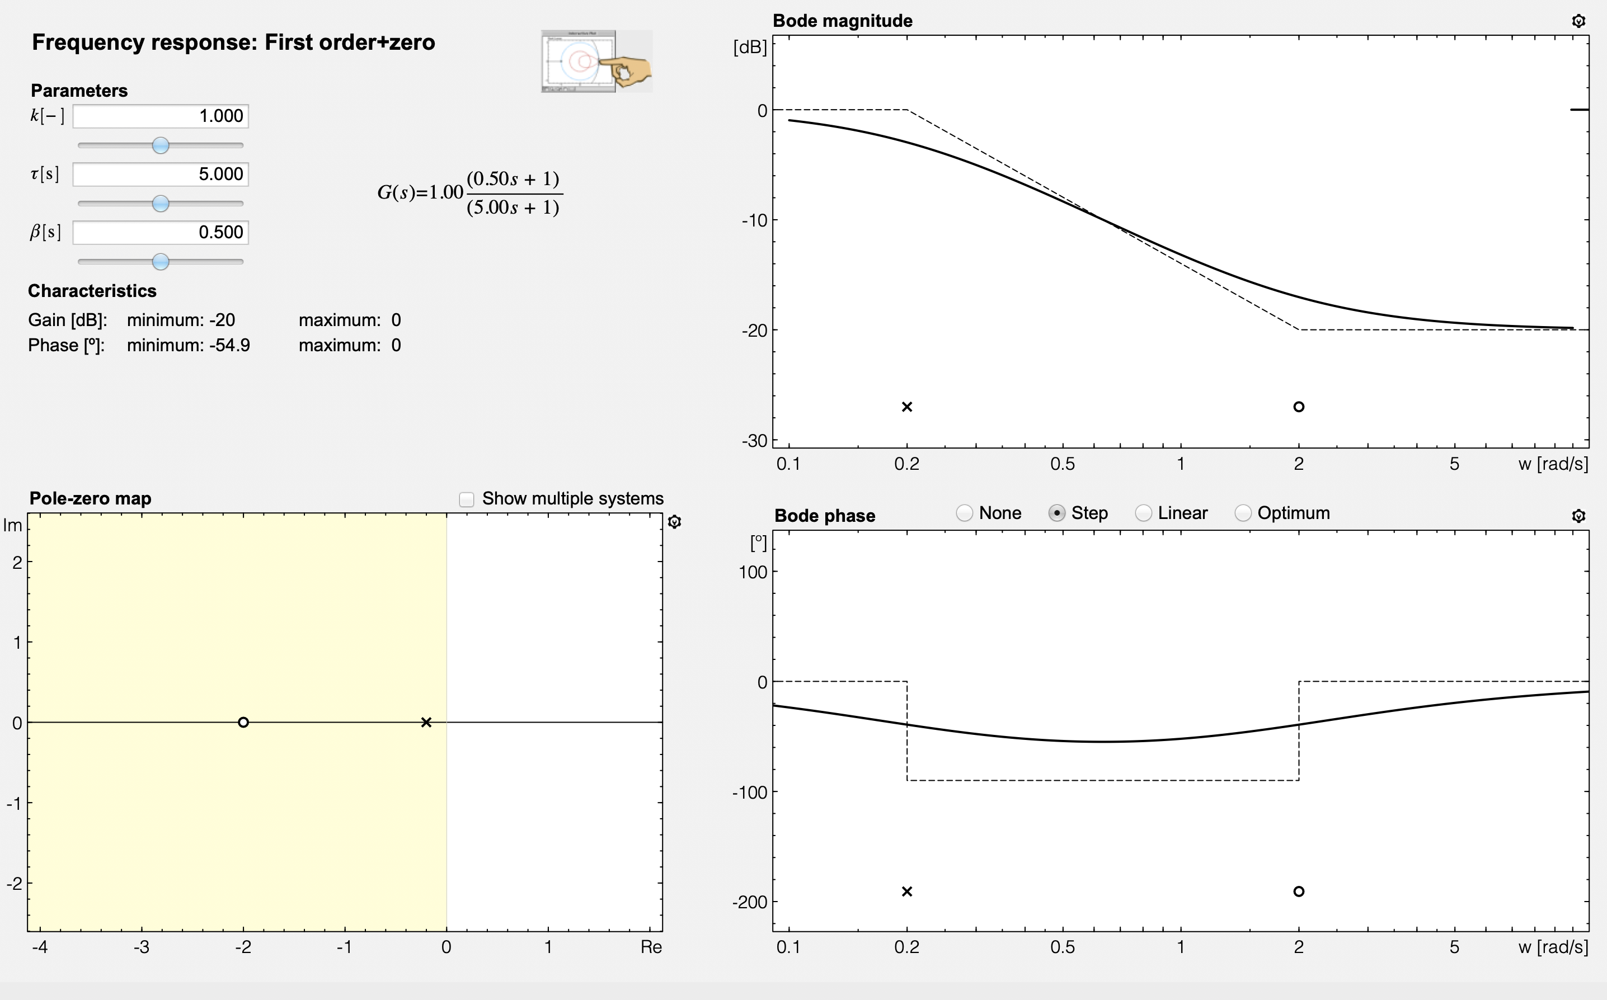
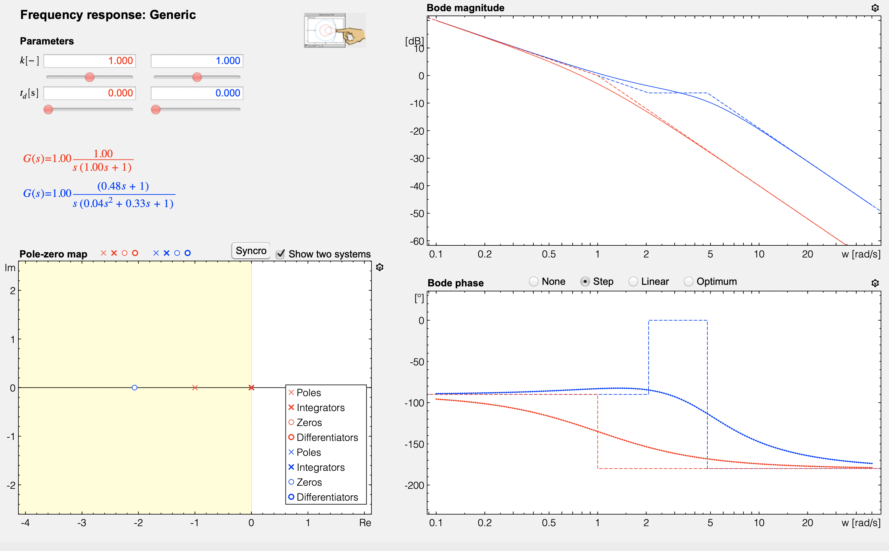
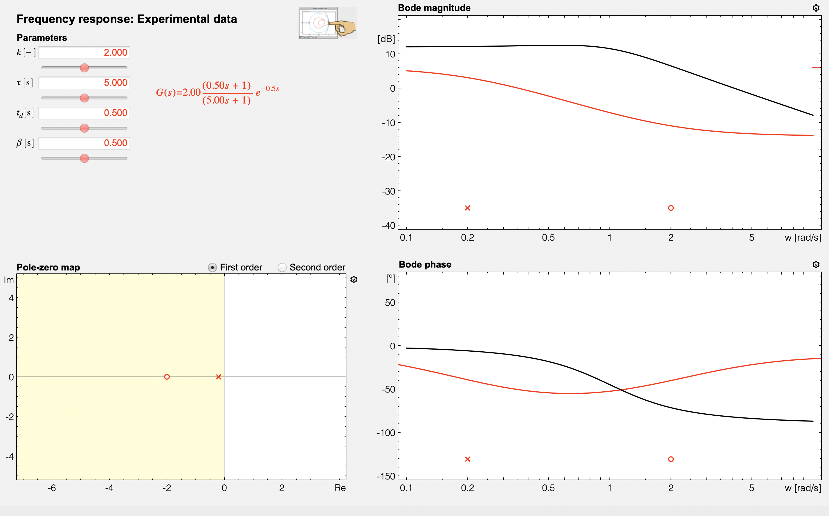
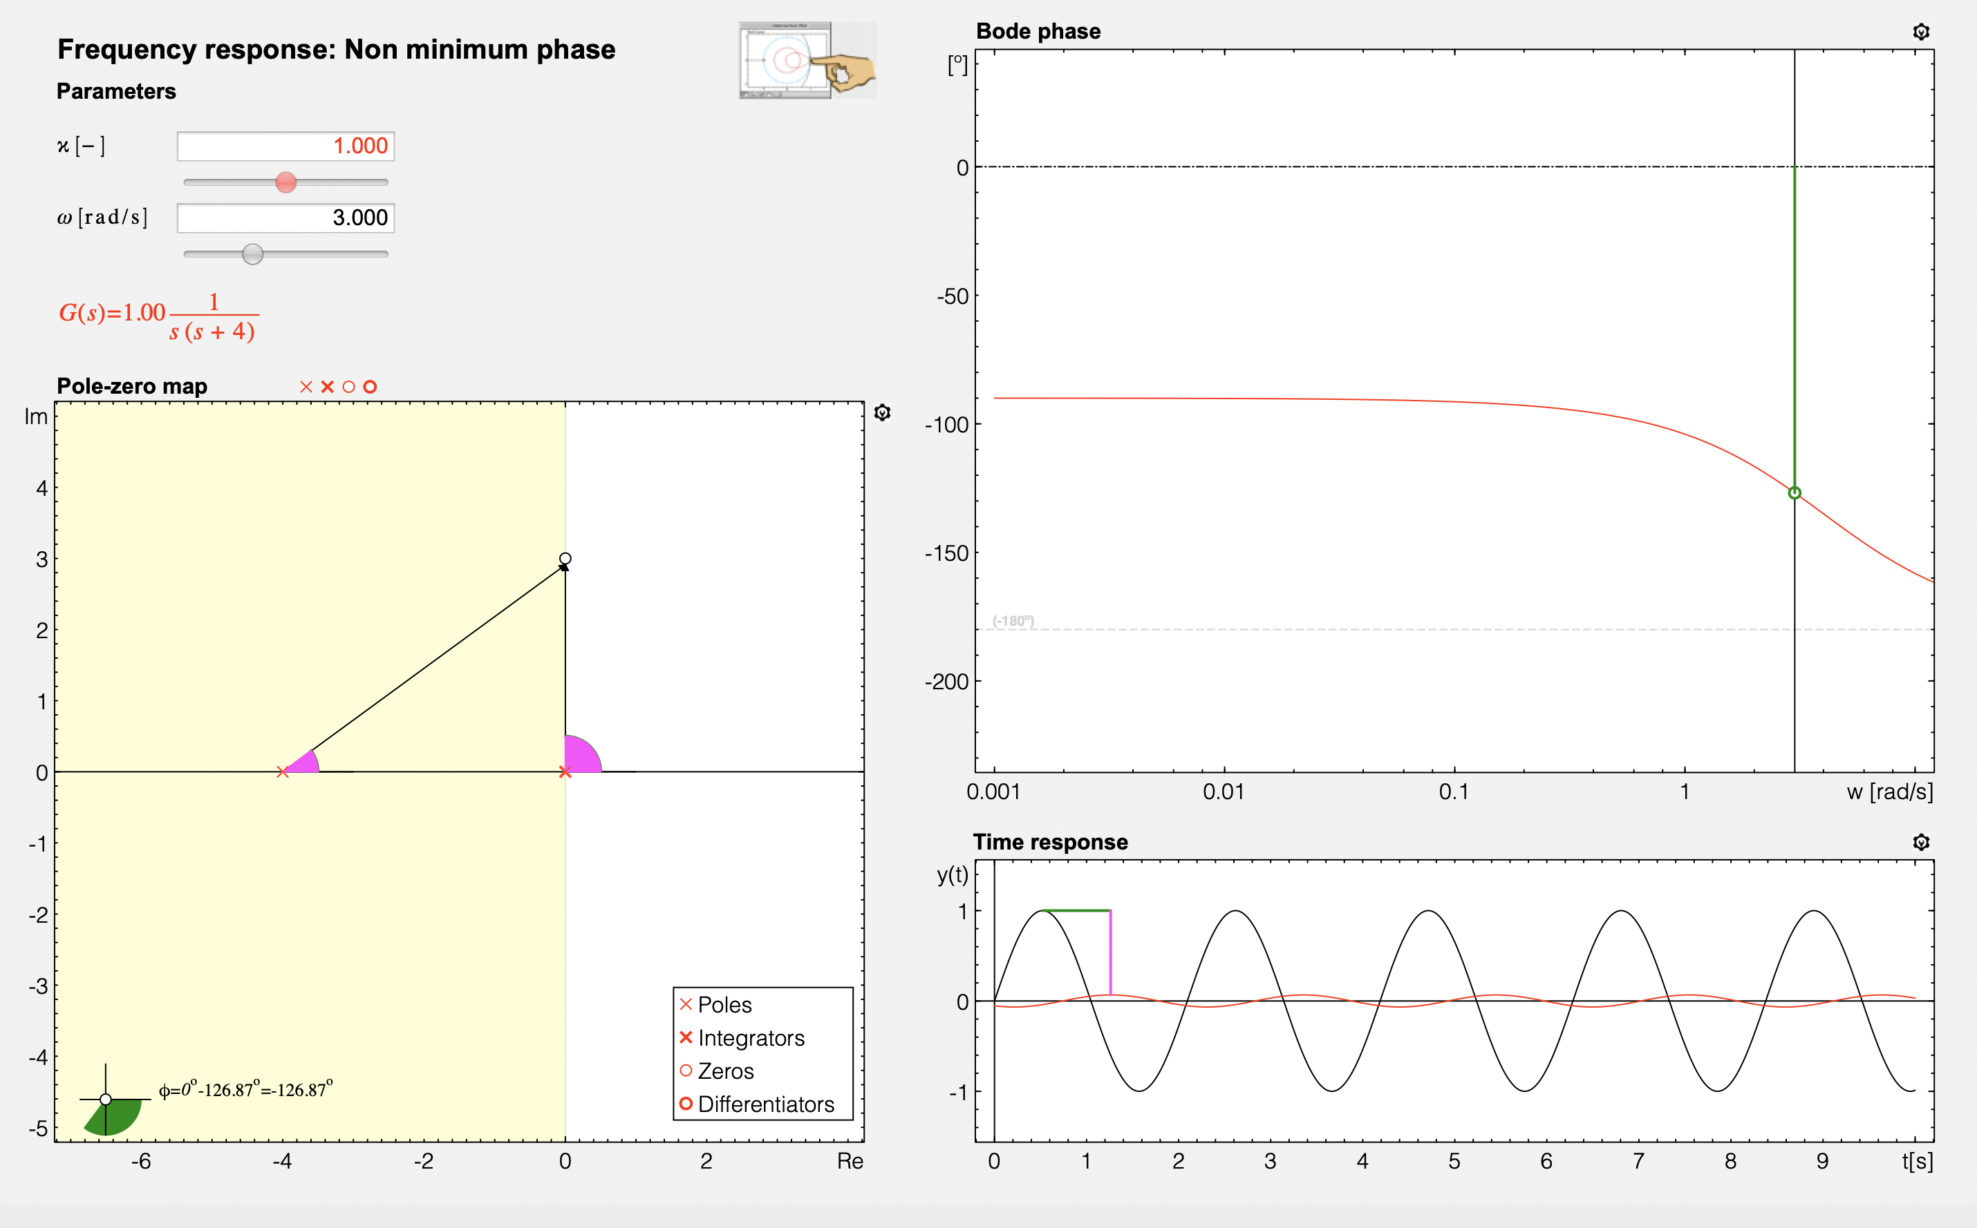
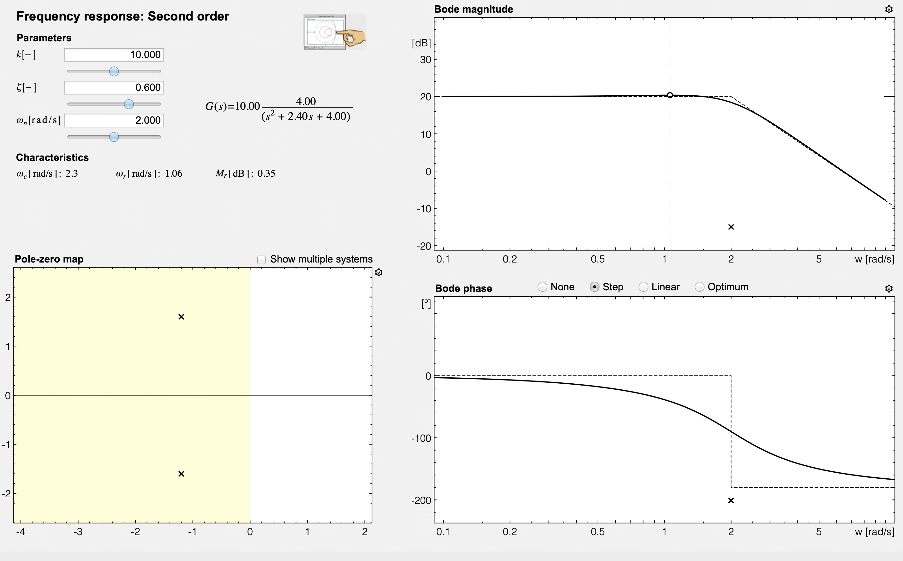
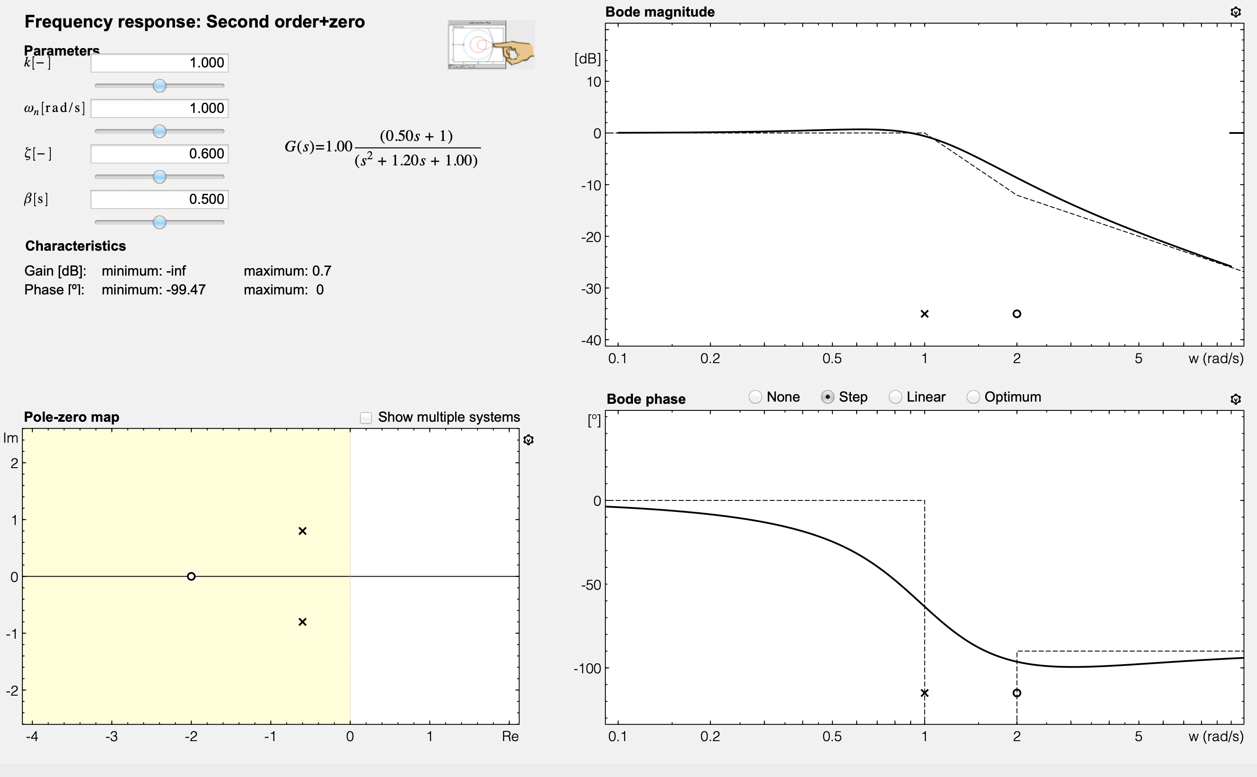
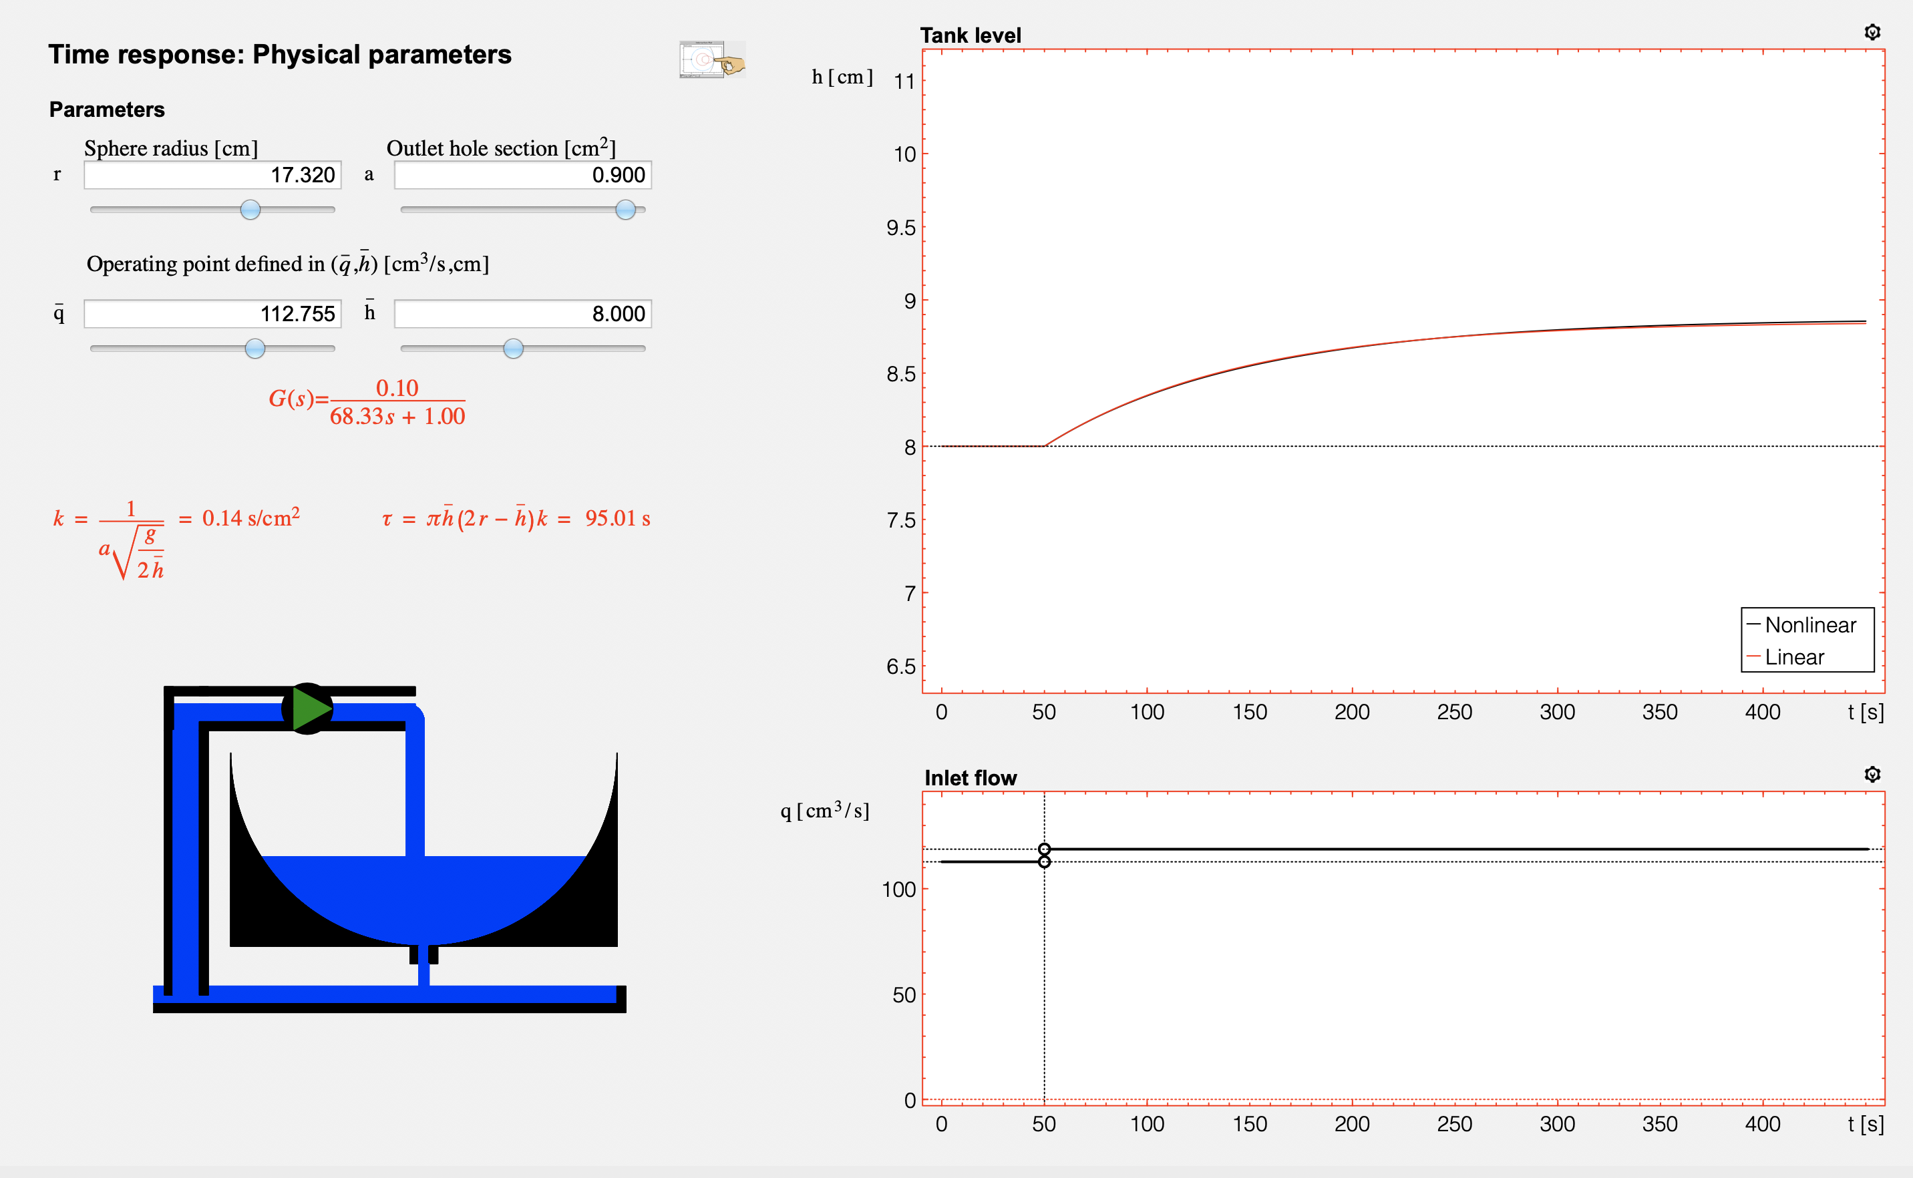
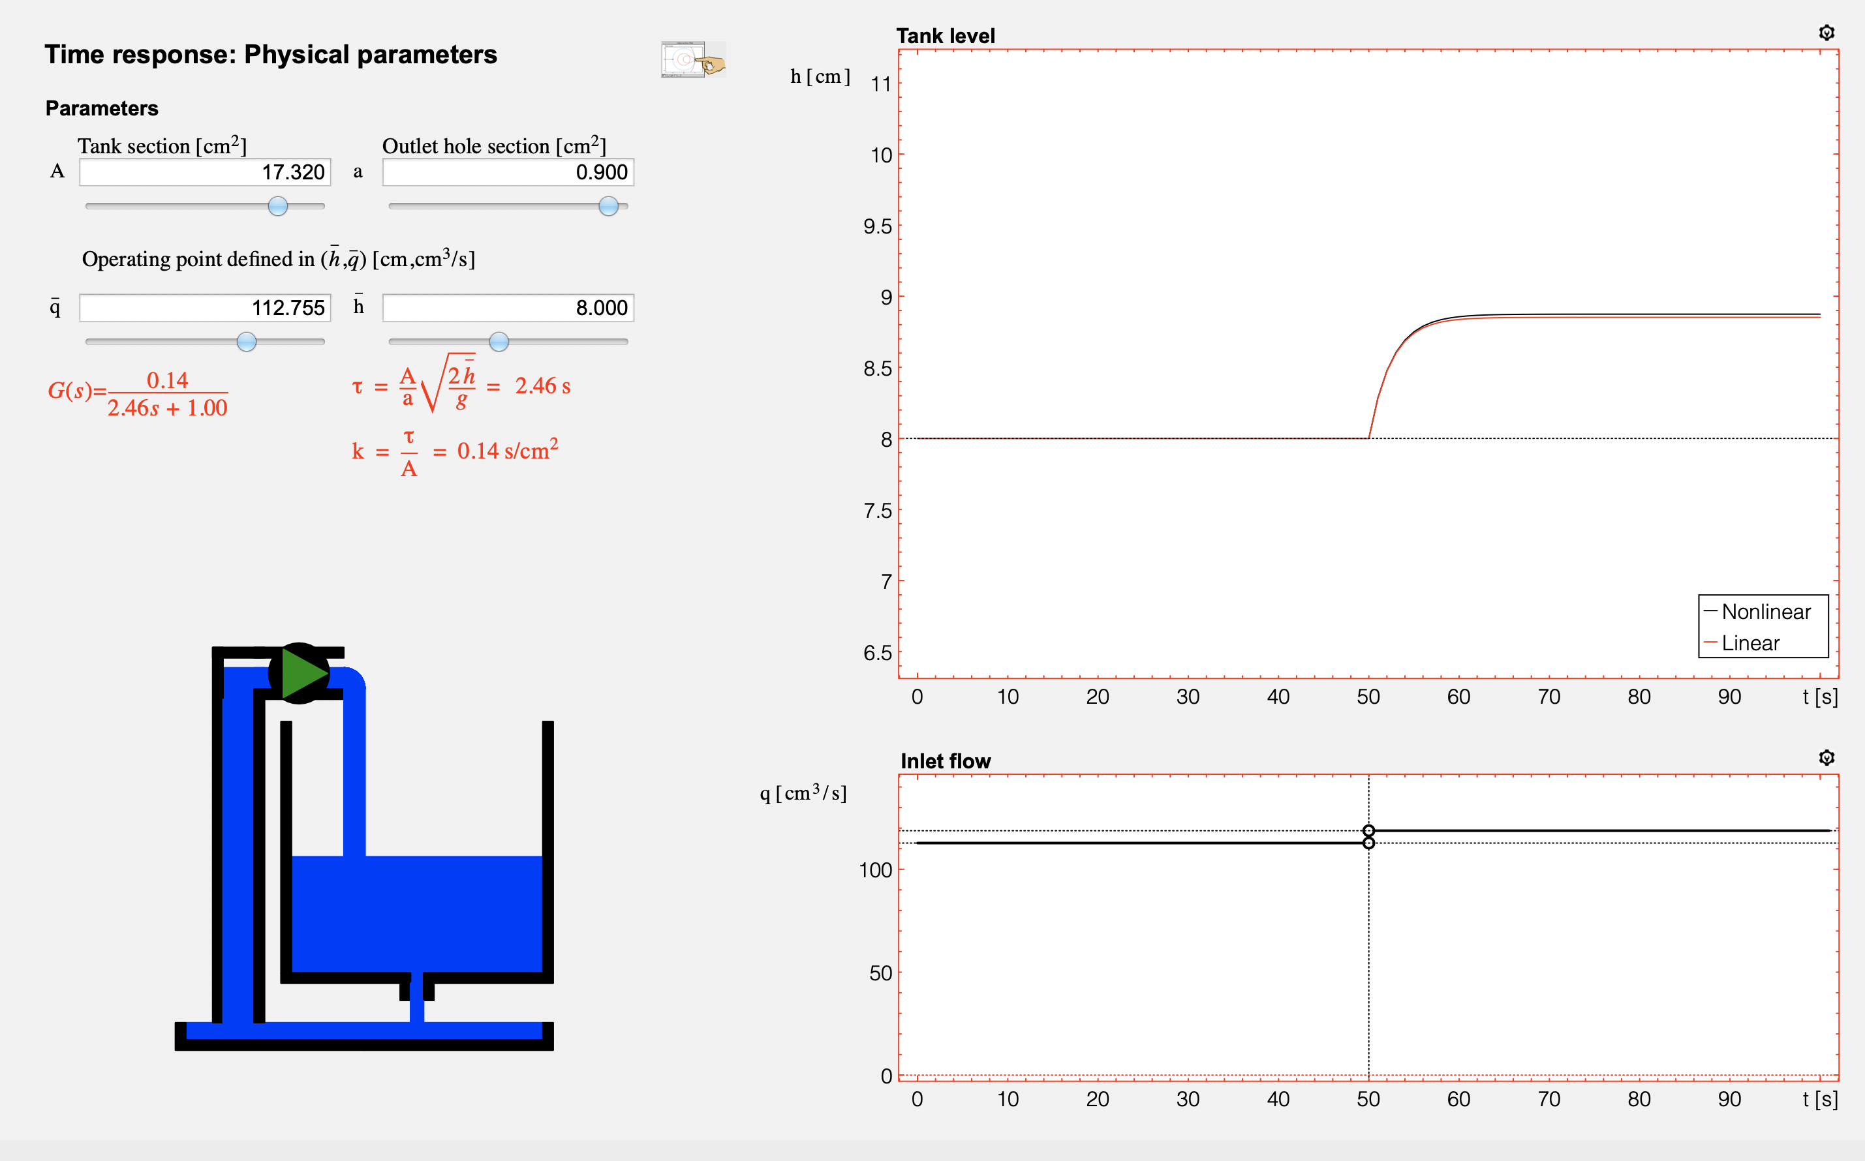
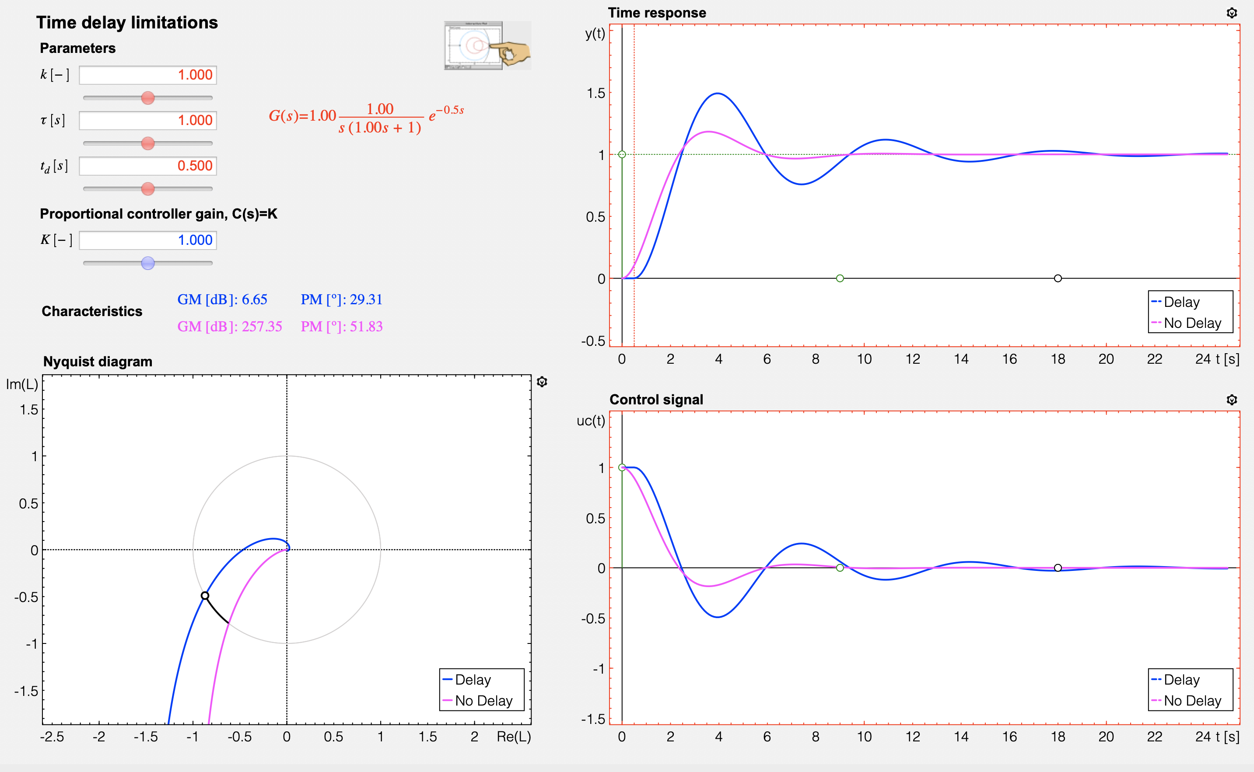
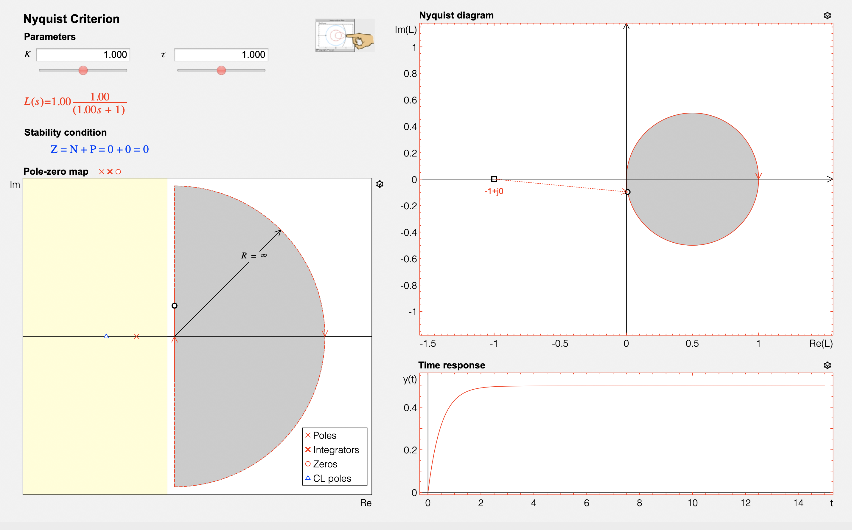
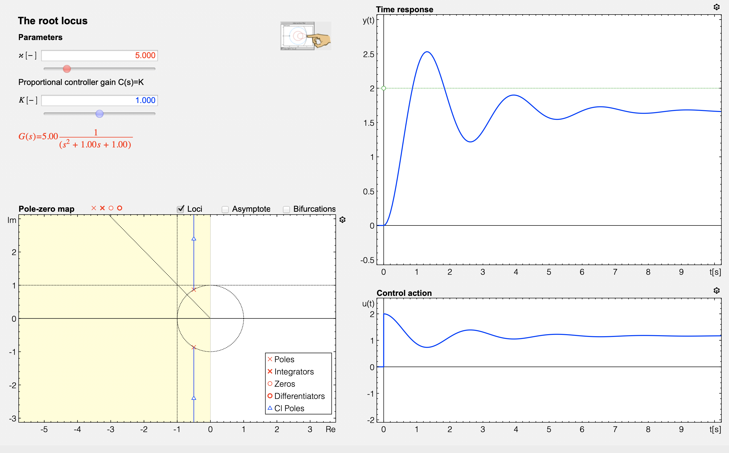
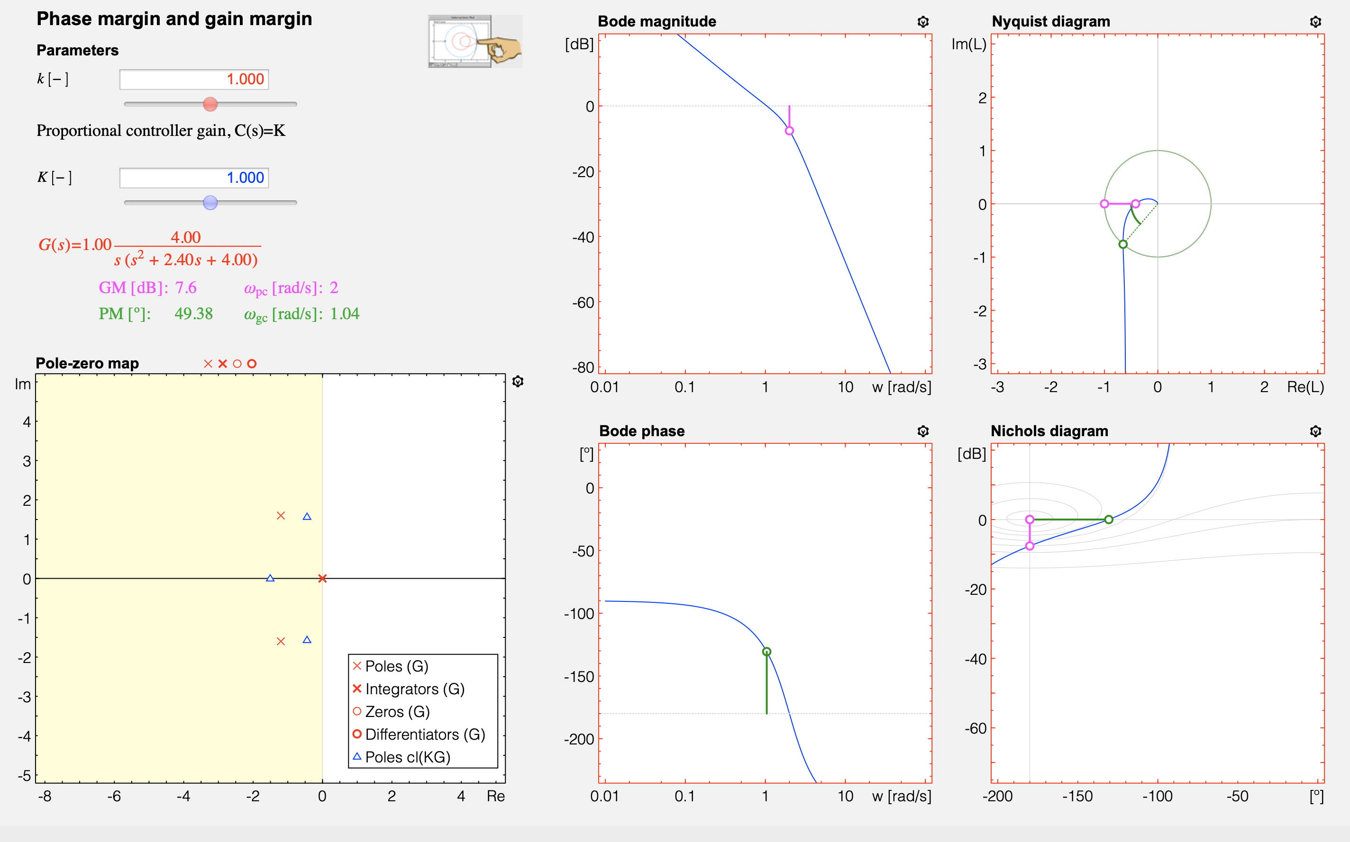
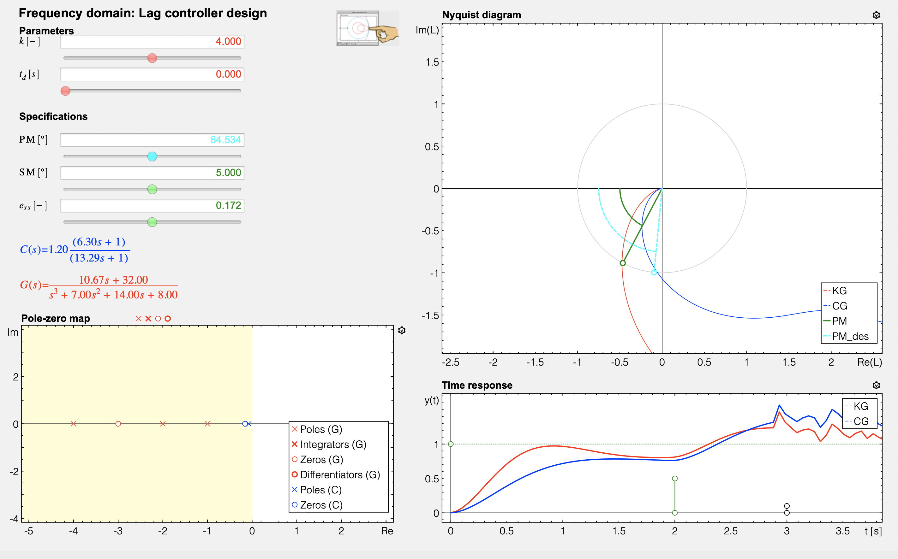
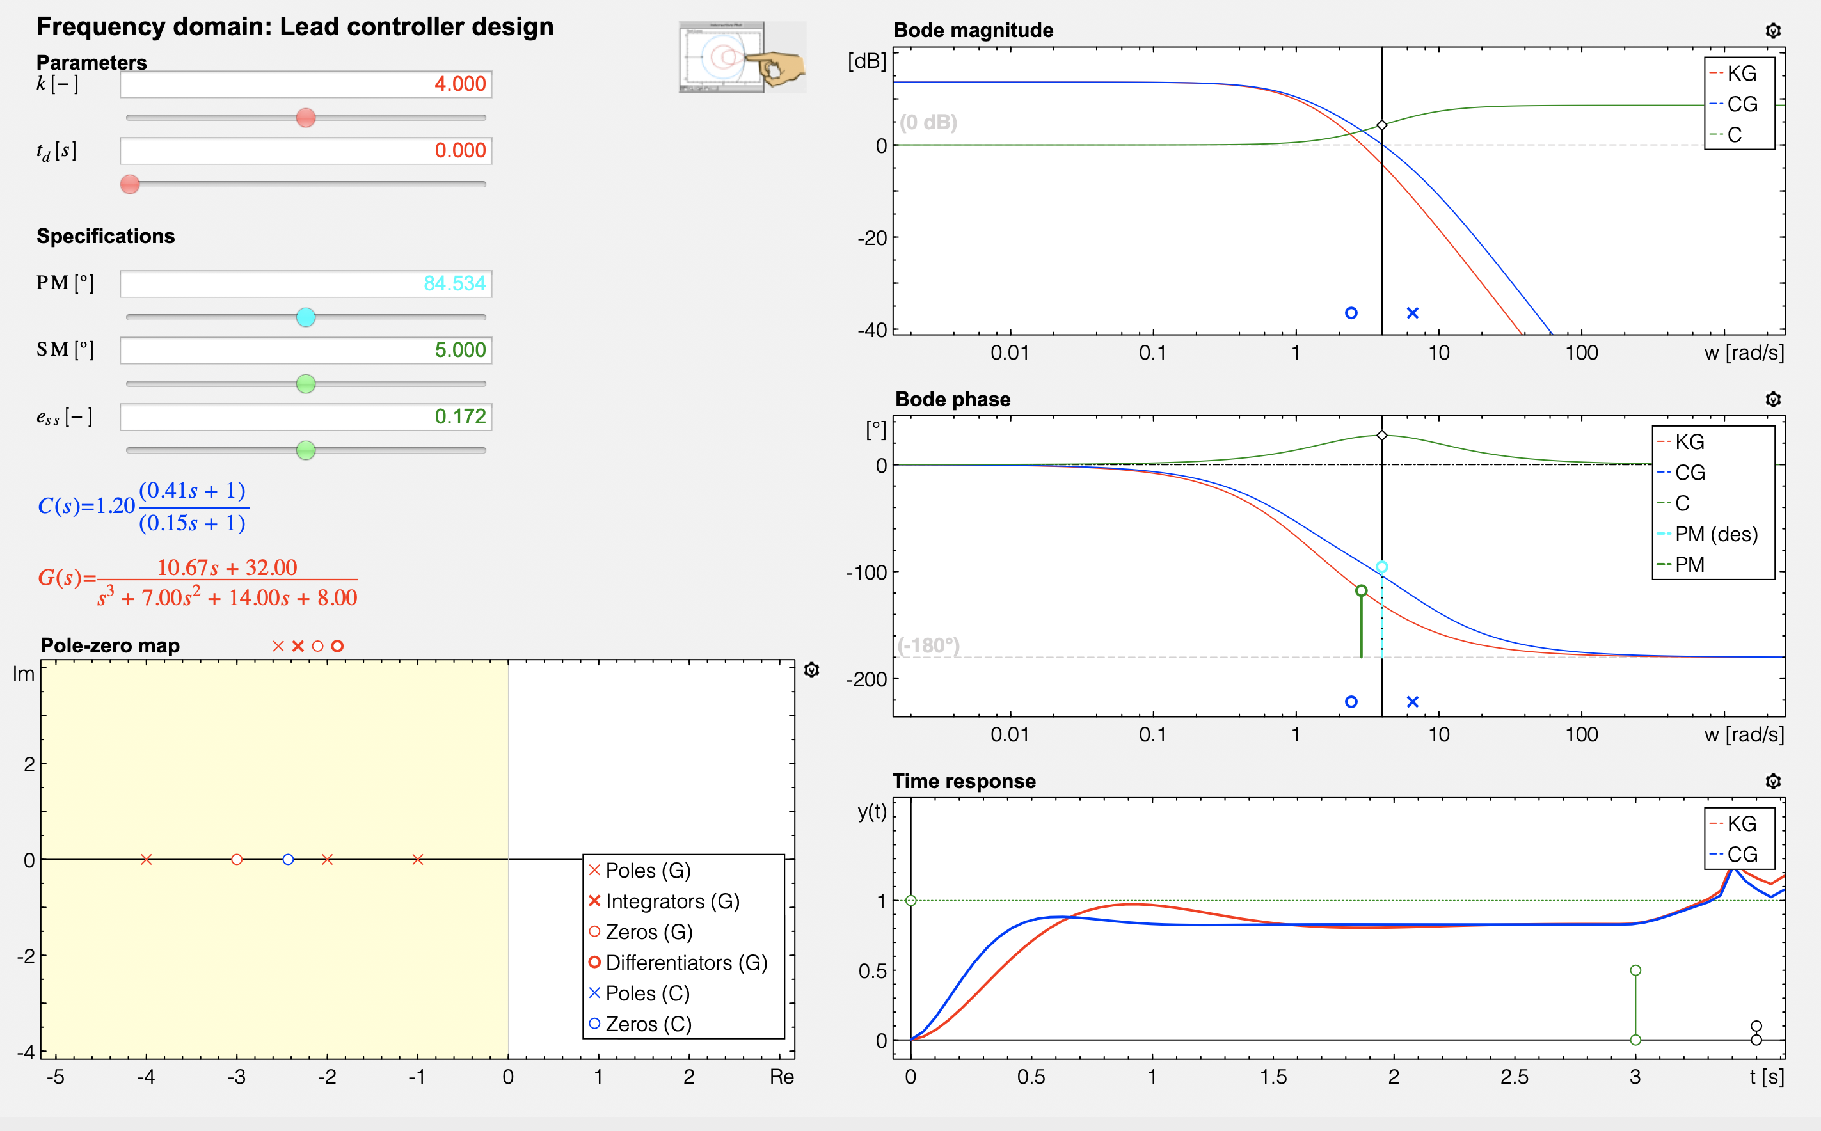
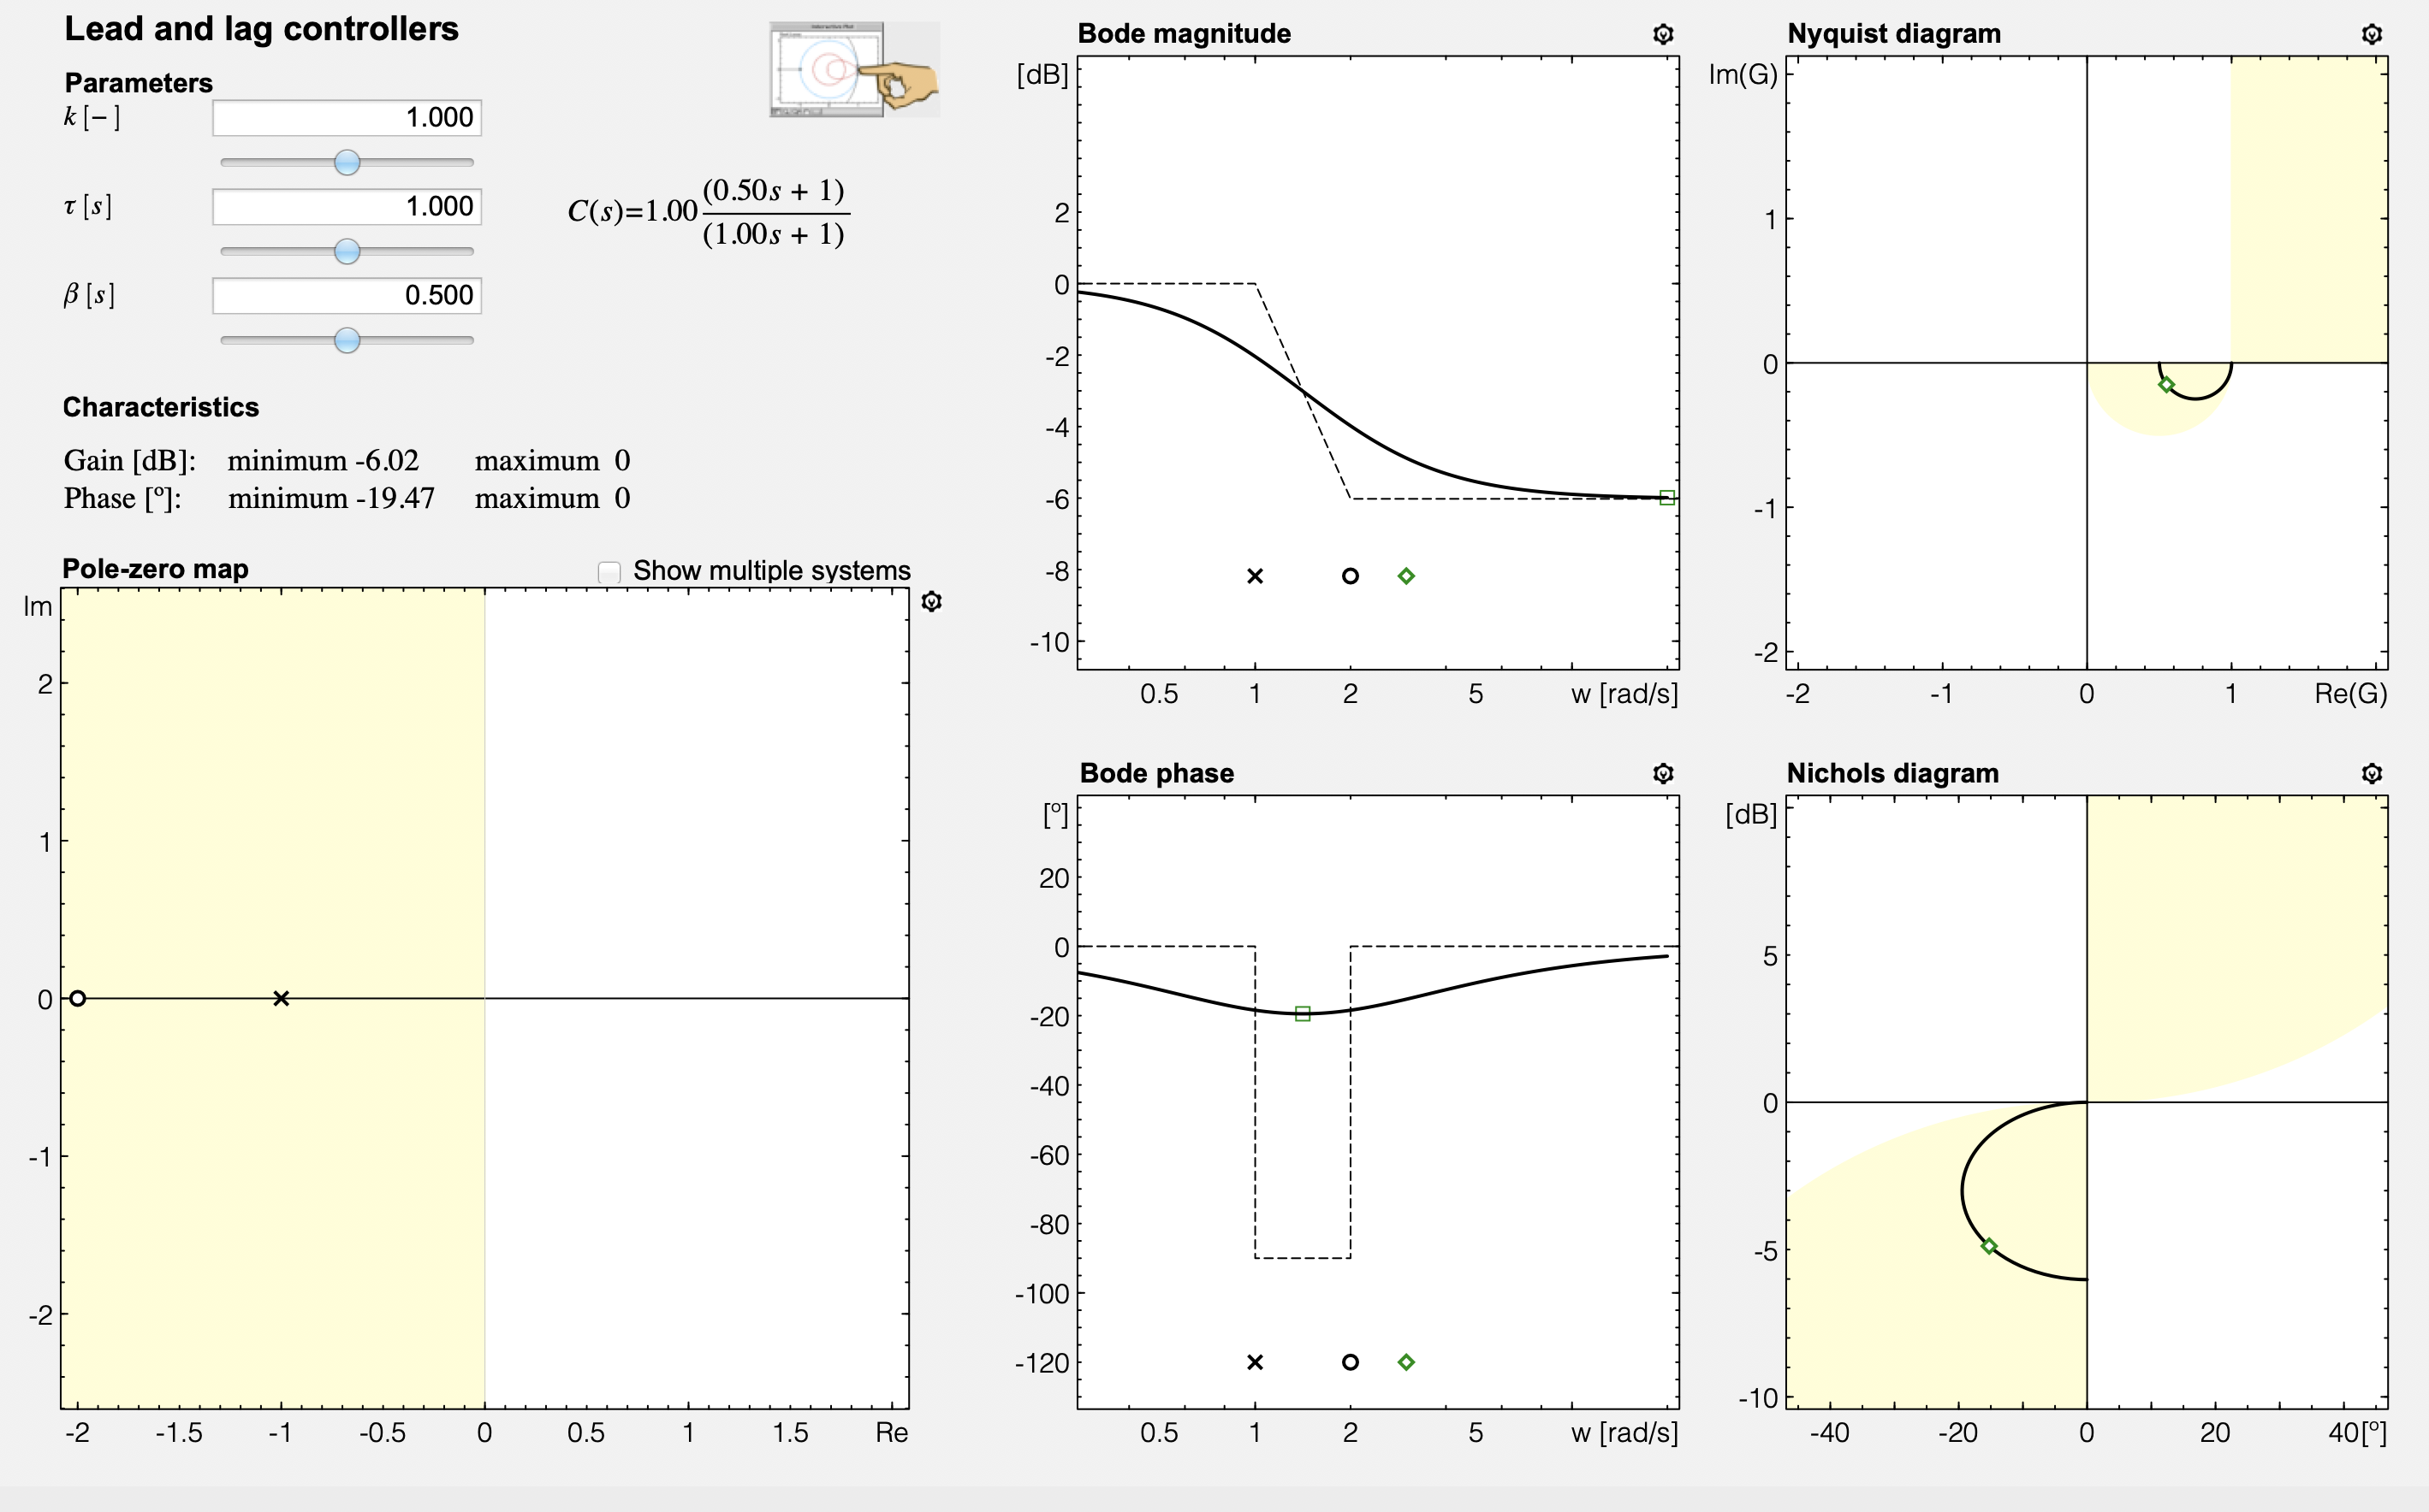
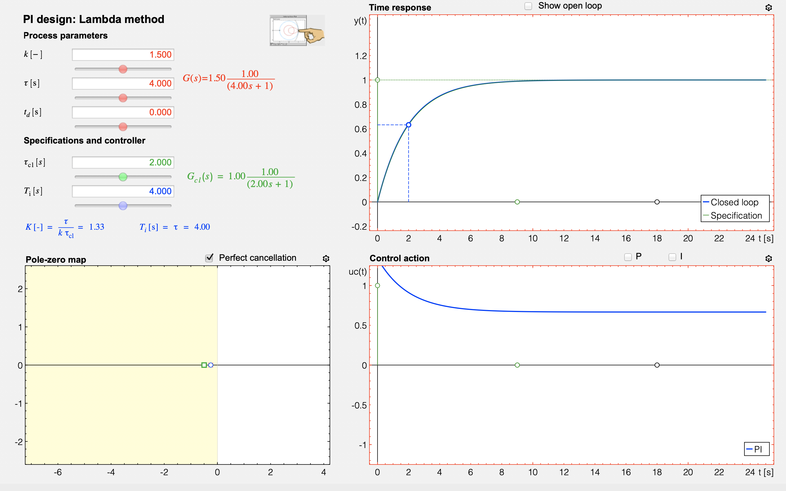
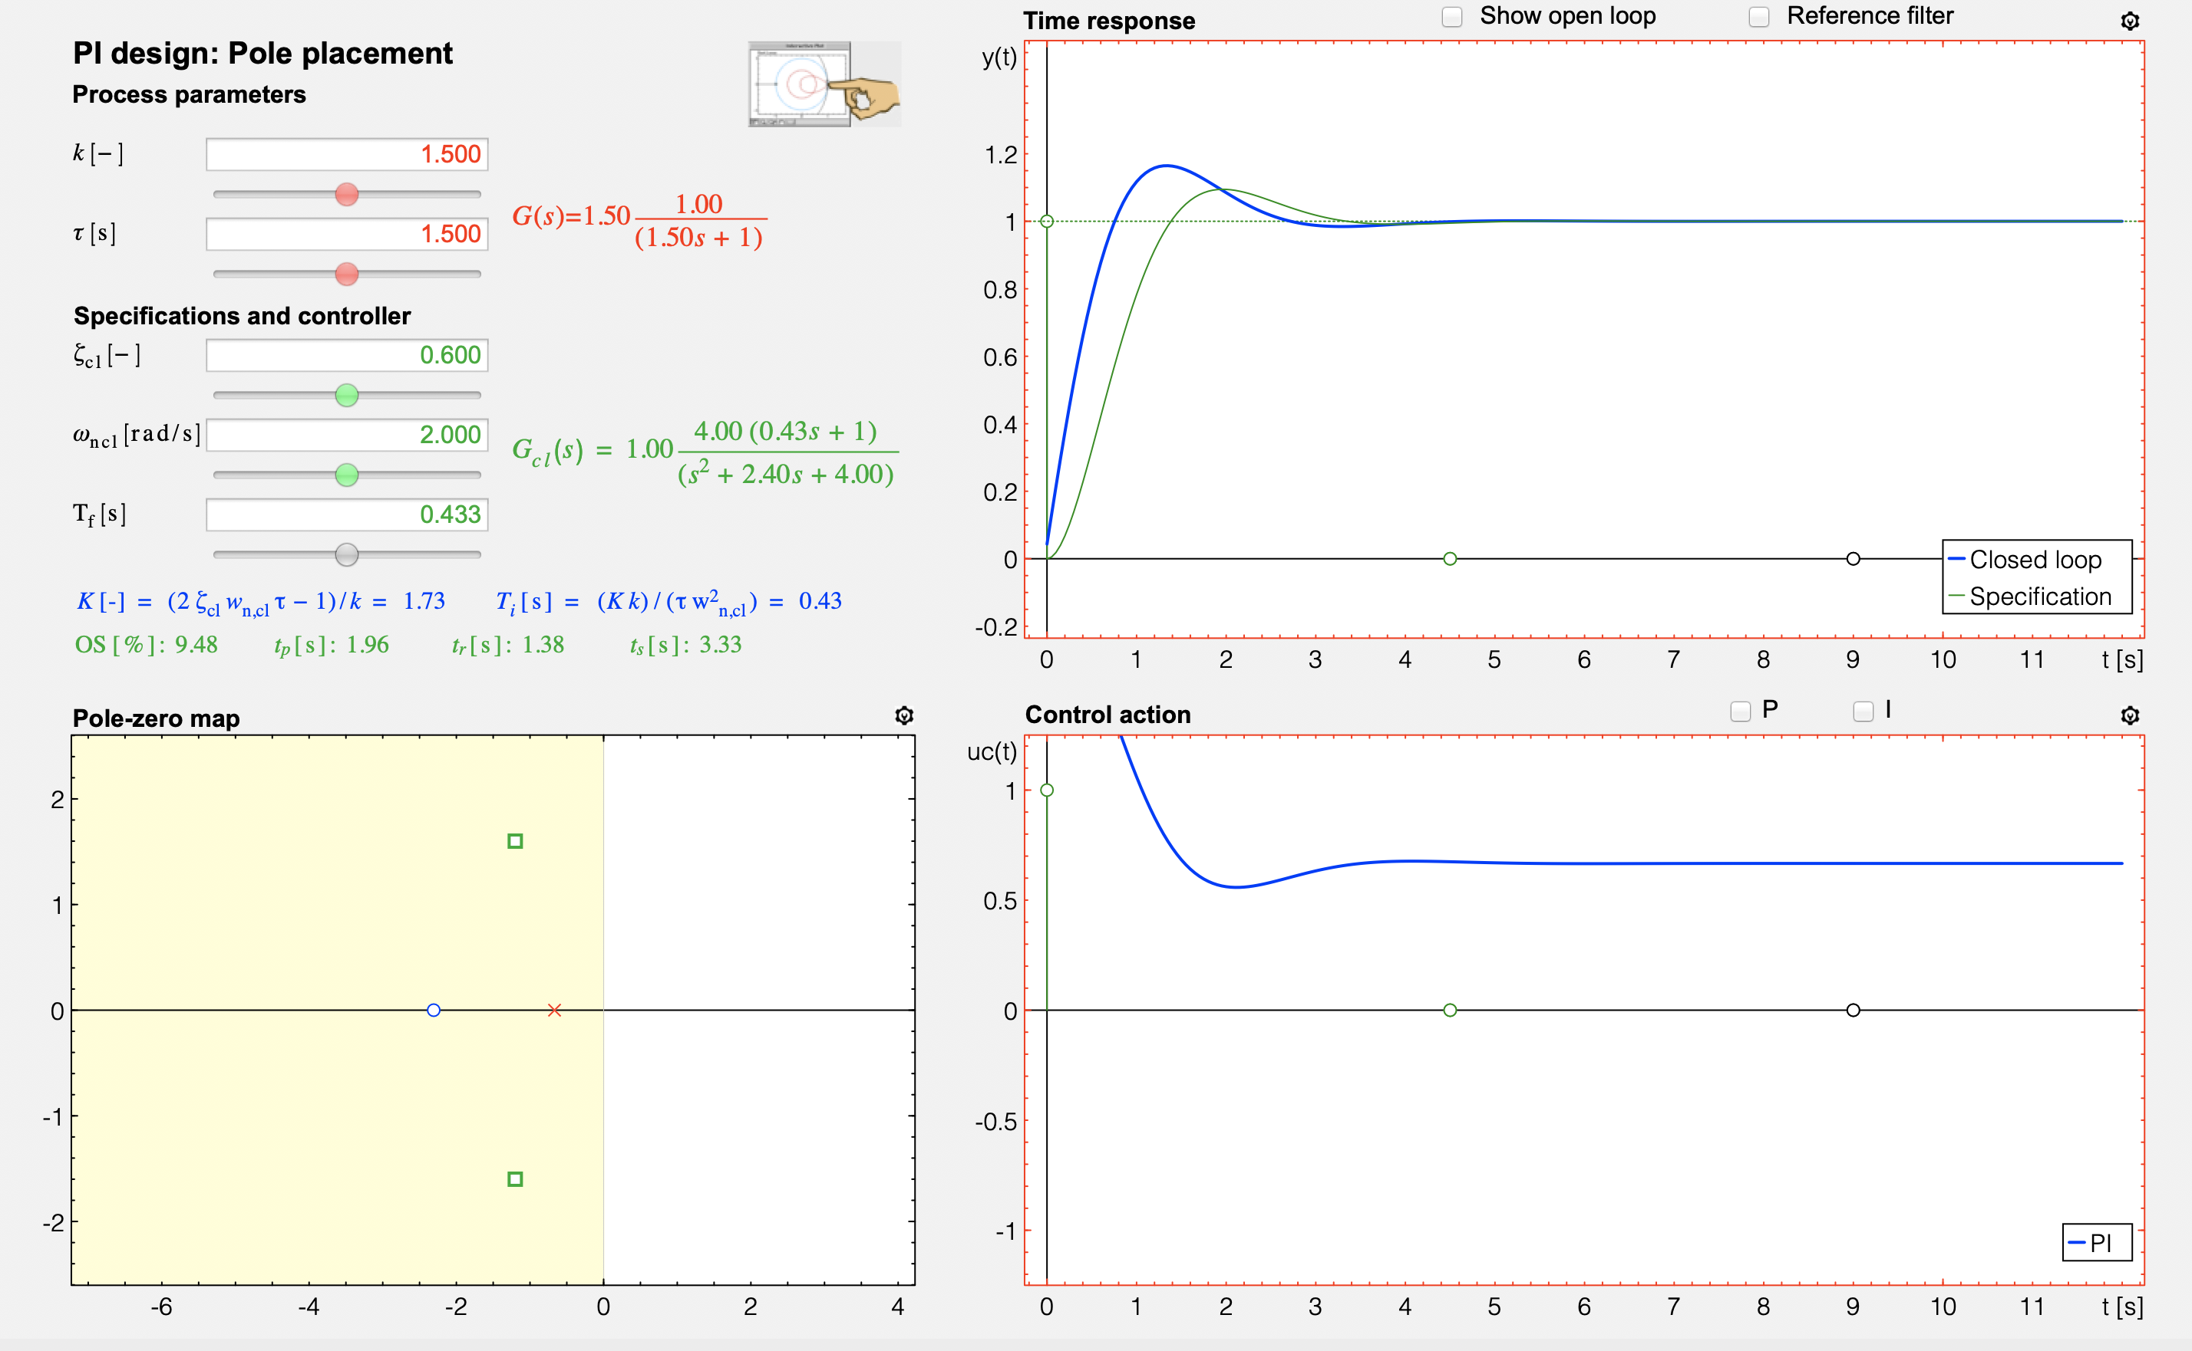
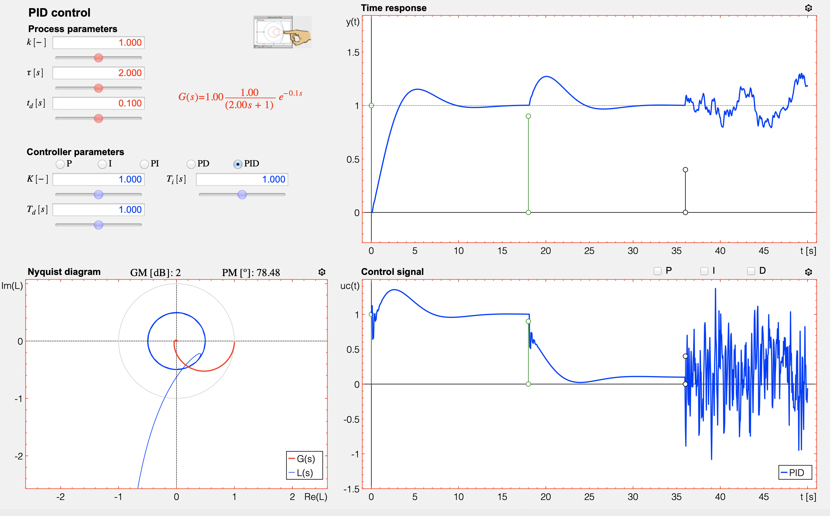
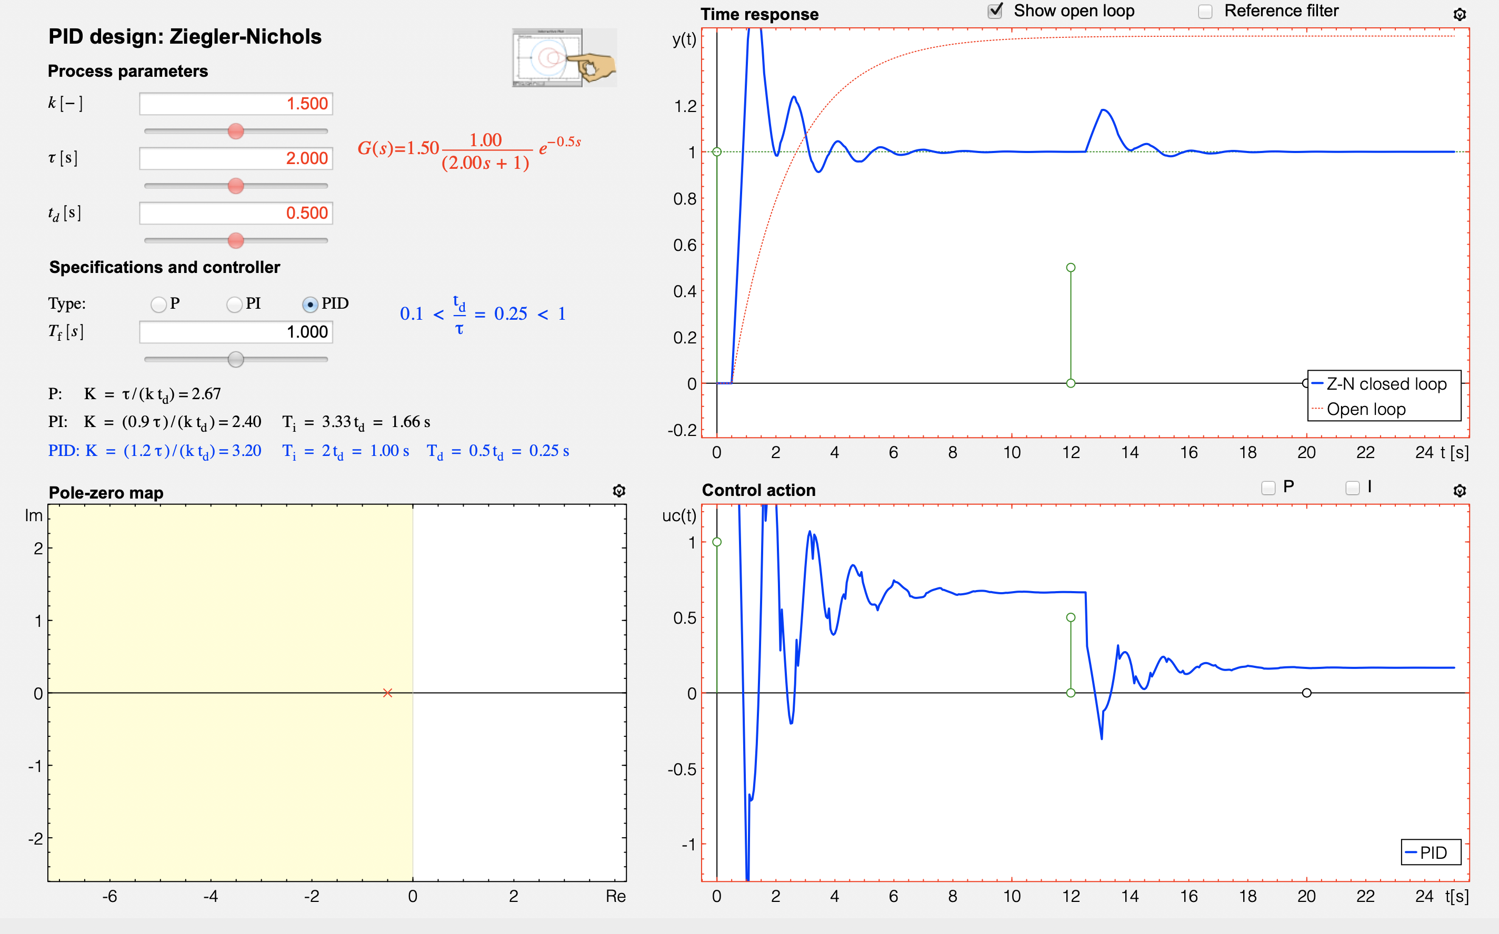
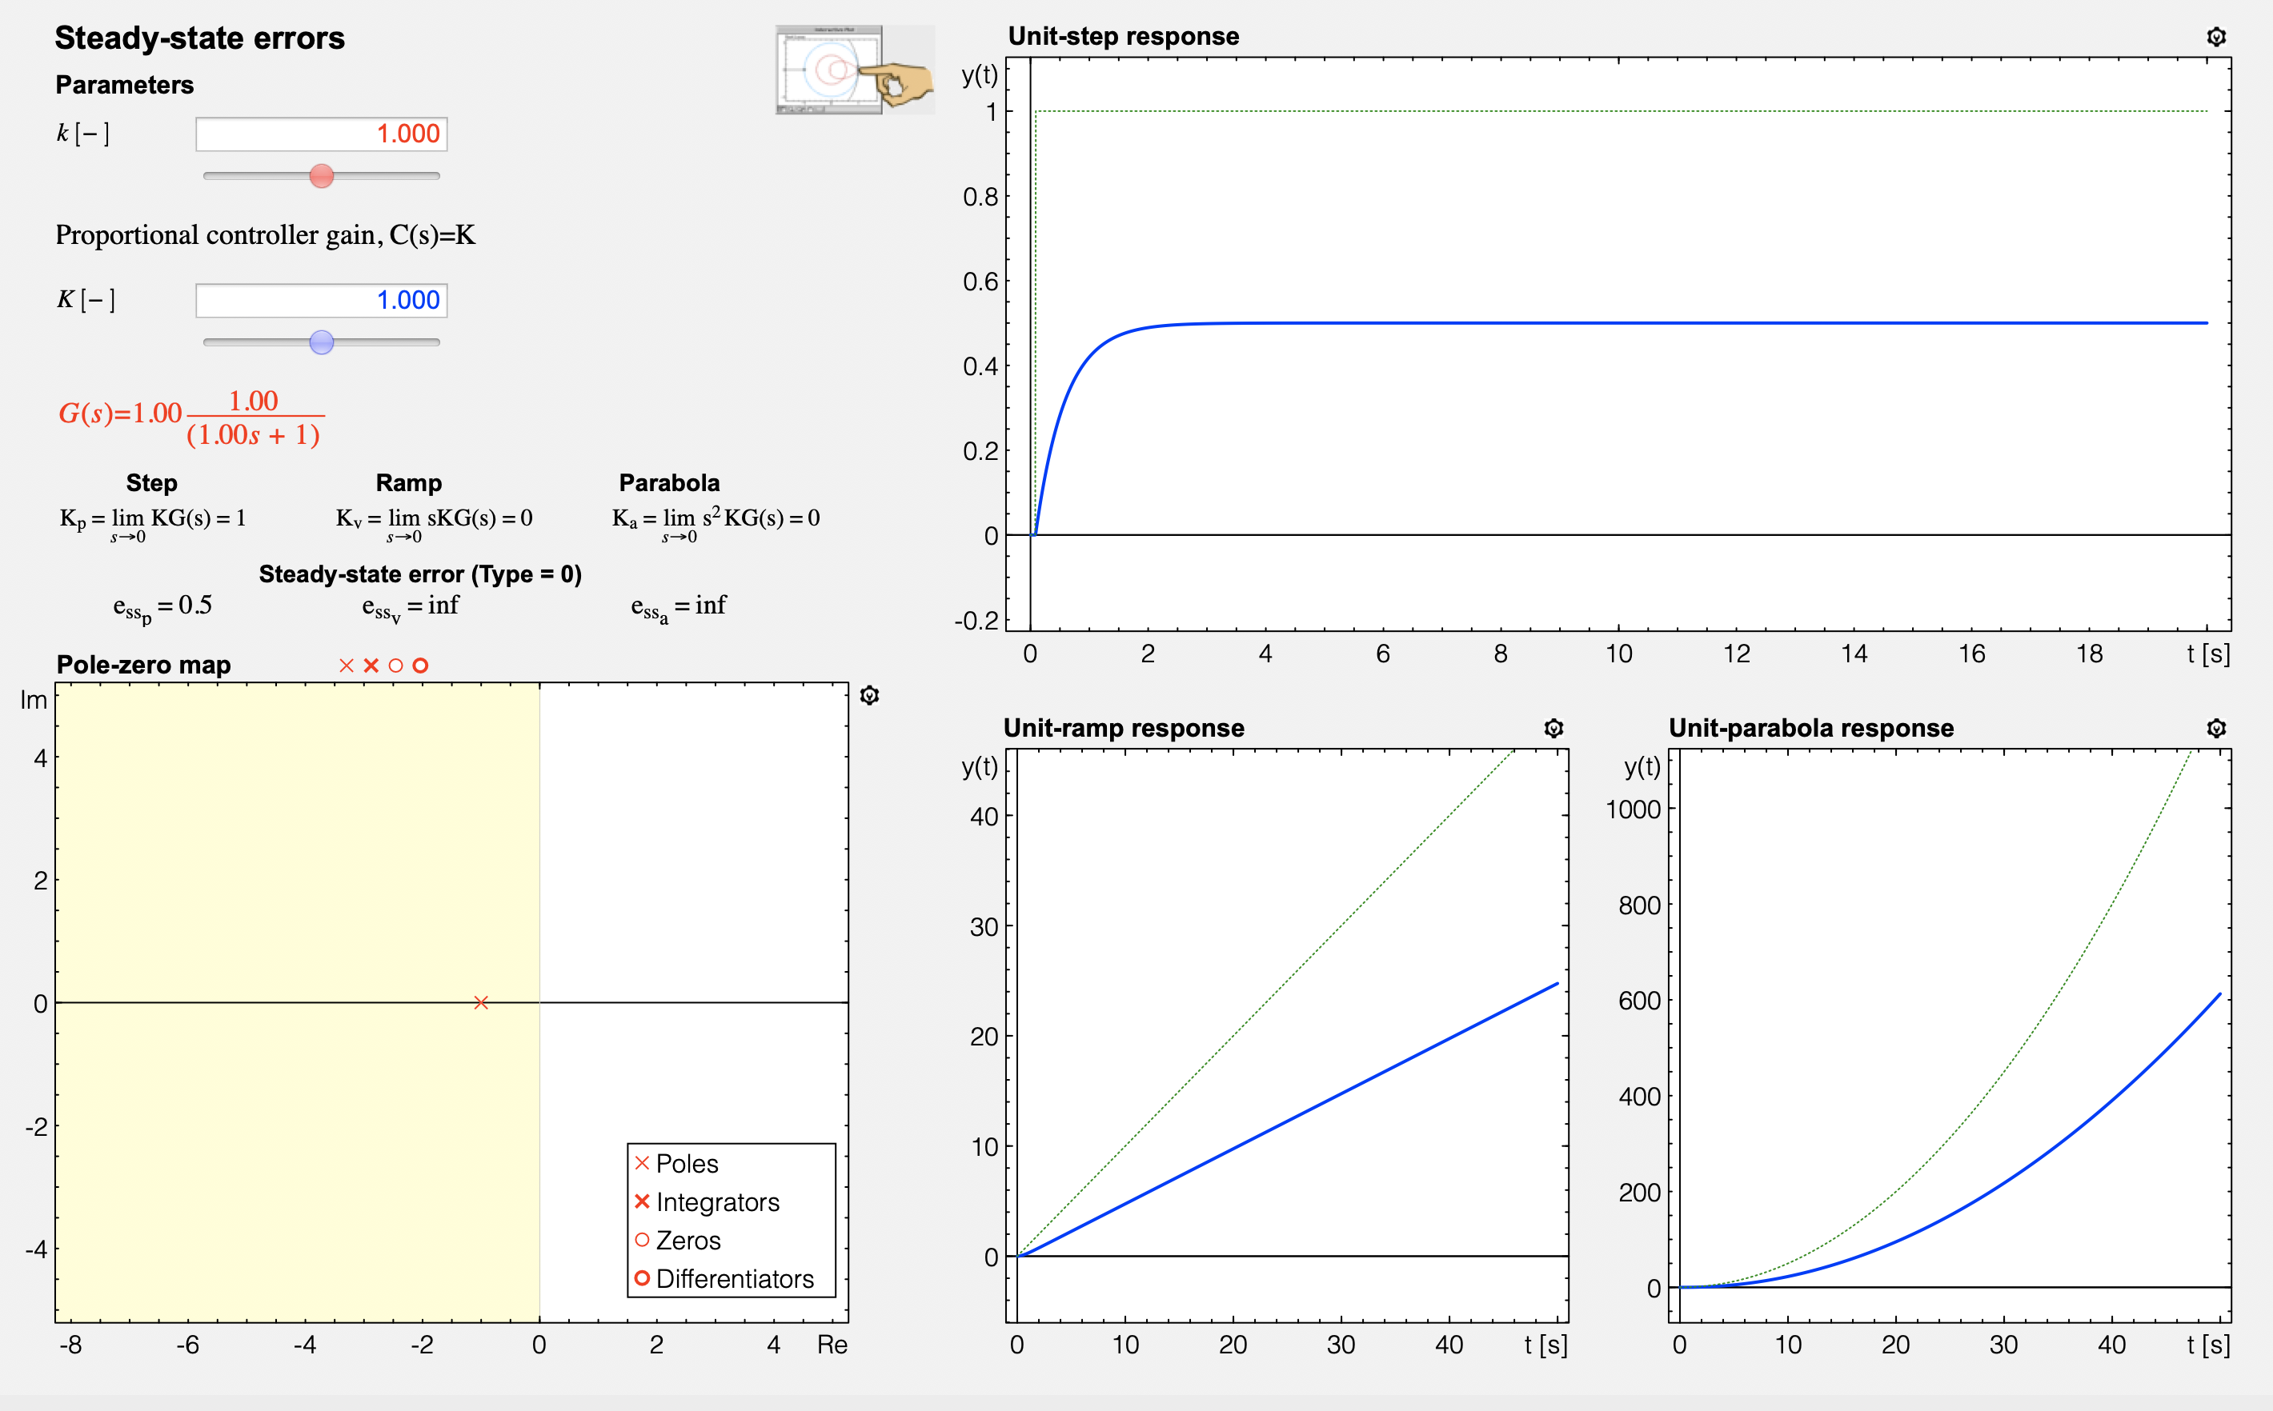
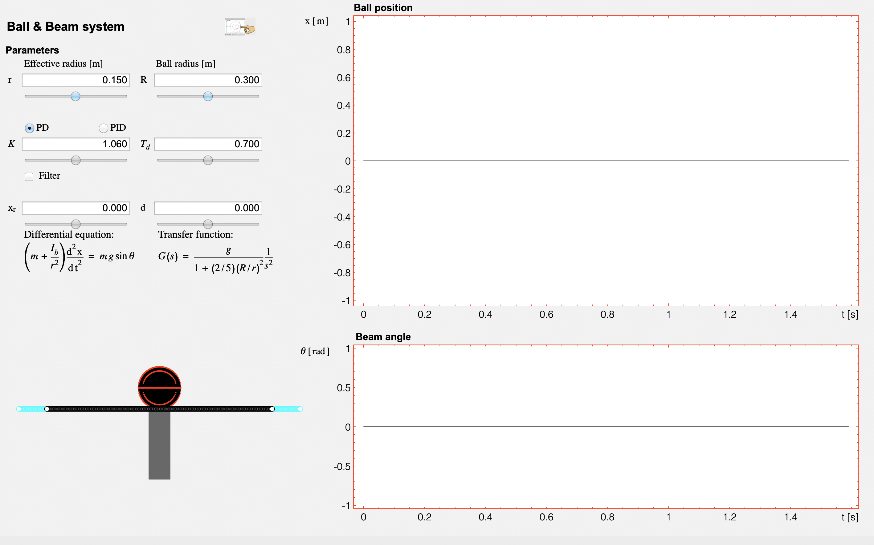
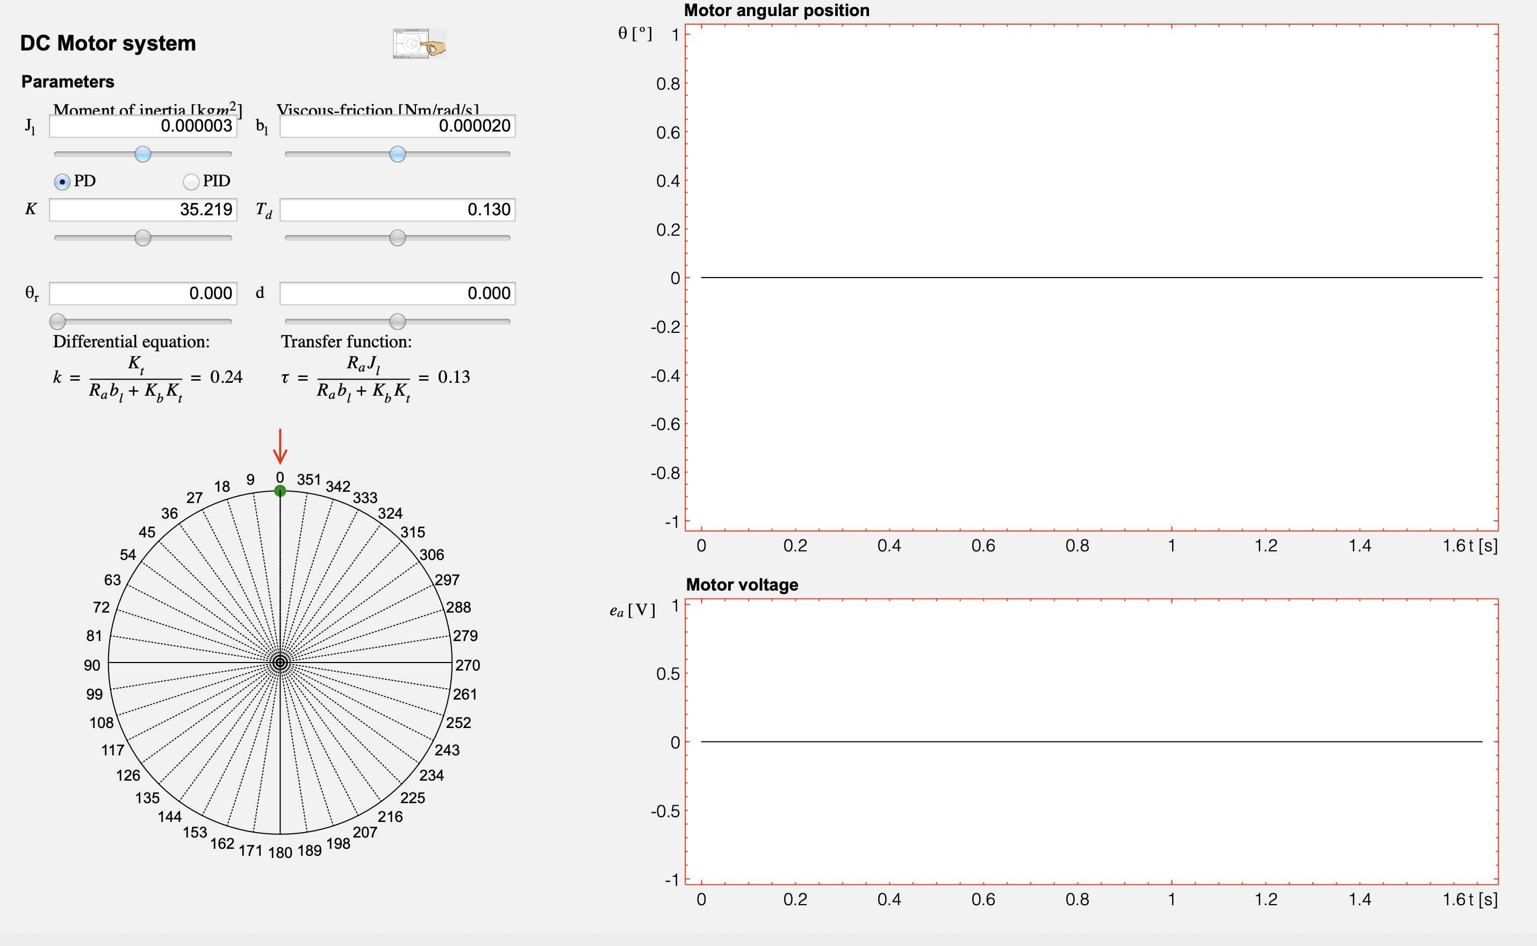
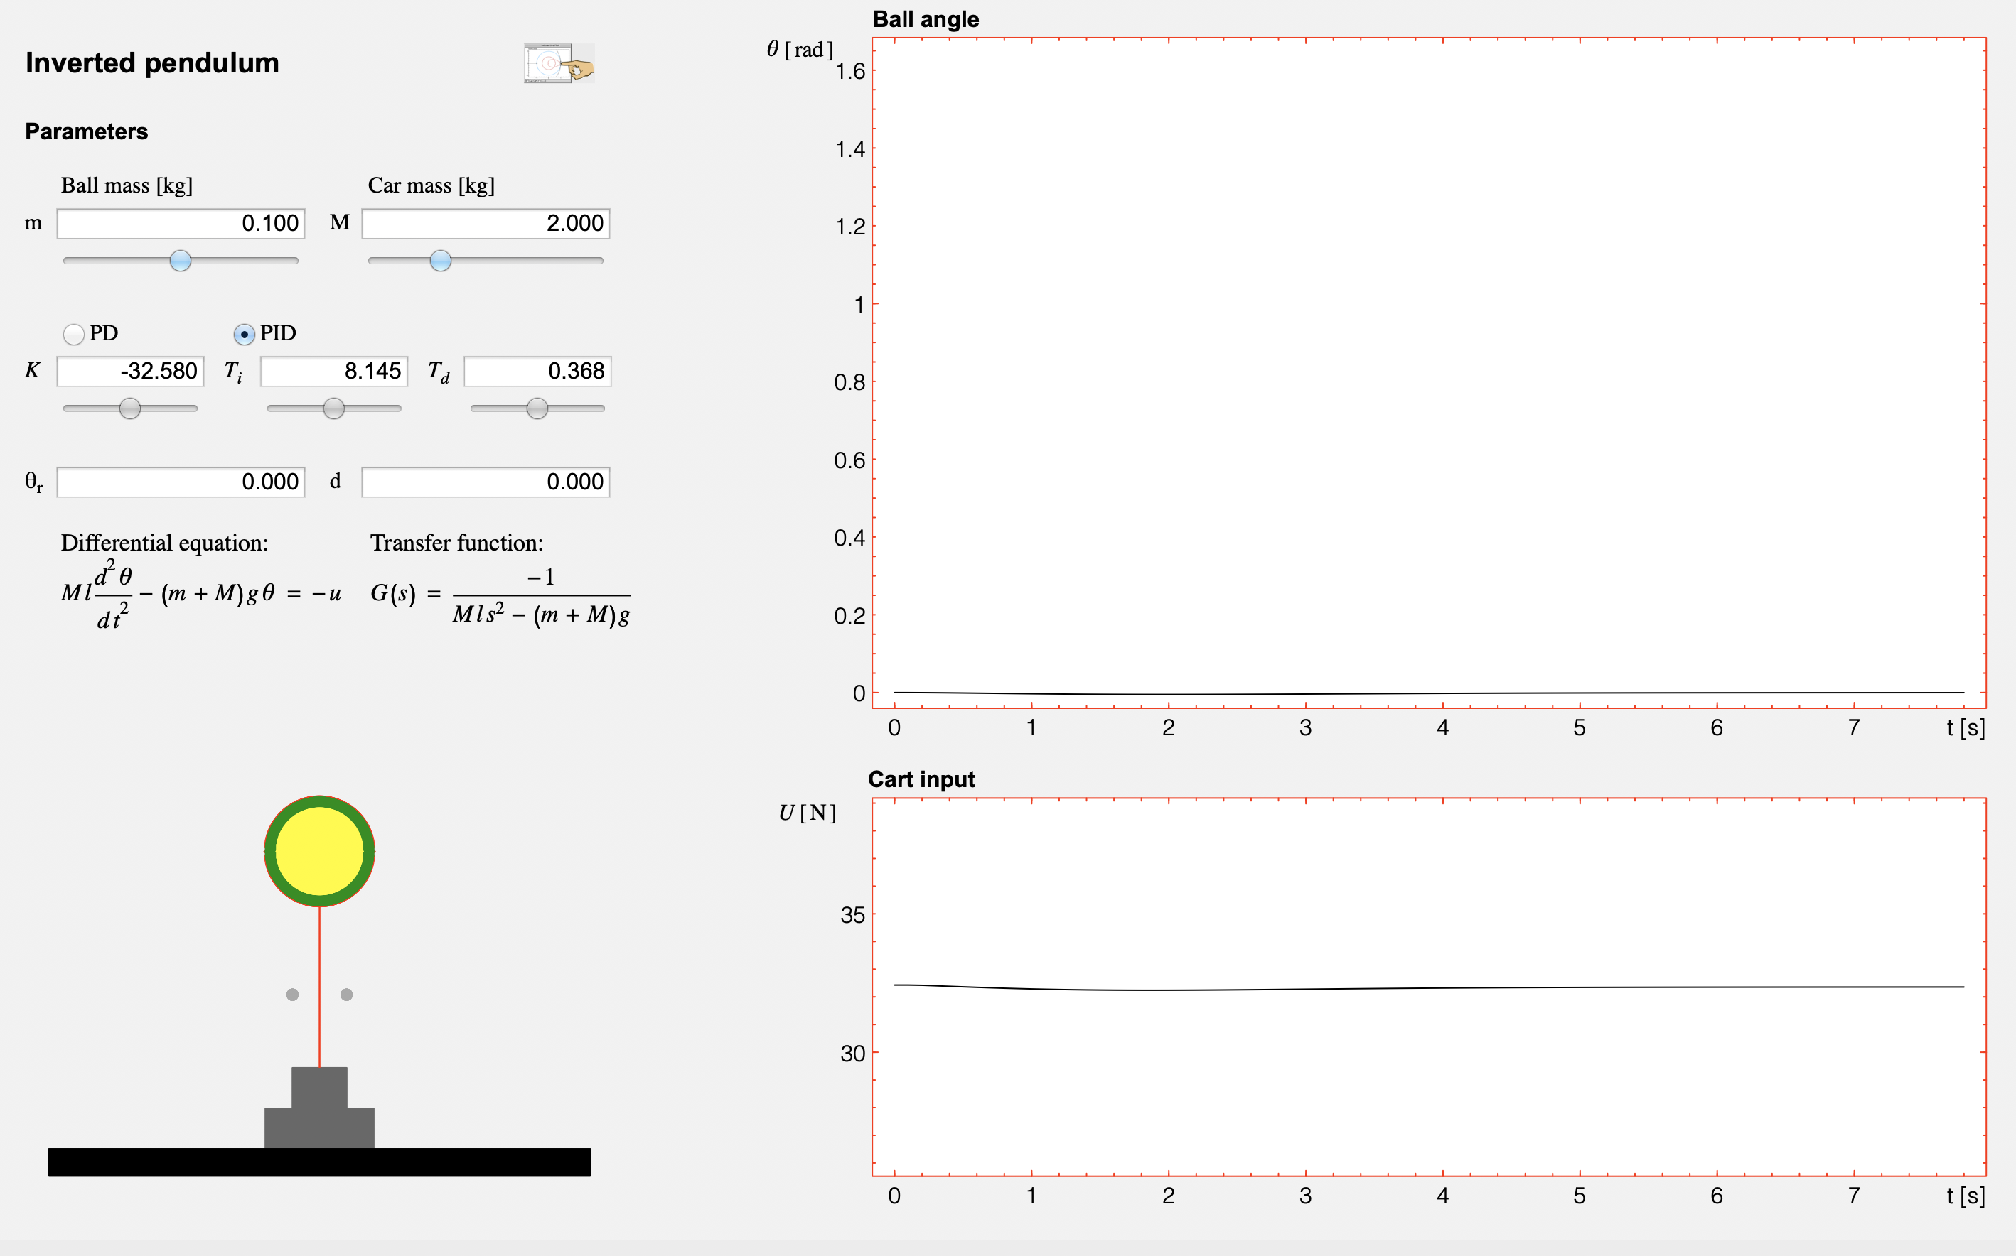
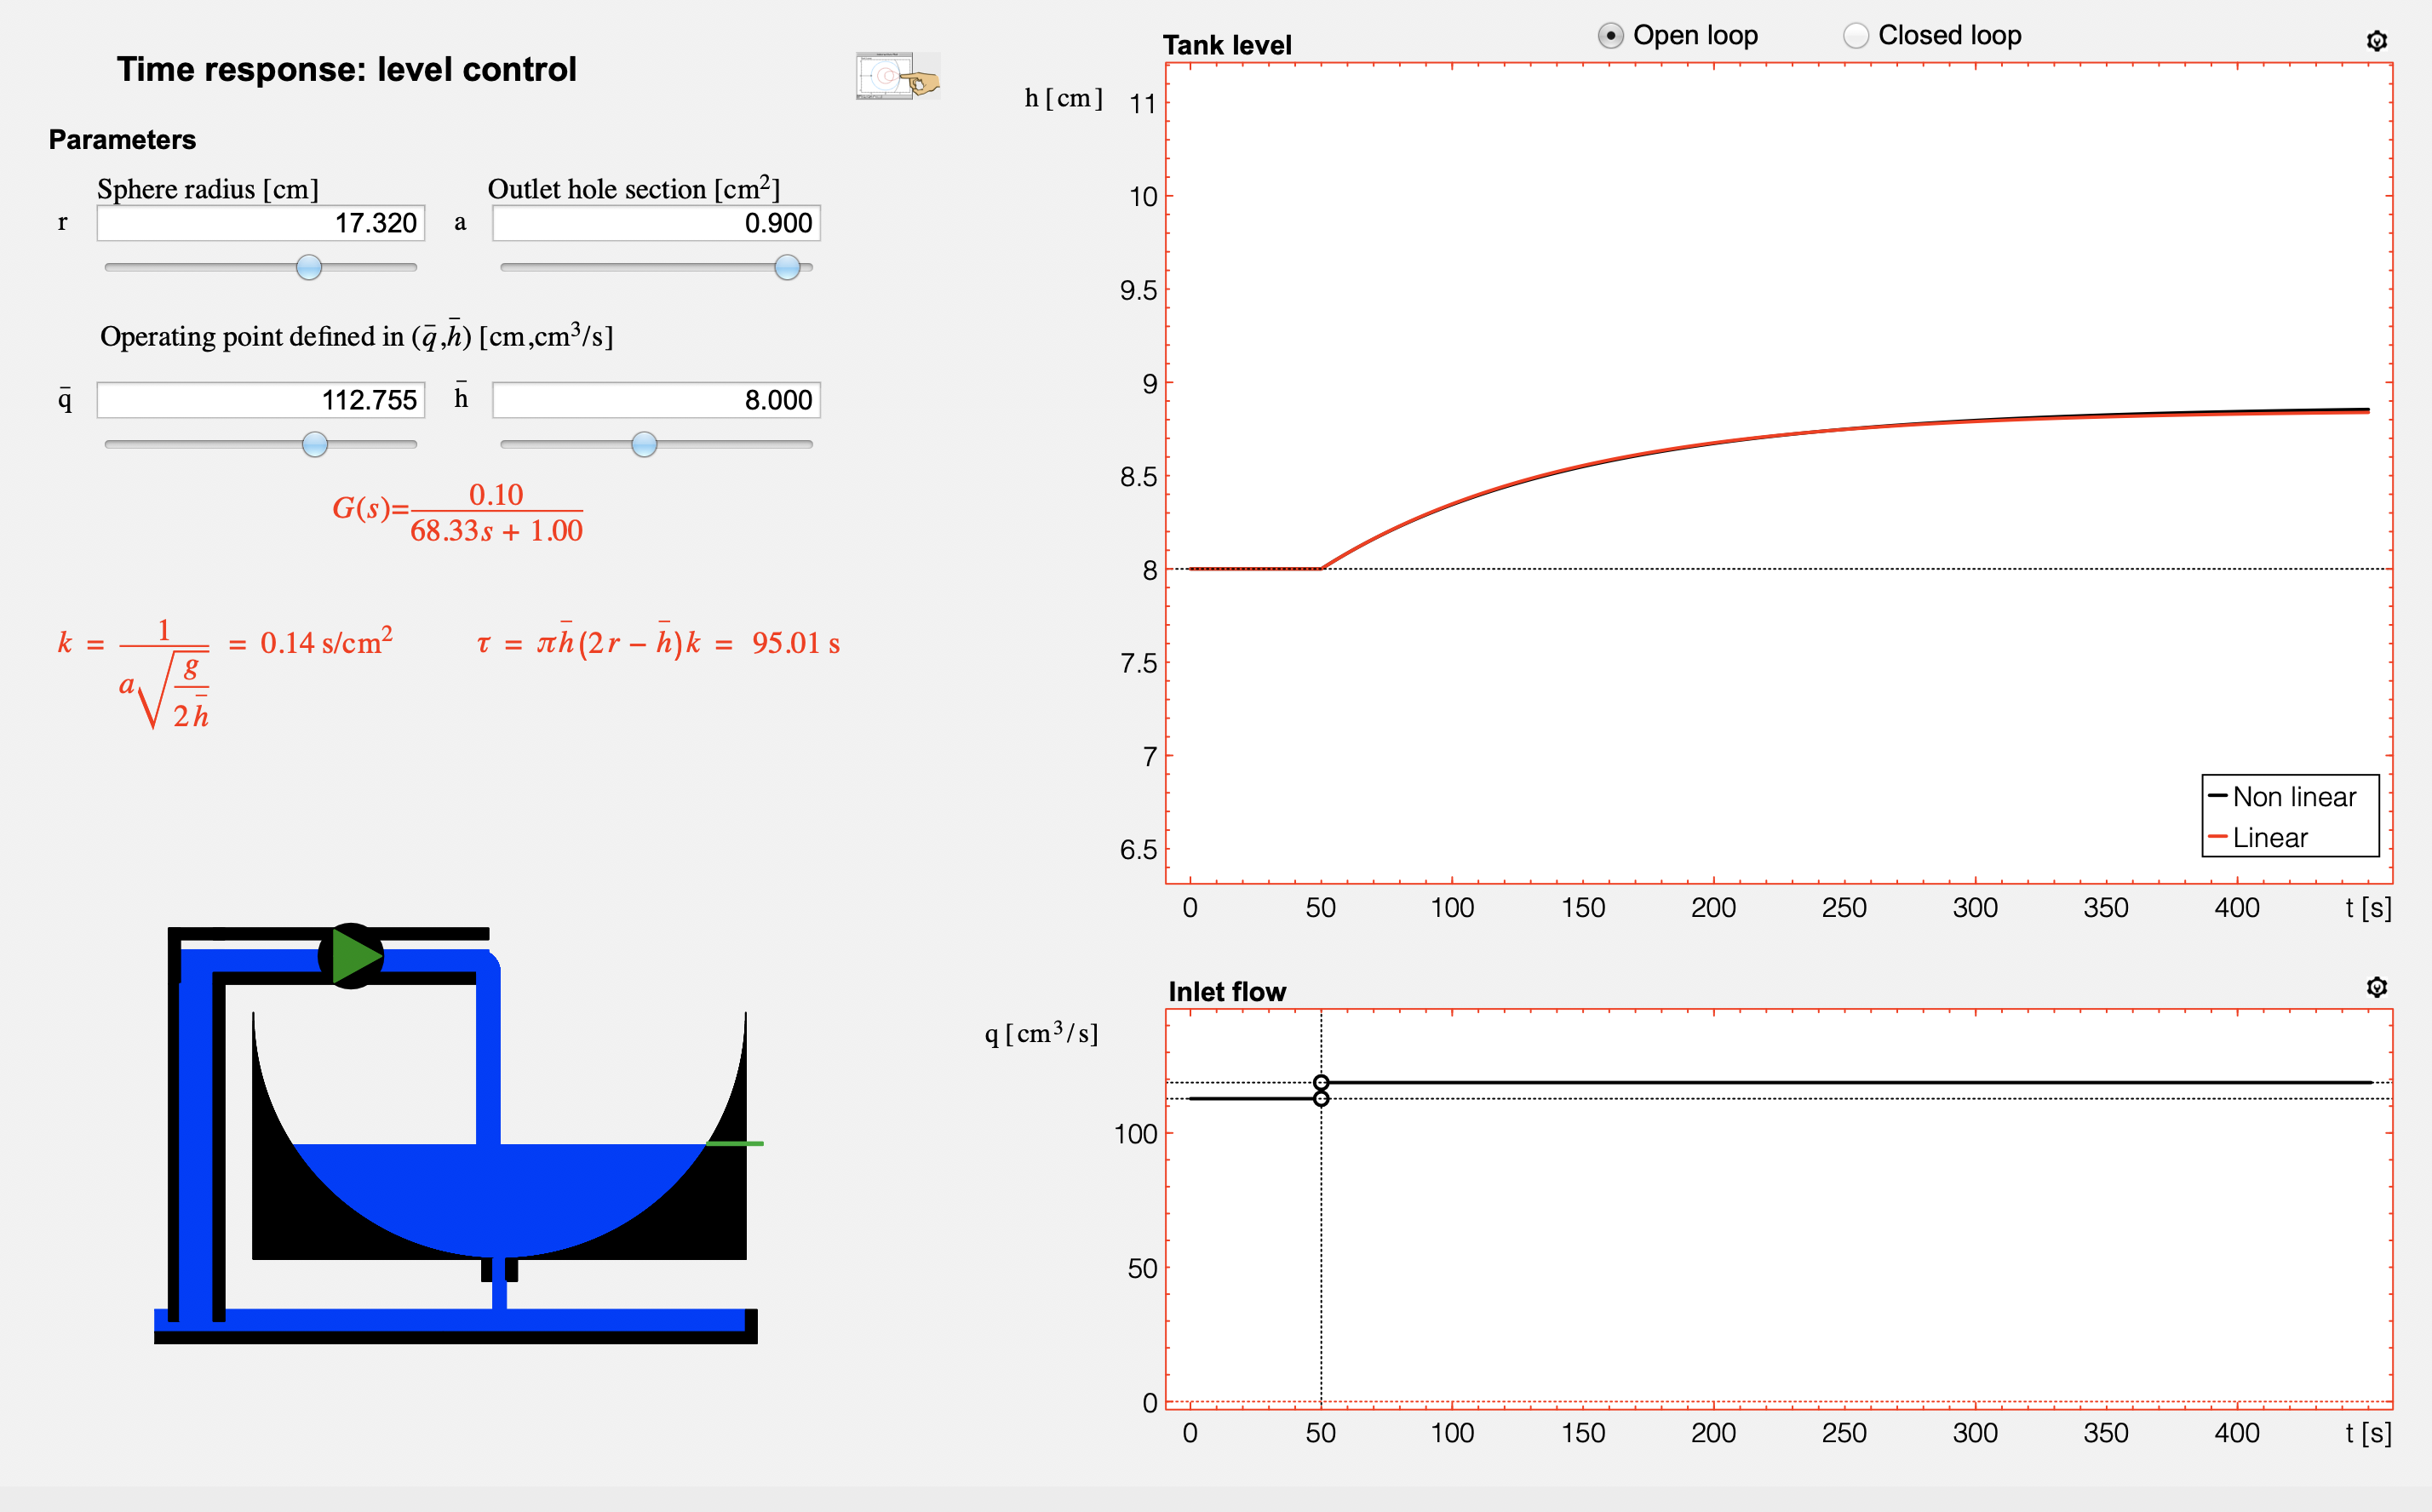
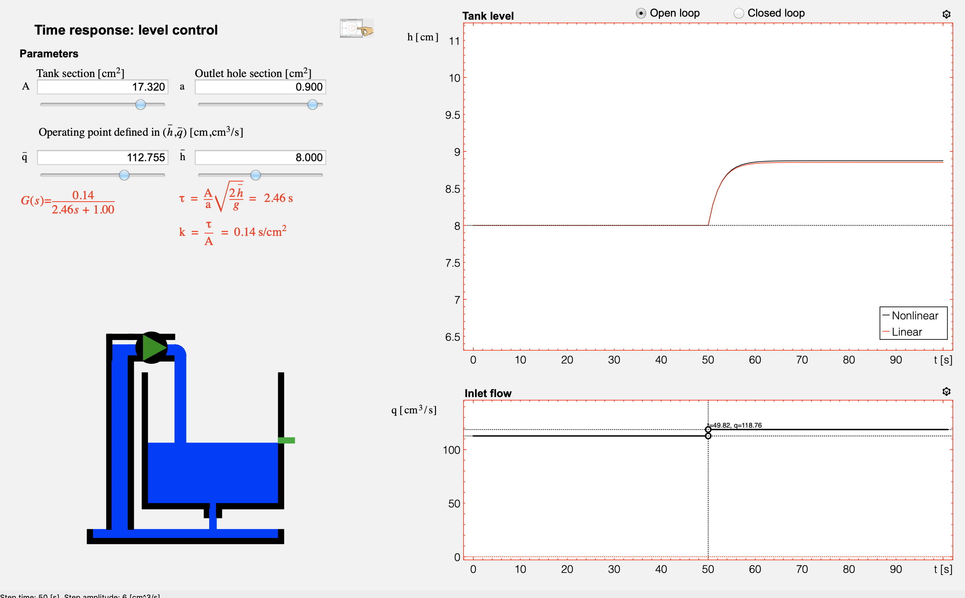
5. Automatic Control with Interactive Tools
Notes:
26
26

Slide 27
5. Automatic Control with Interactive Tools
Learning structure of each interactive tool
Concepts analyzed and learning outcomes
Summary of fundamental theory
References related to this concept
Interactive application
Homework
Notes:
27
Information handling: remote access, bigger availability, and above all, Interactivity

Slide 28
5. Automatic Control with Interactive Tools
Effect of a Zero on the Time Response of a Second-Order Linear Systems
Concepts analyzed and learning outcomes
Summary of fundamental theory
References related to this concept
Interactive application
Homework
Effect of a zero in the time response to a step input of a linear time-invariant second-order system.
Effect of an RHP zero and inverse response.
The main objective of this tool consists of studying and analyzing the effect of a zero on the time response of a continuous second-order system in an interactive way. It is very useful to analyze the inverse response concept.
Notes:
28
Information handling: remote access, bigger availability, and above all, Interactivity

Slide 29
5. Automatic Control with Interactive Tools
Limitations Imposed by Time Delay in Closed-Loop Systems
Concepts analyzed and learning outcomes
Summary of fundamental theory
References related to this concept
Interactive application
Homework
Effect of time delay on closed-loop performance.
Influence of time delay on closed-loop stability.
This tool is devoted to analyzing the influence of the presence of time delay in the open-loop transfer function in the closed-loop stability and performance. The Nyquist diagram is used as main frequency-domain representation, also analyzing the effects on the closed-loop time response to a step reference and the influence of load disturbances and noise.
Notes:
29
Information handling: remote access, bigger availability, and above all, Interactivity

Slide 30
5. Automatic Control with Interactive Tools
The Nyquist Stability Criterion
Concepts analyzed and learning outcomes
Summary of fundamental theory
References related to this concept
Interactive application
Homework
Understand the Nyquist stability criterion and the role of the Nyquist plot.
Stability analysis through visualization.
This interactive tool is devoted to graphically understanding the Nyquist criterion, and how the stability of the closedloop
system can be analyzed based on the open-loop transfer function and by the application of Cauchy’s theorem.
Notes:
30
Information handling: remote access, bigger availability, and above all, Interactivity

Slide 31
5. Automatic Control with Interactive Tools
PID Control
Concepts analyzed and learning outcomes
Summary of fundamental theory
References related to this concept
Interactive application
Homework
Characteristics of proportional (P) control.
Characteristics of integral (I) control.
Characteristics of derivative (D) control.
PID control
This tool is devoted to analyzing the effect of the three control actions which a PID controller implements, both in the
time and frequency domains.
Notes:
31
Information handling: remote access, bigger availability, and above all, Interactivity

Slide 32
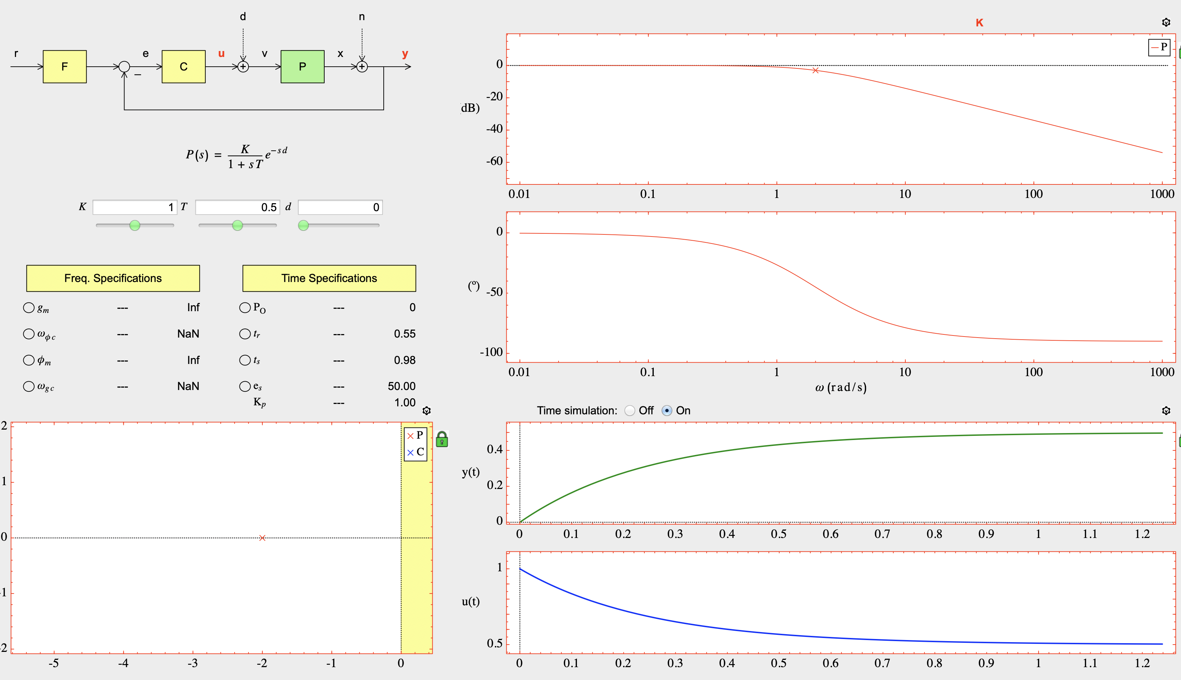
5. Automatic Control with Interactive Tools
LCSD Control
Concepts analyzed and learning outcomes
Summary of fundamental theory
References related to this concept
Interactive application
Homework
Linear control system design (LCSD)
Loop shaping of the open-loop transfer function L(s)
Extended specifications in the frequency domain
Relationships between time and frequency-domain specifications
This tool is devoted to realice linear control system design using the classical manual loop shaping.
Notes:
32
Information handling: remote access, bigger availability, and above all, Interactivity

Slide 33
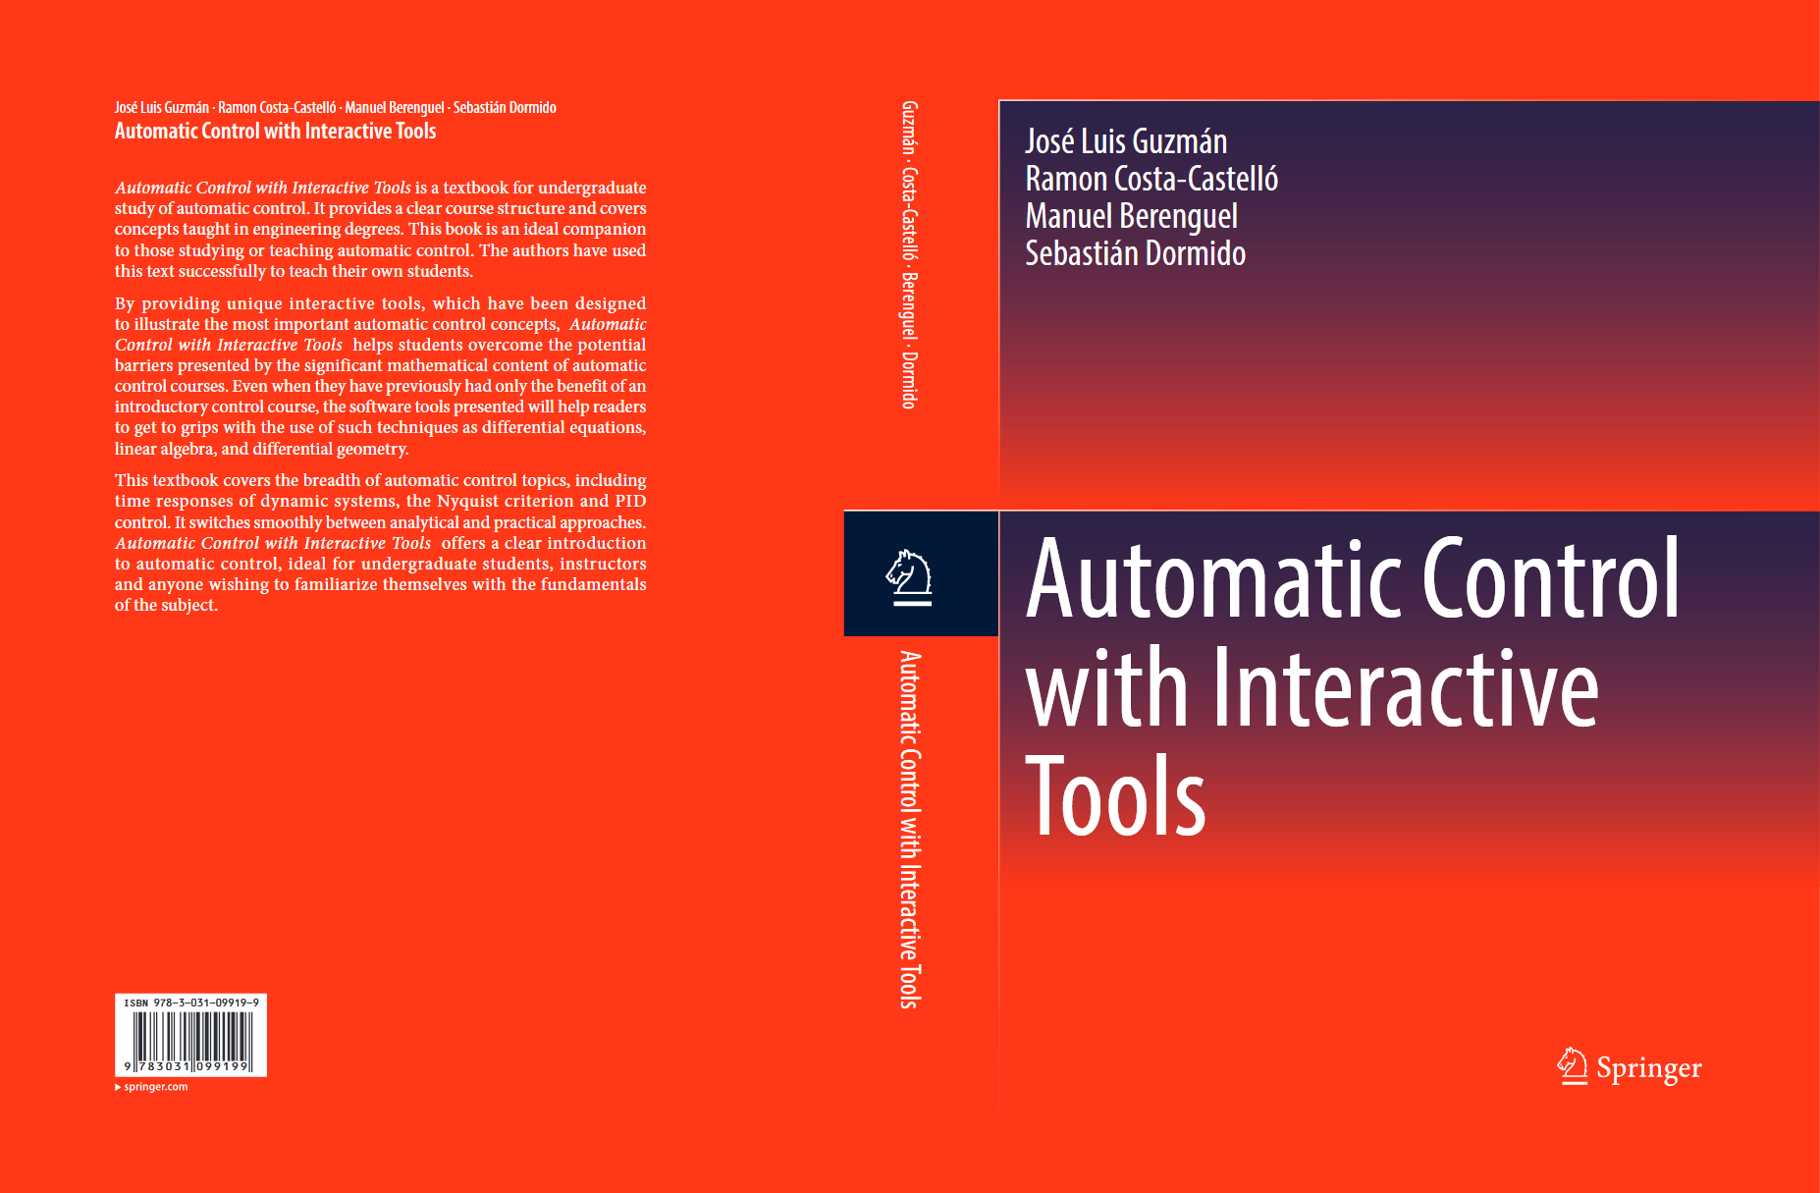
5. Automatic Control with Interactive Tools

Slide 34

Website of the book (www2.ual.es/icontrol/)

Slide 35
6. Conclusions
The philosophy behind interactive software is to minimize programming effort so that the student can focus on learning control concepts.
Interactive tools promote to understand essential aspects of dynamic systems and their control.
Teaching control concepts has never been more motivating than today with the use of interactive software as a teaching assistant.
Interactive control tools reinforce fundamental aspects of basic control concepts: system dynamics, stability, feedback, and compensation.

Slide 36





Acknowledgment
Karl J. Åström
Lund Univ.
Tore Hagglünd
Lund Univ.
Yves Piguet
Calerga
José Manuel Diaz
UNED
Daniel E. Rivera
ASU Univ.

Slide 37
Thank you
for your attention
and questions?

