Slide 1

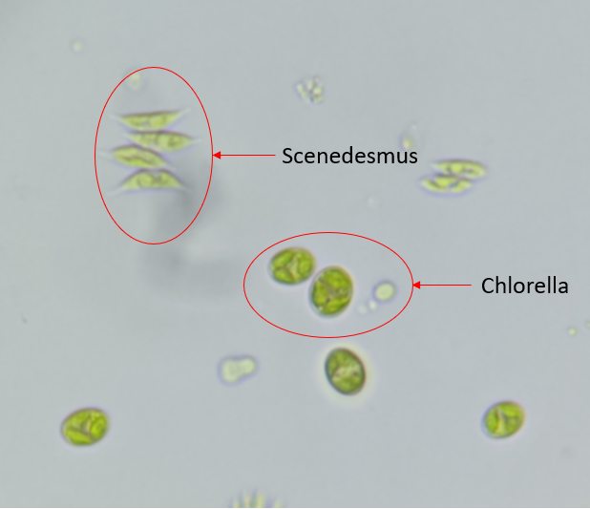
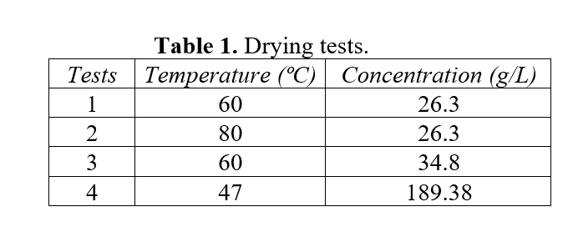
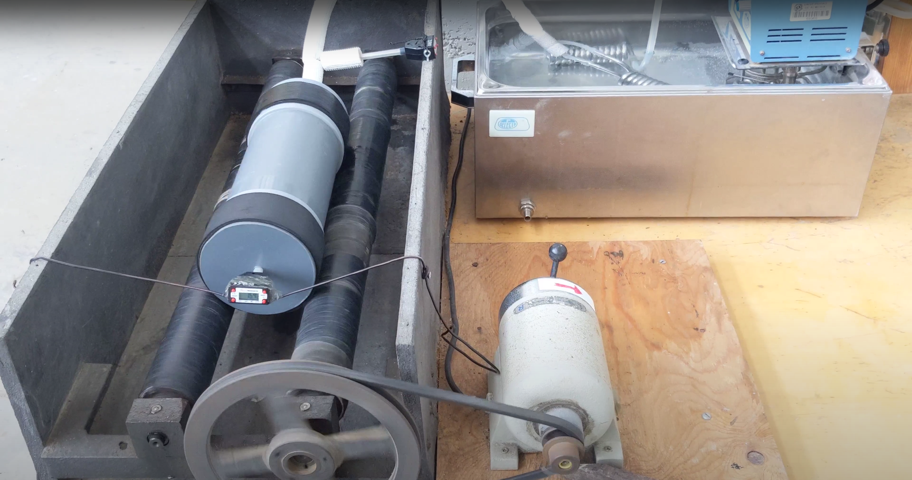
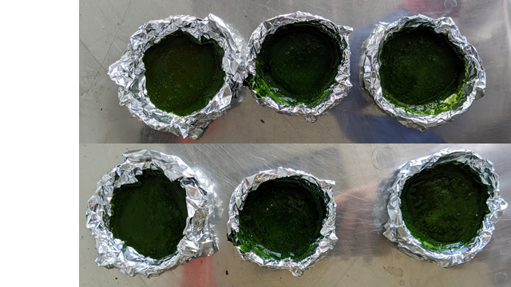
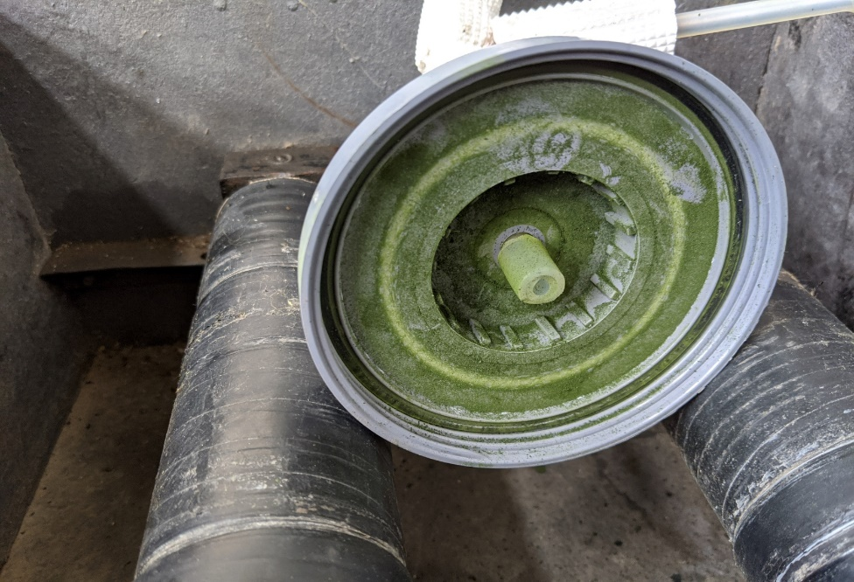
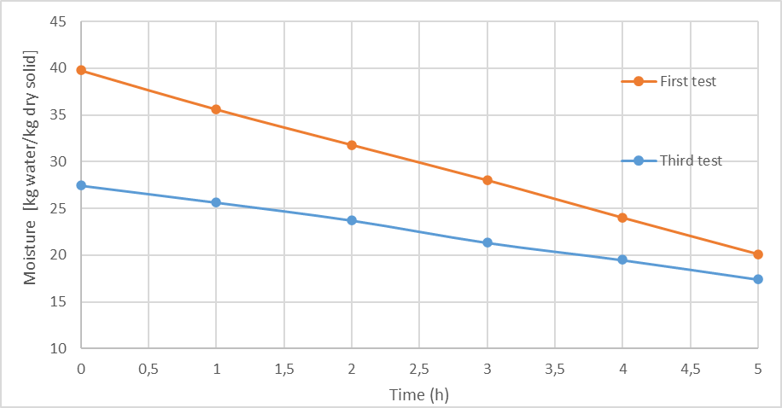
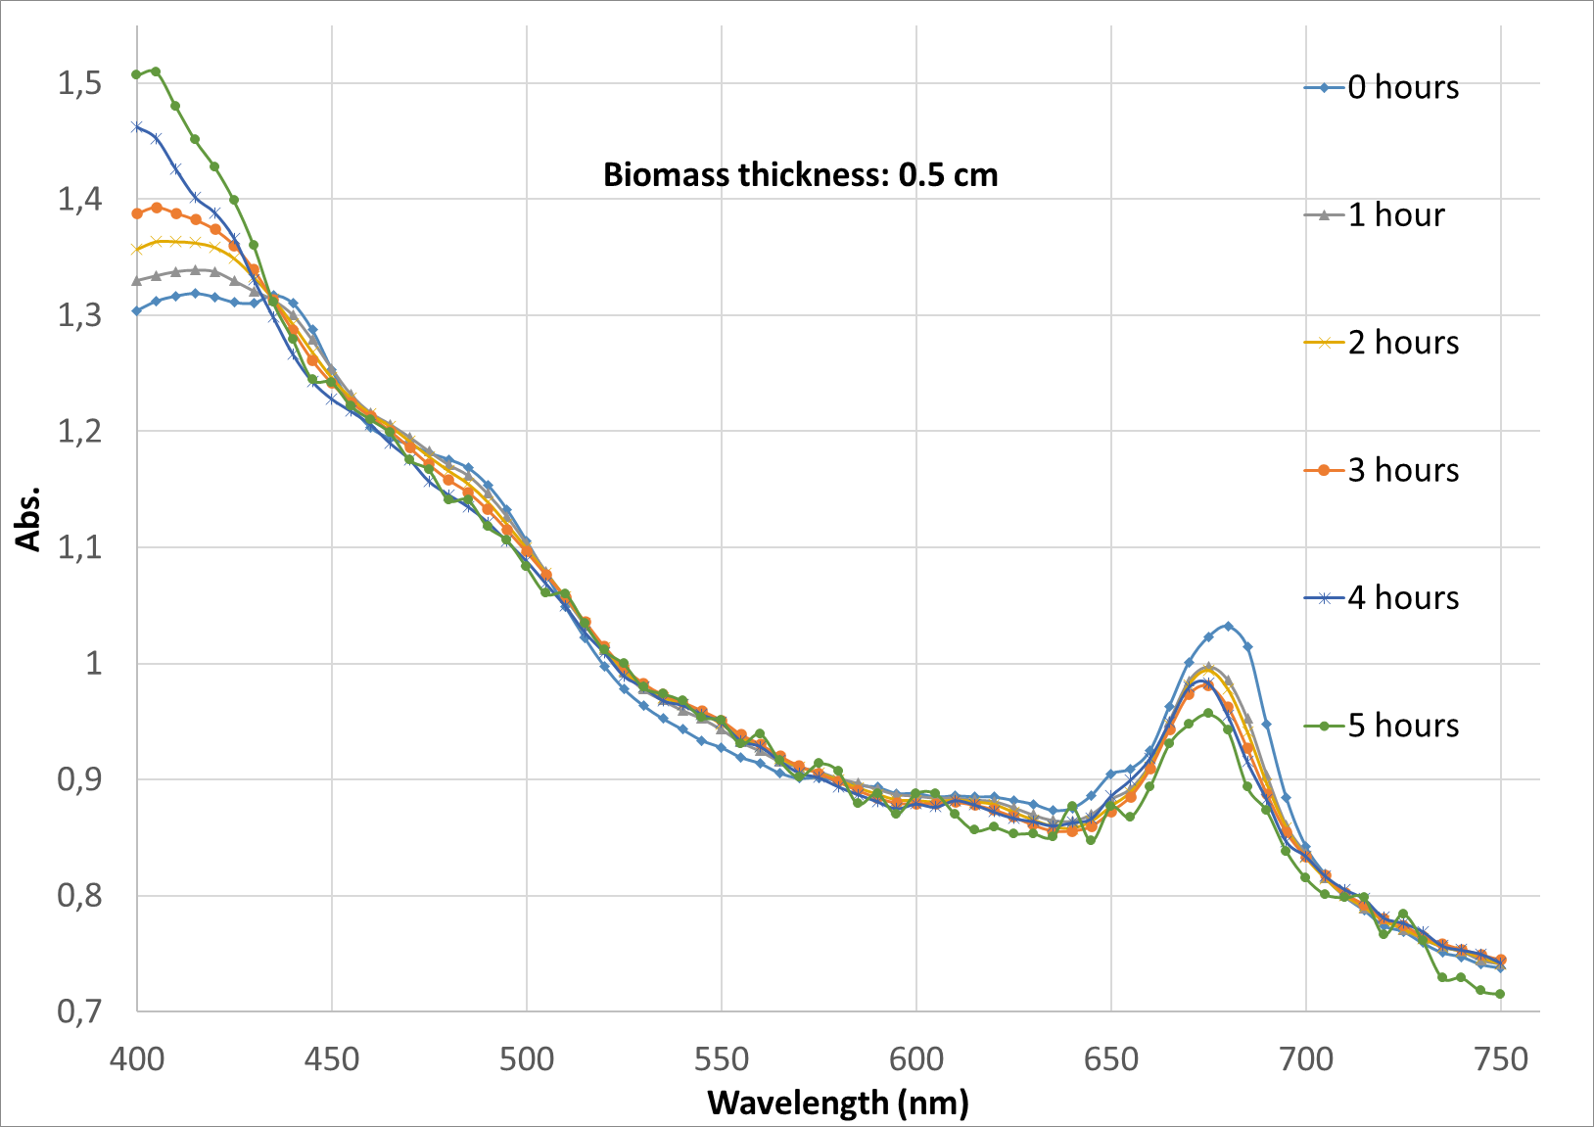
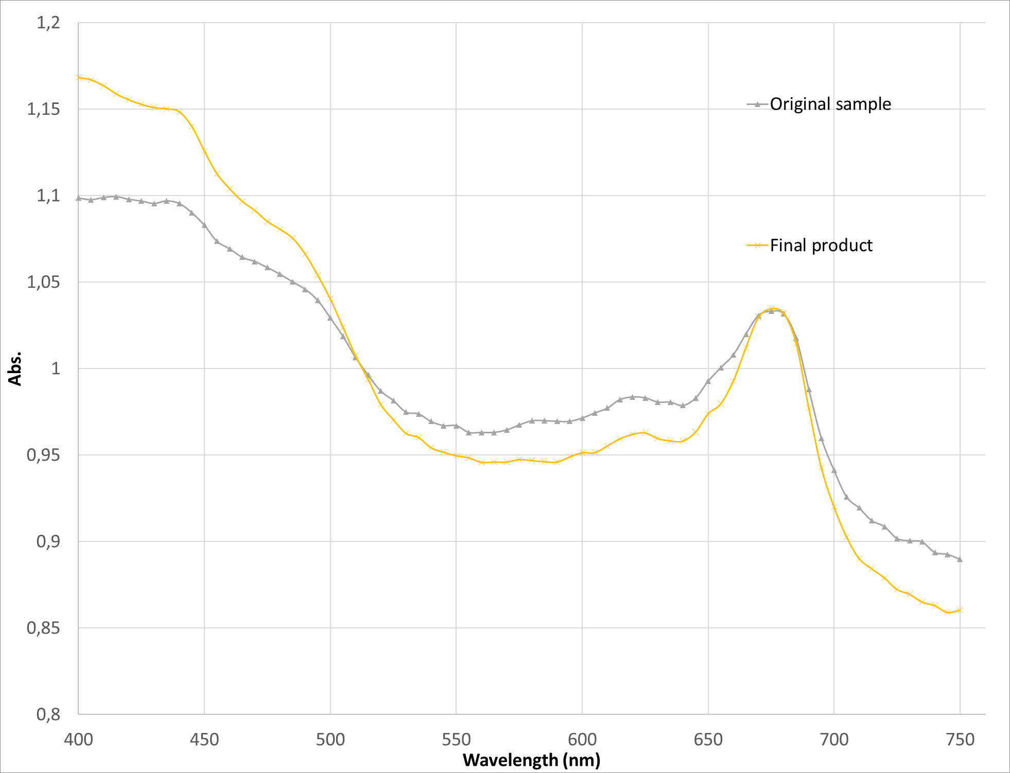
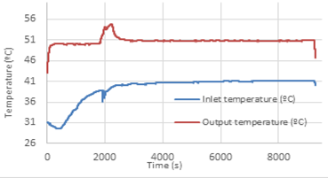
Technical viability of microalgae drying
Darío Hernández Hofmann ^{1,2}* , M.Guadalupe Pinna-Hernández^{1,2},
Cintia Gómez Serrano^{1,2} and F.Gabriel Acién Fernández ^{1,2}
*e-mail:dariohh96@gmail.com
¹ Universidad de Almería, Departamento de Ingeniería Química, Escuela Superior de Ingeniería, Ctra. de Sacramento s/n, Almería, España.
² Solar Energy Research Centre (CIESOL), Joint Centre University of Almería-CIEMAT, Almería, 04120, Spain
Introduction
Introduction
Microalgae are a potential source of high-value products such as pigments, nutraceuticals, agricultural biostimulants and protein-rich biomass as food supplements. For that over the last few years, microalgae are becoming an important subject because their wide range of uses and applications. When talking about their commercialization ,they are often sold as a dried powder to use them in food , for example, to allow easy transportation and long-term duration. The last reason is critical , so it is important to carry out a drying process that doesn’t degrade the microalgae and allows to reach the desired level of humidity on it
Objectives
Image 1. Microalgae
The general objective of this research is to study different drying processes in order to know which one is more technically feasible and if it is possible to consider as a pre-treatment of the microalgae biomass.
The specific objectives are: i) Technically evaluate a microalgae drying process in an oven by varying the temperature, biomass concentration and the height biomass in the aluminum trays, ii) Study the possible degradation process of the microalgae during the drying and iii) Simulate a rotary drying process for microalgae.
Methodology/materials and tests
This study was carried out by using biomass with two strains of microalgae: Scenedesmus Almeriensis and Chlorella Vulgaris. For this research (Table 1), different methods of drying and equipment are used:
i) A drying oven, in which the biomass was introduced in makeshift aluminium trays (Image 2).
ii) A rotary dryer (Image 3) with the following dimensions : 33 cm long and 10.5 cm of diameter. Ceramic balls were put inside in order to prevent the biomass to get stuck inside the tube wall. The air used to dry was previously heated using a hot water bath and was introduced inside the tube with a flow of 2325 L/h.
Image 2. Aluminum trays with the micralgae introduced into the oven
Image 3. Rotatory drying
Results
In the experiments performed in the drying oven is observed that we can operate in a range of temperatures between 60 and 80 ºC, obtaining the best results at 80 ºC. Also, it is observed in the third test that a slightly preconcentrated biomass (34.7 g/L) gives better results in terms of moisture (17.43 [kg water/kg dry solid]) compared to the first test at the same temperature (60ºC) with moisture (20.10 [kg water/kg dry solid]) so is expected that if the tests lasted longer, drying time would be better in third test as seen in Figure 1.
However, drying performance seemed could be improved so a comparative test was done in a rotary dryer. The test was carried out under similar conditions as fourth test in both equipment, the results proved that ,in terms of time, the rotary dryer was better (about 1.67 hours to complete the process). Furthermore, after making spectrophotometric scans to the final product in both cases , it seems that there isn’t substantial differences in terms of the degradation of the microalgae using both methods as seen in Figure 2.
Figure 1. Moisture comparative between first and third test
DRYING OVEN
ROTARY DRYER
Figure 2. Spectrophotmetric scans
Figure 3. Rotatory dryer test
Conclusions and future researches
In conclusion, oven drying offers good results in terms of quality as it’s doesn’t degrade the microalgae too much and is easy to set it up and operate. However, as the process takes too long to achieve the desired results (5 hours or more) ,it is not viable in terms of energy consumption. That is the reason for study cheaper alternatives, in this case a rotary dryer is a a good option. After making a test, results were greater as it took significantly less time (about 4 hour less than previous tests) and the spectrophotometric scans of the final product seemed a little bit better at first glance, this might be because the microalgae are exposed to less direct heat.
Although it seems that less operation time means less economical cost, this affirmation needs further research so it’s needed to test deeply about power consumption in both cases and a proper design of both operations according to the wanted production of microalgae.
References
Hasti Hosseinizand, Shahad Sockhansanj and C.Jim lin. “Study of the drying mechanism of microalgae Chlorella Vulgaris and the optimun drying temperature to preserve quality characteristics”. Drying technology (2017), pages 1049-1060.

